Slide 1
Backpacking with Code: Software Portability for DHTC
Christina Koch (ckoch5@wisc.edu)
Research Computing Facilitator
University of Wisconsin - Madison

Slide 2
Goals For This Session
Understand the basics of...
how software works
where software is installed
how software is accessed and run
...and the implications for Distributed High Throughput Computing (DHTC)
Describe what it means to make software “portable”
Learn about and use software portability techniques

Slide 3
An Analogy
Running software on your own computer is like cooking in your own kitchen.
Photo by jschantz on flickr, CC-BY

Slide 4
On Your Computer
You know what you already have.
All the software you need is already installed.
You know where everything is (mostly).
You have full control.
You can add new programs when and where you want.

Slide 5
The Problem
Running on a shared computer is like cooking in someone else’s kitchen.
Photo by F Deventhal on Wikimedia, CC-BY

Slide 6
On Someone Else’s Computer
What’s already there?
Is R installed? Or Python? What about the packages you need?
Do you know where anything is?
Are you allowed to change whatever you want?

Slide 7
The Solution
Think like a backpacker.
Take your software with you
Install anywhere
Run anywhere
This is called making software portable
Photo by Derrick Mercer on Flickr, CC-BY-SA

Slide 8
preliminary Concepts

Slide 9
Software Programs Are Files
Principle
Software is a set of files.
These files have instructions for the computer to execute.
Implications for DHTC
Isolate the specific software files needed for a job and bring them along.

Slide 10
How Software Works*
*Not to scale
Program
(software, code, executable, binary)

Slide 11
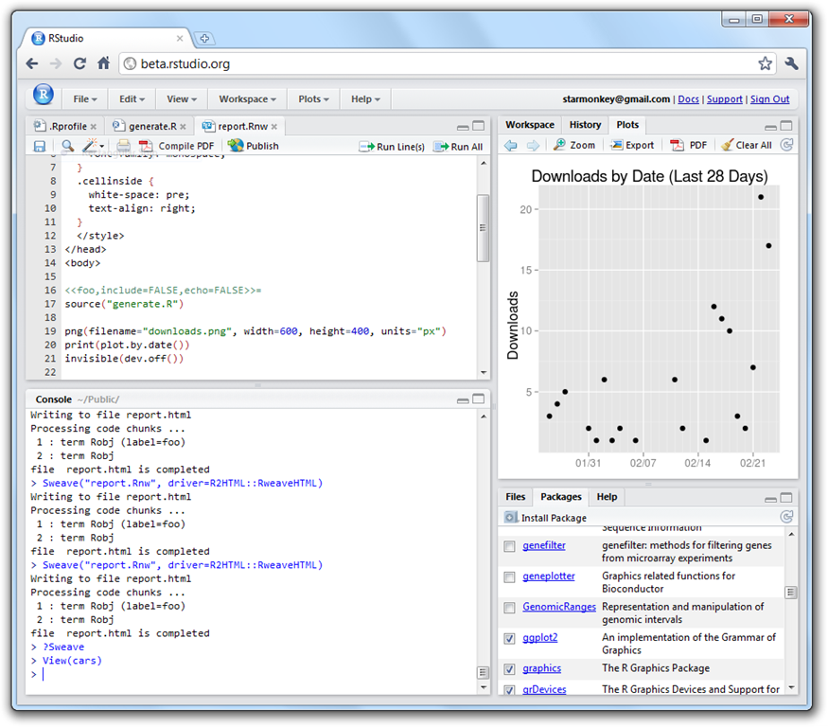
How Software Works*
*Not to scale
Program
(software, code, executable, binary)
Running Program
(process, instance)
launches to

Slide 12
How Software Works*
*Not to scale
Program
(software, code, executable, binary)
Running Program
(process, instance)
launches to
depends on
runs own tasks

Slide 13
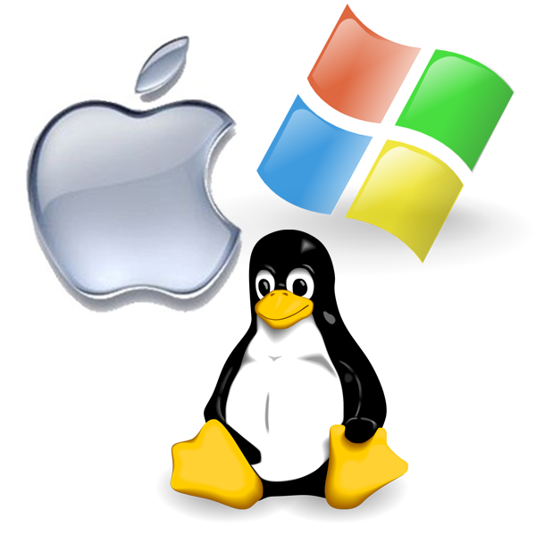
How Software Works*
*Not to scale
Program
(software, code, executable, binary)
Running Program
(process, instance)
Operating System
makes requests
launches to
monitors running programs
depends on
runs own tasks

Slide 14
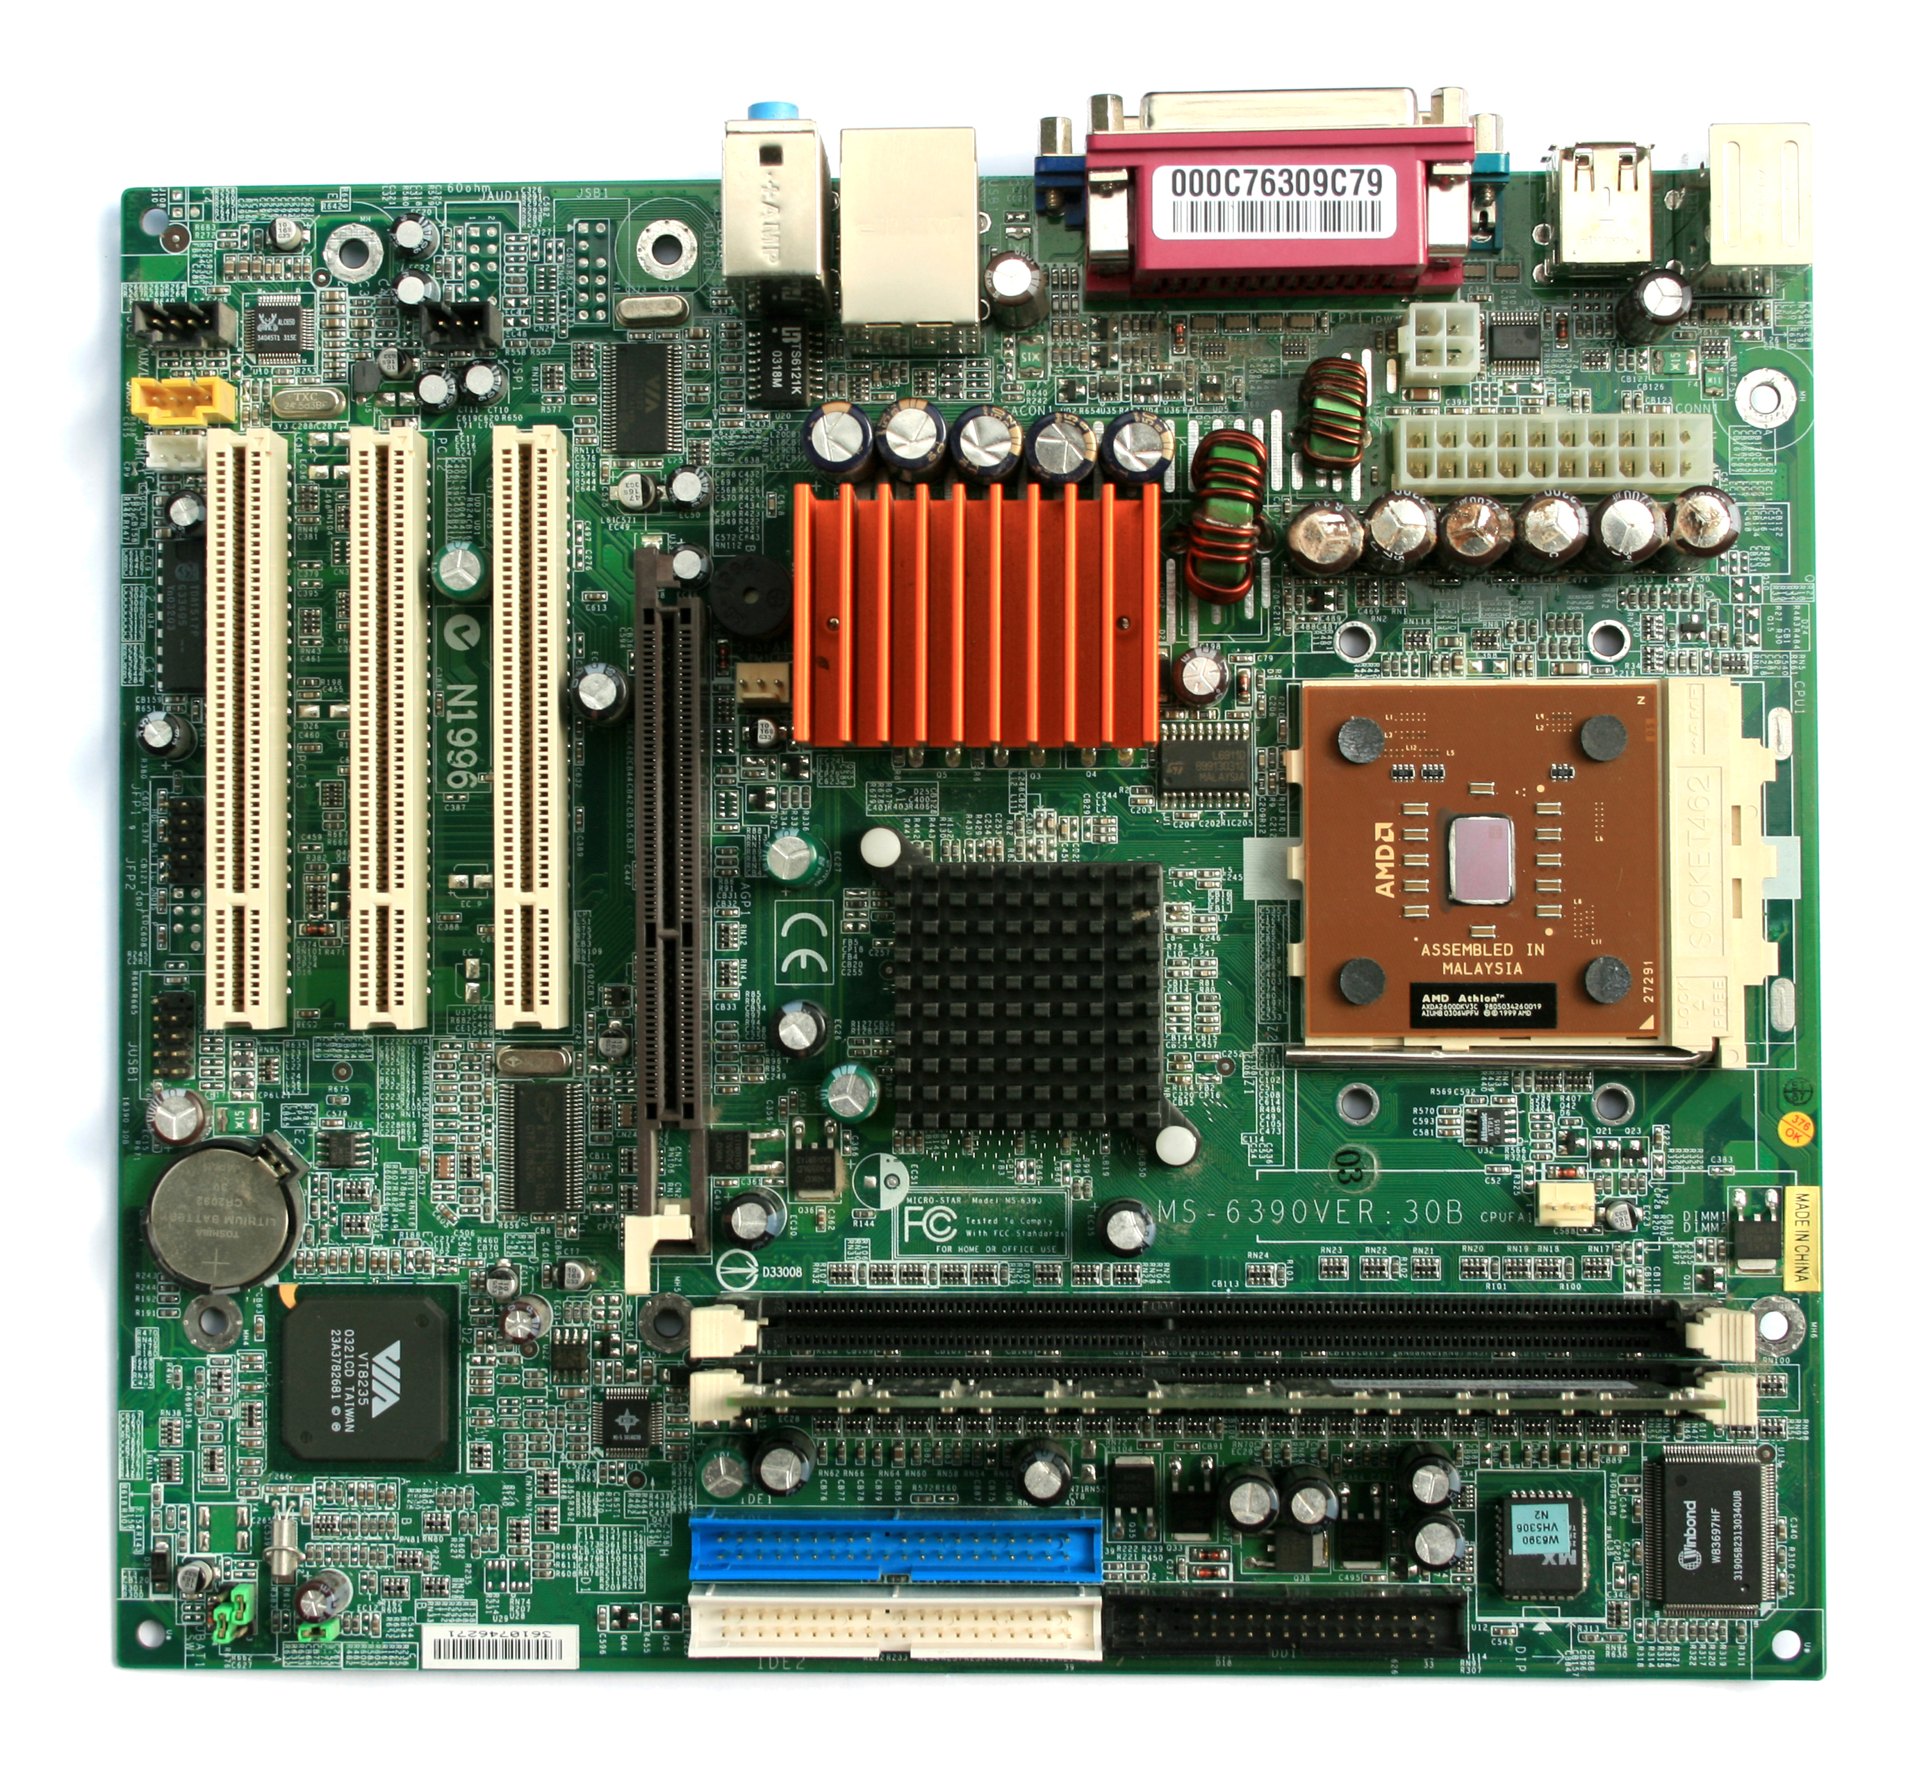
How Software Works*
*Not to scale
Program
(software, code, executable, binary)
Running Program
(process, instance)
Operating System
Hardware
(processors, memory, disk)
makes requests
launches to
monitors running programs
translates program’s request
depends on
runs own tasks

Slide 15
How Software Works
Principle:
Software depends on the operating system, and other installed programs.
Implications for DHTC:
Software must be able to run on target operating system (usually Linux).
Know what else your software depends on.

Slide 16
Location, Location, Location
Where can software be installed?
bin/
bin/
system locations
/
usr/
local
lib/
ada/
home/
local locations
al/

Slide 17
Location, Location, Location
Who can install the software?
bin/
bin/
administrator
/
usr/
local
lib/
ada/
home/
folder owner
al/

Slide 18
Location, Location, Location
Who can access the software?
bin/
bin/
anyone
/
usr/
local
lib/
ada/
home/
folder owner+
al/

Slide 19
Location, Location, Location
Principle:
Software files have to be installed somewhere in the file system.
Implications for DHTC:
Software must be installable without administrative privileges.
The software’s location needs to be accessible to you.

Slide 20
Command Line
How to automate programs?

Slide 21
Command Line
Principle:
To automatically run software, need to use text commands (command line).
Implications for DHTC:
Software must have ability to be run from the command line.
Multiple commands are okay, as long as they can be executed in order within a job.

Slide 22
Command Line and Location
To run a program on the command line, your computer needs to know where the program is located in your computer’s file system.
$ ls
$ python
$ ~/wrapper.sh
How does the command
line know what `ls` is?
Where is python installed?

Slide 23
Two Location Options
Provide a path (relative or absolute)
[~/Code]$ mypy/bin/python --version
Python 2.7.7
Use “the” PATH
$ export PATH=/Users/alice/Code/mypy/bin:$PATH
$ echo $PATH
/Users/alice/Code/mypy/bin:/usr/local/bin:/usr/bin:/bin:/usr/sbin:/sbin
$ which python
/Users/alice/Code/mypy/bin/python

Slide 24
Command Line
Principle:
To run a program on the command line, the computer has to be able to find it.
Implications for DHTC:
There are different ways to “find” your software on the command line: relative path, absolute path, and PATH variable

Slide 25
Portability
Run “anywhere” by:
bringing along the software files you need…
to a location you can access/control…
using the command line to run…
by providing the correct software location…
(on Linux).

Slide 26
Bring Along Software Files

Slide 27
Ways to Prepare Software Files
Download pre-compiled software
Compile yourself
Single binary file
Installation contained in a single folder

Slide 28
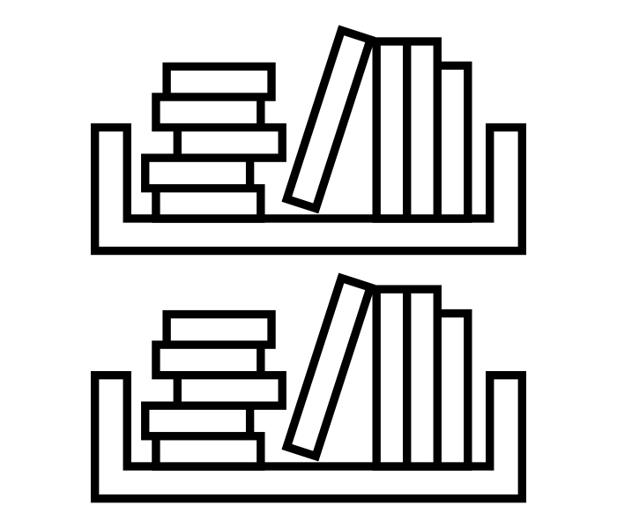
What is Compilation?
Source Code
Binary
compiled + linked into
compiler
and OS
libraries
uses
run on
binary code by Kiran Shastry from the Noun Project
Source Code by Mohamed Mbarki from the Noun Project
Computer by rahmat from the Noun Project
books by Viral faisalovers from the Noun Project
Notes:
get better icons for these slides

Slide 29
Static Linking
Source Code
Static Binary
compiled + static link into
compiler
and OS
libraries
run anywhere
Book by Aleksandr Vector from the Noun Project
Notes:
get better icons for these slides

Slide 30
Compilation Process
Use a compiler (like gcc) directly
Can use options to control compilation process
More common:
./configure # can also include options
make
make install

Slide 31
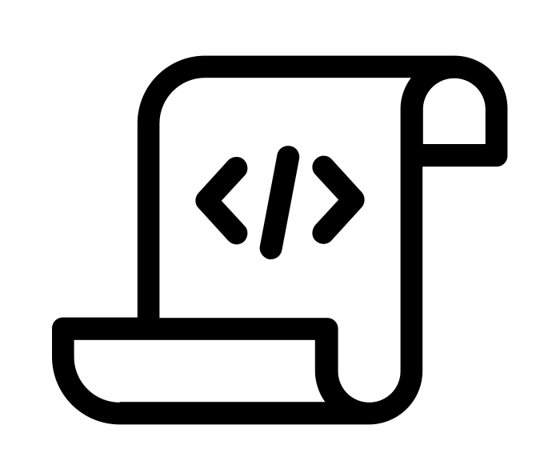
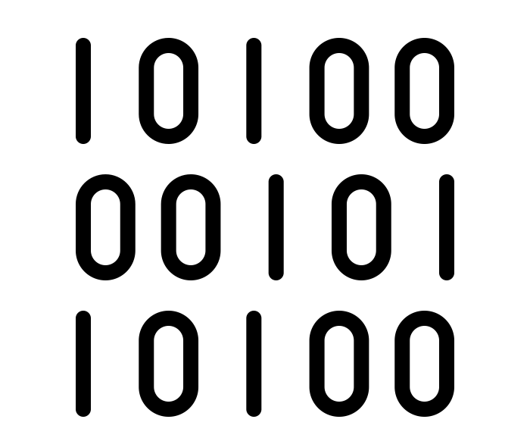
Interpreted code
Instead of being compiled and then run…
…interpreted languages are translated into binary code “on the fly.”
script by Adrien Coquet from the Noun Project
translate by Adrien Coquet from the Noun Project
coding by Vectorstall from the Noun Project

Slide 32
What Kind of Code?
Programs written in C, C++ and Fortran are typically compiled.
For interpreted (scripting) languages like perl, Python, R, or Julia:
Don’t compile the scripts, but *do* use a compiled copy of the underlying language interpreter.

Slide 33
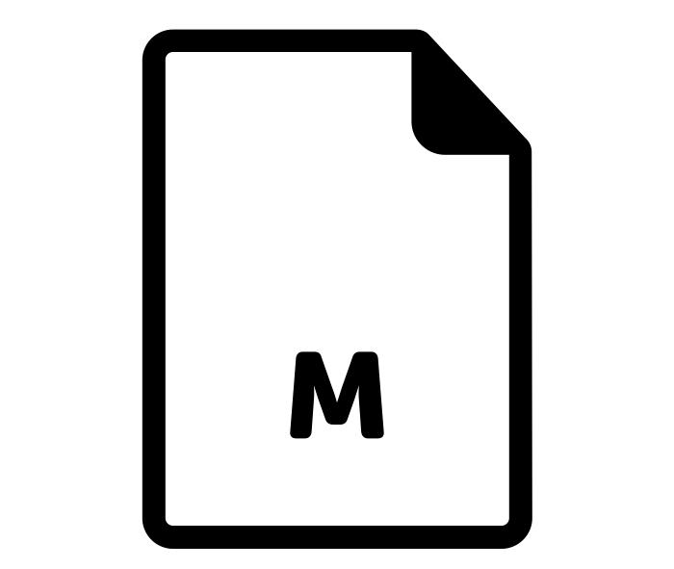
Matlab
Matlab is a scripting language…but can also be compiled.
compile .m files using Matlab compiler (mcc)
[Requires license]
compiled file and Matlab Runtime work together to run program.
[no license needed]
M File by Viktor Vorobyev from the Noun Project
Gears by Trevor Dsouza from the Noun Project

Slide 34
Ways to Run Software
Executable
Wrapper Script
Software must be a single compiled binary file.
Software can be in any compiled format.
executable = program.exe
queue 1
executable = run_program.sh
transfer_input_files =
program.tar.gz
queue 1
program.exe
#!/bin/bash
# run_program.sh
tar –xzf program.tar.gz
program/bin/run in.dat
Notes:
do something with colors or arrows

Slide 35
Single Binary Workflow
Execute server
Option 1
Submit server
compile
Static binary
Option 2
download

Slide 36
Wrapper Script Workflow
Execute server
Submit server
set up run
wrapper script
set up run
source code, compiled code or single binary
set up run
script by ✦ Shmidt Sergey ✦ from the Noun Project

Slide 37
Bring Along Containers
Notes:
work on transition into containers

Slide 38
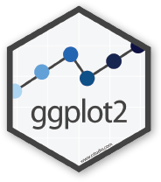
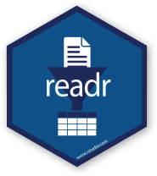
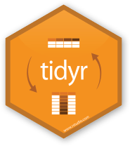
Containers
Containers are a tool for capturing an entire job “environment” (software, libraries, operating system) into an “image” that can be used again.
Credit: polaroid photos by Nick Bluth from the Noun Project

Slide 39
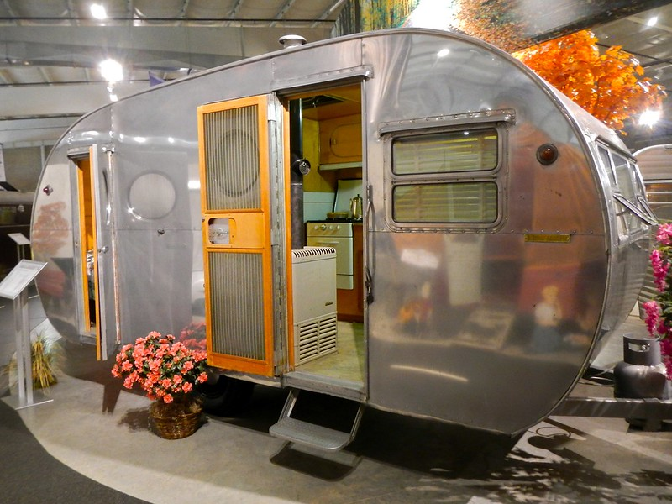
Returning to Our Analogy…
Using a container is kind of like bringing along a whole kitchen…
Photo by PunkToad on Flickr, CC-BY

Slide 40
Why Containers?
Why use containers instead of the methods we just discussed?
Notes:
multiply this slide?

Slide 41
Why Containers?
Complex installations: software that has a lot of dependencies or components.
Photo on pikrepo
Notes:
multiply this slide?

Slide 42
Why Containers?
Software that can’t be moved: do files or libraries have to be at a specific path?
Photo by R. Miller on Flickr, CC-BY
Notes:
multiply this slide?

Slide 43
Why Containers?
Sharing with others: one container can be used by a whole group that’s doing the same thing.
Photo by Ella Olsson on Flickr, CC-BY
Notes:
multiply this slide?

Slide 44
Why Containers?
Reproducibility: save a copy of your environment.
Photo by Marco Verch on Flickr, CC-BY
Notes:
multiply this slide?

Slide 45
Using Containers
To use a container as your software portability tool, need to either:
Find a pre-existing container with what you need.
Build your own container.*
* not covered today

Slide 46
Container Types
Two common container systems:
Docker Singularity
https://www.docker.com/ https://sylabs.io/
The container itself will always be some version of Linux - but can be run on Linux / Mac / Windows if Docker or Singularity is installed
Notes:
discuss a bit more about these – and how they’re used in jobs.
Distinguish between container/image + engine?

Slide 47
Submit File Requirements
Docker (from CHTC submit server)
Singularity (from OSG submit server)
universe = docker
docker_image = python:3.7.0
requirements = (HasDocker == true)
+SingularityImage = “/cvmfs/singularity.opensciencegrid.org/centos/python-34-centos7:latest”
requirements = (HAS_SINGULARITY == true)
Notes:
Update singularity image!! (check exercise also)

Slide 48
Container Workflow
Execute server(s)
Submit server
script
+ name of container image
container
image
Registry (e.g. DockerHub)

Slide 49
Conclusion
To use any software in a DHTC system:
Create/find software package:
download pre-compiled code, compile your own, create/find a container
Account for all dependencies, files, and requirements in the submit file.
If needed, write a script to set up the environment when the job runs.

Slide 50
Pre-Installed Software

Slide 51
Pre-existing Software
The ideal for DHTC is to package and bring along your own software, but...
You can use pre-existing software installations if the computers you’re running on have your software installed (or access to a repository with the software).

Slide 52
Pre-existing Software via OSG Connect
On the Open Science Grid, jobs submitted from OSG Connect have access to a software repository maintained by OSG Connect staff.
The software repository is available across the OSG.
Software is accessed using “modules”.

Slide 53
Software Across the OSG
OSG Connect

Slide 54
Module Commands
See what modules are available
Load a module
See loaded modules
[~]$ module avail
[~]$ module spider lammps
[~]$ module load lammps/20180822
[~]$ module list

Slide 55
Module Workflow
Find a module for your software.
Write a wrapper script that loads the module and runs your code.
Include requirements to ensure that your job has access to modules.
requirements = (HAS_MODULES =?= true) && (OSGVO_OS_STRING == “RHEL7”) && (OpSys == “LINUX”)

Slide 56
Module Workflow
Execute server
Submit server
wrapper script
load
+ run
load
+ run
+ requirements
software modules

