Slide 1
Backpacking with Code:
Software Portability for DHTC
Christina Koch (ckoch5@wisc.edu)
Research Computing Facilitator
University of Wisconsin - Madison

Slide 2
Goals For This Session
Describe what it means to make software “portable”
Understand the basics of...
  how software works
  where software is installed
  how software is accessed and run
...and the implications for Distributed High Throughput Computing (DHTC) and software portability.
Learn about and use software portability techniques

Slide 3
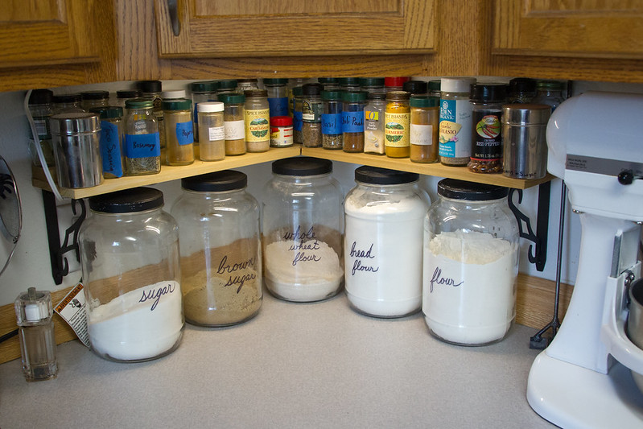
An Analogy
Running software on your own computer is like cooking in your own kitchen.
Photo by jschantz on flickr, CC-BY

Slide 4
On Your Computer
You know what you already have.
  All the software you need is already installed.
You know where everything is (mostly).
You have full control.
  You can add new programs when and where you want.

Slide 5
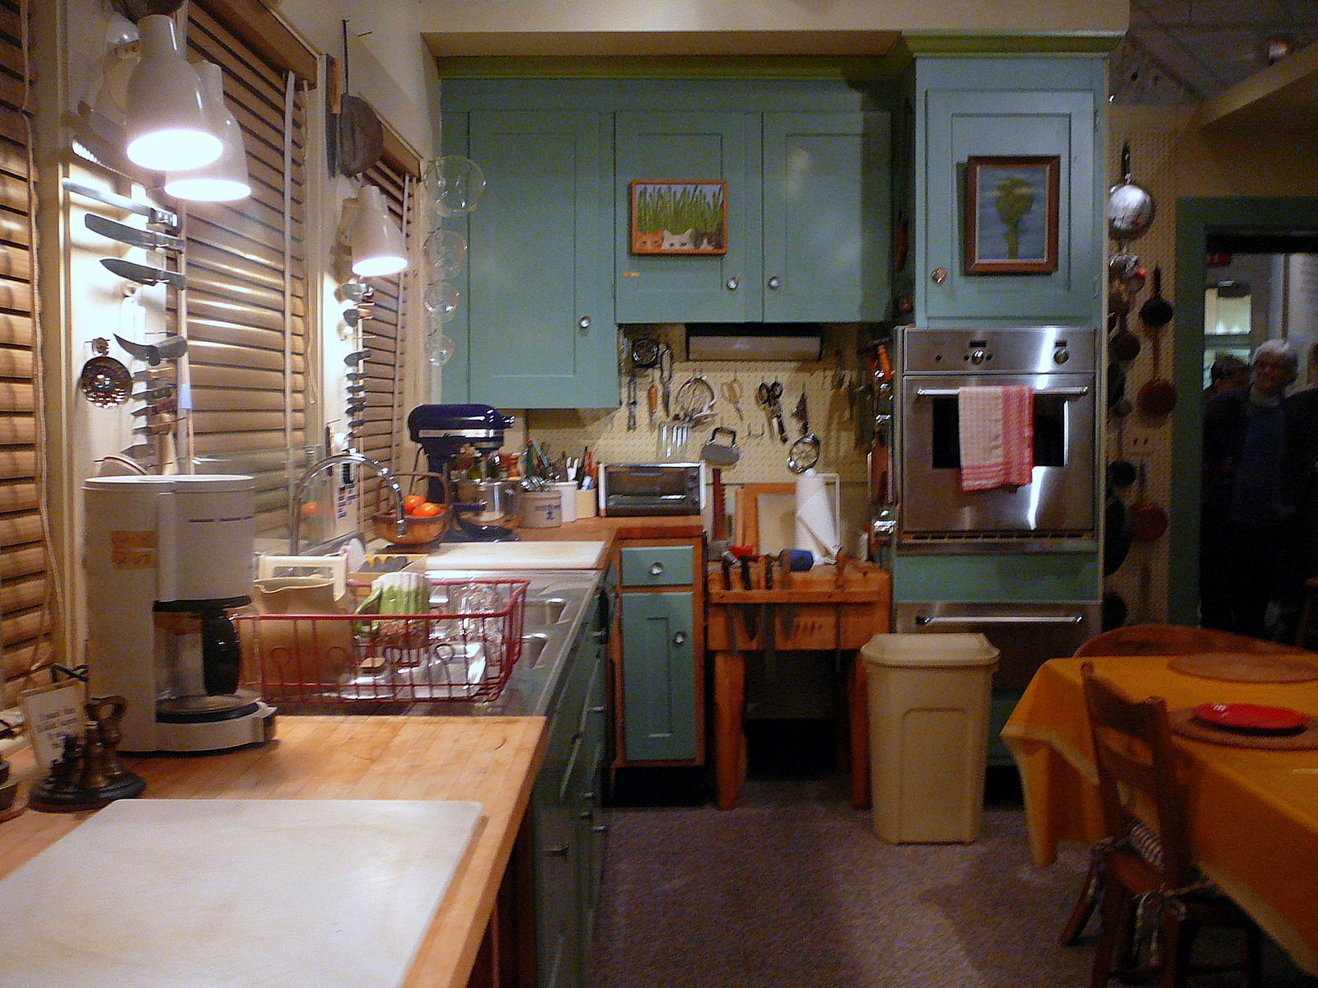
The Challenge
Running on a shared computer is like cooking in someone else’s kitchen.
Photo by F Deventhal on Wikimedia, CC-BY

Slide 6
On Someone Else’s Computer
What’s already there?
  Is R installed? Or Python? What about the packages you need?
Do you know where anything is?
Are you allowed to change whatever you want?

Slide 7
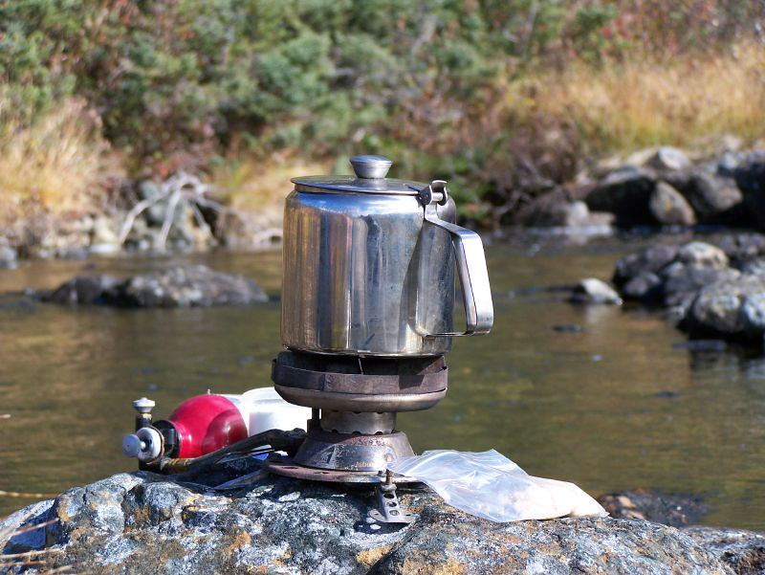
The Solution
Think like a backpacker.
Take your software with you
  Install anywhere
  Run anywhere
This is called making software portable
Photo by Derrick Mercer on Flickr, CC-BY-SA

Slide 8
preliminary Concepts

Slide 9
Software Programs Are Files
Principle
  Software is a set of files.
  These files have instructions for the computer to execute.
Implications for DHTC
  Isolate the specific software files needed for a job and bring them along.

Slide 10

How Software Works*
*Not to scale
Program
(software, code, executable, binary)

Slide 11
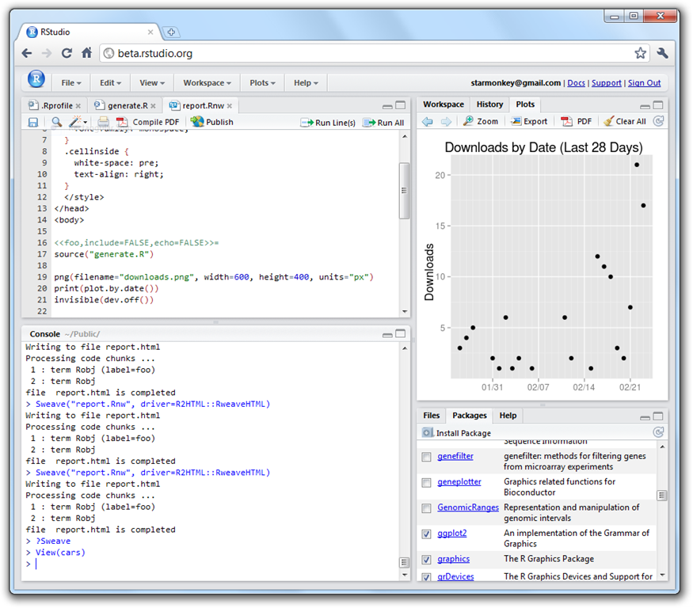
How Software Works*
*Not to scale
Program
(software, code, executable, binary)
Running Program
(process, instance)
launches to

Slide 12

How Software Works*
*Not to scale
Program
(software, code, executable, binary)
Running Program
(process, instance)
launches to
depends on
runs own tasks

Slide 13
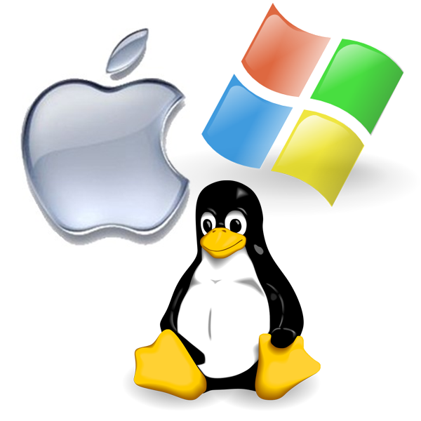
How Software Works*
*Not to scale
Program
(software, code, executable, binary)
Running Program
(process, instance)
Operating System
makes requests
launches to
monitors running programs
depends on
runs own tasks

Slide 14
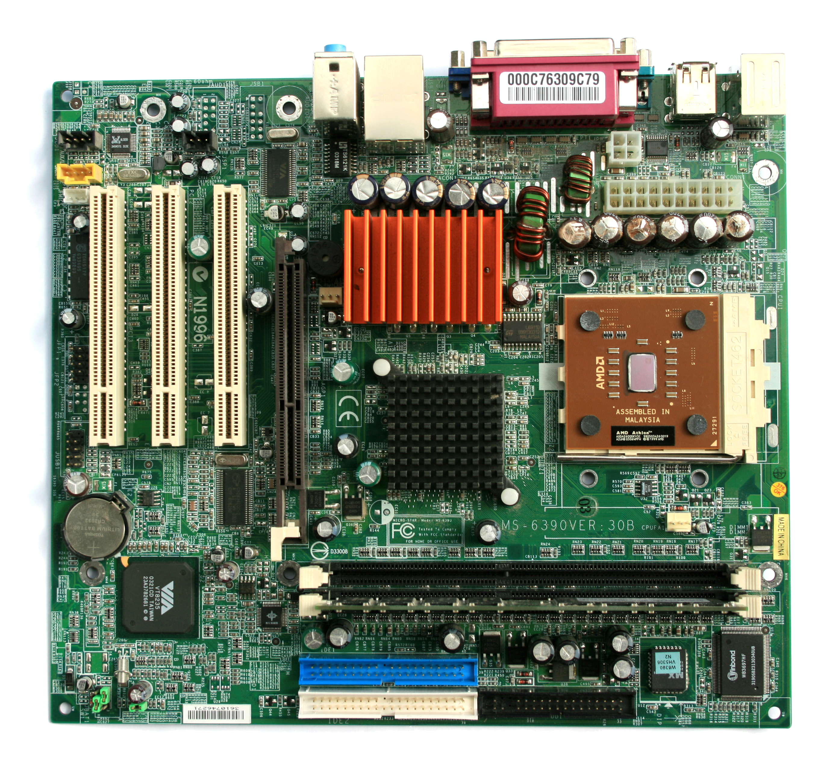
How Software Works*
*Not to scale
Program
(software, code, executable, binary)
Running Program
(process, instance)
Operating System
Hardware
(processors, memory, disk)
makes requests
launches to
monitors running programs
translates program’s request
depends on
runs own tasks

Slide 15
How Software Works
Principle:
  Software depends on the operating system, and other installed programs.
Implications for DHTC:
  Software must be able to run on target operating system (usually Linux).
  Know what else your software depends on.

Slide 16
Location, Location, Location
Where can software be installed?
bin/
bin/
system locations
/
usr/
local
lib/
ada/
home/
local locations
al/

Slide 17
Location, Location, Location
Who can add to these locations?
bin/
bin/
administrator
/
usr/
local
lib/
ada/
home/
folder owner
al/

Slide 18
Location, Location, Location
Principle:
  Software files have to be installed somewhere in the file system.
Implications for DHTC:
  Software must be installable without administrative privileges.
  The software’s location needs to be accessible to you.

Slide 19
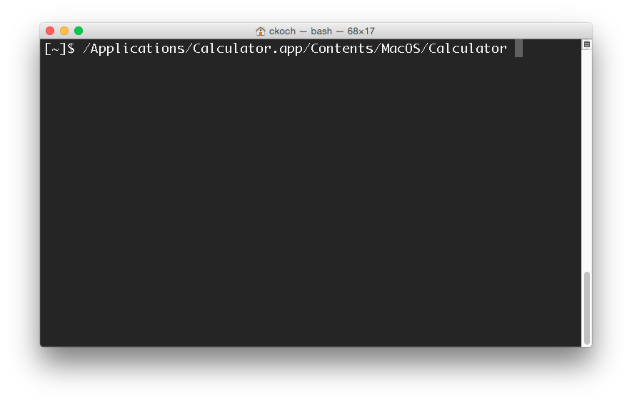
Command Line
How to automate programs?

Slide 20
Command Line
Principle:
  To automatically run software, need to use text commands (command line).
Implications for DHTC:
  Software must have ability to be run from the command line.
  Multiple commands are okay, as long as they can be executed in order within a job.

Slide 21
Command Line and Location
To run a program on the command line, your computer needs to know where the program is located in your computer’s file system.
$ ls
$ python
$ ~/wrapper.sh
How does the command
line know what `ls` is?
Where is python installed?

Slide 22
Two Location Options
Provide a path (relative or absolute)
[~/Code]$ mypy/bin/python --version
Python 2.7.7
Use “the” PATH
$ export PATH=/Users/alice/Code/mypy/bin:$PATH
$ echo $PATH
/Users/alice/Code/mypy/bin:/usr/local/bin:/usr/bin:/bin:/usr/sbin:/sbin
$ which python
/Users/alice/Code/mypy/bin/python

Slide 23
Command Line and Location
Principle:
  To run a program on the command line, the computer has to be able to find it.
Implications for DHTC:
  There are different ways to “find” your software on the command line: relative path, absolute path, and PATH variable

Slide 24
Portability
Run “anywhere” by:
  bringing along the (Linux-compatible) software files you need…
  to a location you can access/control…
  telling the command line where that location is…
  and using it to run your code.

Slide 25
Demo
GUI → Command line
Full installation → Bring along files
Adding installation to the command line

Slide 26
Bring Along
Software Files

Slide 27
Ways to Prepare Software Files
Download pre-compiled software
Compile yourself
  Single binary file
  Installation contained in a single folder

Slide 28
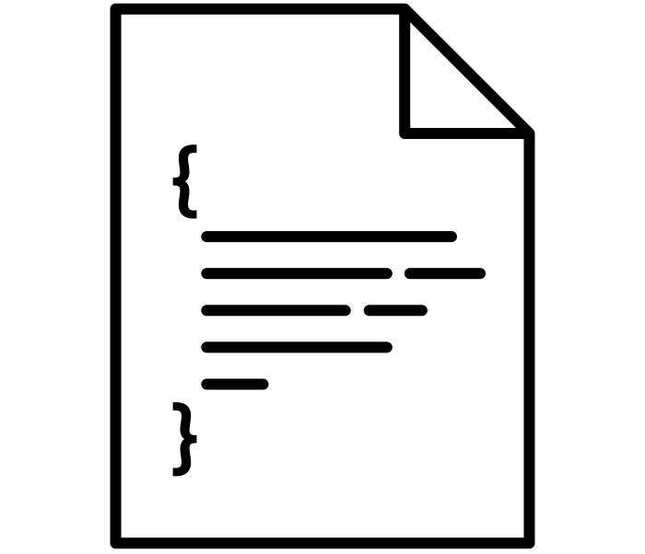



What is Compilation?
Source Code
Binary
compiled + linked into
compiler
and OS
libraries
uses
run on
binary code by Kiran Shastry from the Noun Project
Source Code by Mohamed Mbarki from the Noun Project
Computer by rahmat from the Noun Project
books by Viral faisalovers from the Noun Project
Notes:
get better icons for these slides

Slide 29
Compilation Process
Use a compiler (like gcc) directly
  Can use options to control compilation process
More common:
  ./configure # can also include options
  make
  make install

Slide 30

Static Linking
Source Code
Static Binary
compiled + static link into
compiler
and OS
libraries
run anywhere
Book by Aleksandr Vector from the Noun Project
Notes:
get better icons for these slides

Slide 31

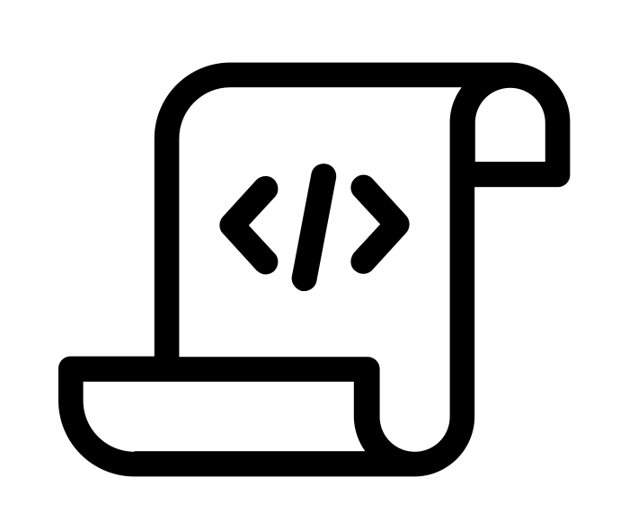
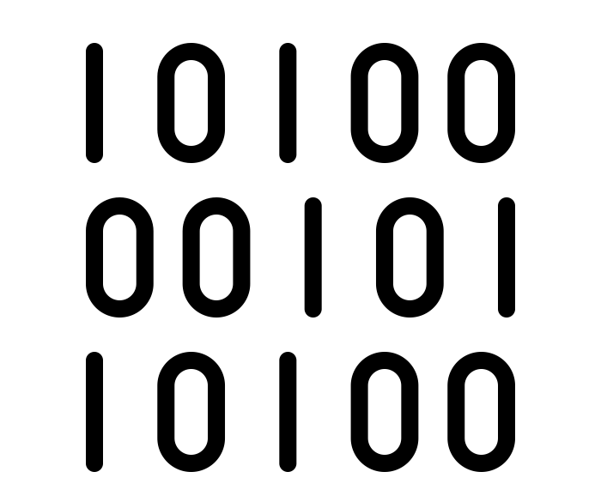
Interpreted Code
Instead of being compiled and then run…
…interpreted languages are translated into binary code “on the fly.”
script by Adrien Coquet from the Noun Project
translate by Adrien Coquet from the Noun Project
coding by Vectorstall from the Noun Project

Slide 32
What Kind of Code?
Programs written in C, C++ and Fortran are typically compiled.
For interpreted (scripting) languages like perl, Python, R, or Julia:
  Don’t compile the scripts, but *do* use a compiled copy of the underlying language interpreter.

Slide 33
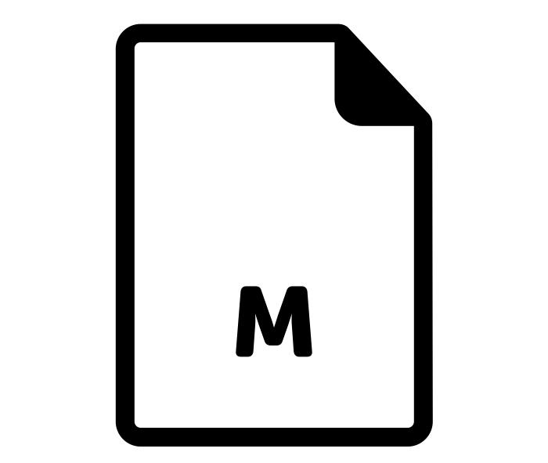

Matlab
Matlab is a scripting language…but can also be compiled.
compile .m files using Matlab compiler (mcc)
[Requires license]
compiled file and Matlab Runtime work together to run program.
[no license needed]
M File by Viktor Vorobyev from the Noun Project
Gears by Trevor Dsouza from the Noun Project

Slide 34
Run "Brought-Along"
Software Files

Slide 35

Ways to Run Software
Executable
Wrapper Script
Software must be a single compiled binary file.
Software can be in any compiled format.
executable = program.exe
queue 1
executable = run_program.sh
transfer_input_files =
program.tar.gz
queue 1
program.exe
#!/bin/bash
# run_program.sh
tar –xzf program.tar.gz
program/bin/run in.dat
Notes:
do something with colors or arrows

Slide 36

Single Binary Workflow
Execute server
Option 1
Submit server
compile
Static binary
Option 2
download

Slide 37

Wrapper Script Workflow
Execute server
Submit server
set up run
wrapper script
set up run
source code, compiled code or single binary
set up run
script by ✦ Shmidt Sergey ✦ from the Noun Project

Slide 38
Bring Along Containers
Notes:
work on transition into containers

Slide 39

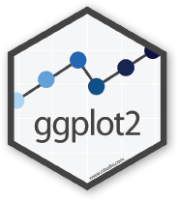
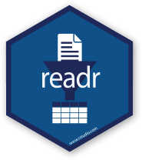


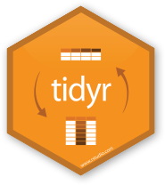
Containers
Containers are a tool for capturing an entire job “environment” (software, libraries, operating system) into an “image” that can be used again.
Credit: polaroid photos by Nick Bluth from the Noun Project

Slide 40
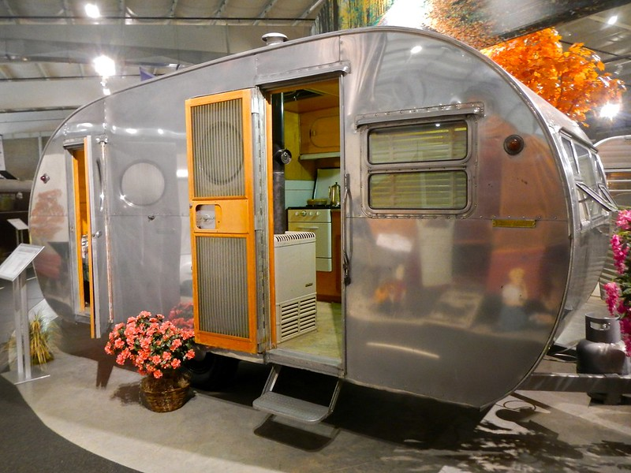
Returning to Our Analogy…
Using a container is kind of like bringing along a whole kitchen…
Photo by PunkToad on Flickr, CC-BY

Slide 41
Why Containers?
Why use containers instead of the methods we just discussed?
Notes:
multiply this slide?

Slide 42
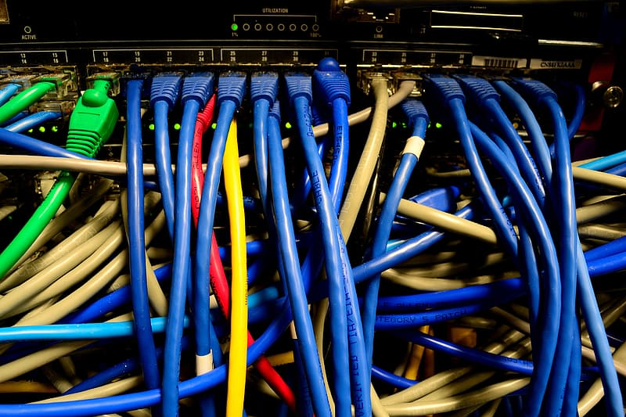
Why Containers?
Complex installations: software that has a lot of dependencies or components.
Photo on pikrepo
Notes:
multiply this slide?

Slide 43

Why Containers?
Software that can’t be moved: do files or libraries have to be at a specific path?
Photo by R. Miller on Flickr, CC-BY
Notes:
multiply this slide?

Slide 44
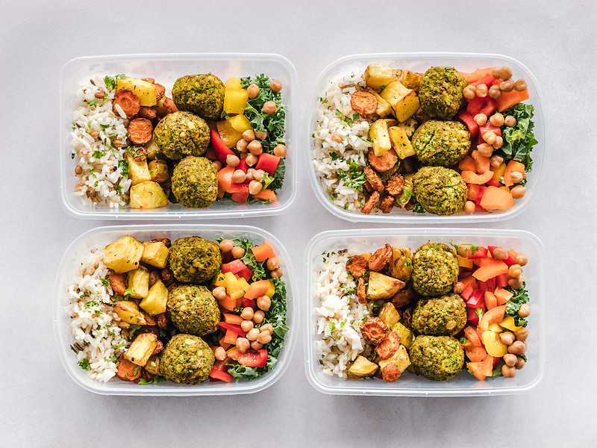
Why Containers?
Sharing with others: one container can be used by a whole group that’s doing the same thing.
Photo by Ella Olsson on Flickr, CC-BY
Notes:
multiply this slide?

Slide 45

Why Containers?
Running on different systems: The same container can run on Linux, Mac and Windows
Photo by Ilona Frey on Unsplash
Notes:
multiply this slide?

Slide 46

Why Containers?
Reproducibility: save a copy of your environment.
Photo by Marco Verch on Flickr, CC-BY
Notes:
multiply this slide?

Slide 47
Getting Containers
To use a container as your software portability tool, need to either:
  Find a pre-existing container with what you need.
  Build your own container.*
* not covered today

Slide 48
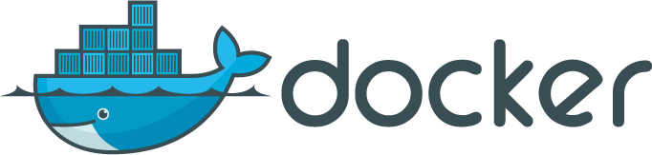

Container Types
Two common container systems:
Docker Singularity
https://www.docker.com/ https://sylabs.io/
Notes:
discuss a bit more about these – and how they’re used in jobs.
Distinguish between container/image + engine?

Slide 49
Container Types
Container system =
  Container image format
  Container "engine" for running
Image Format
  Always Linux-based
  Docker images can be converted to Singularity images
"Engine" capabilities
  Singularity "engine" can run both Docker + Singularity images
  Docker "engine" installs on Linux, Mac, Windows, meaning Docker containers can be run on any OS
Notes:
discuss a bit more about these – and how they’re used in jobs.
Distinguish between container/image + engine?

Slide 50
Run Containers

Slide 51
Submit File Requirements
Docker (from CHTC submit server)
Singularity (from OSG submit server)
universe = docker
docker_image = centos/python-34-centos7:latest
requirements = (HasDocker == true)
+SingularityImage = "/cvmfs/singularity.opensciencegrid.org/centos/python-34-centos7:latest"
requirements = (HAS_SINGULARITY == true)
Notes:
Update singularity image!! (check exercise also)

Slide 52
Container Workflow
Execute server(s)
Submit server
script
+ name of container image
container
image
Registry (e.g. DockerHub)

Slide 53
Wrapping up

Slide 54
Conclusion
To use any software in a DHTC system:
Create/find software package:
  download pre-compiled code, compile your own, create/find a container
Account for all dependencies, files, and requirements in the submit file.
If needed, write a script to set up the environment when the job runs.

Slide 55
Acknowledgements
This material is based upon work supported by the National Science Foundation under Grant No. 2030508. Any opinions, findings, and conclusions or recommendations expressed in this material are those of the author(s) and do not necessarily reflect the views of the National Science Foundation.

Slide 56
Pre-Installed Software
(Extra Slides)

Slide 57
Pre-existing Software
The ideal for DHTC is to package and bring along your own software, but...
You can use pre-existing software installations if the computers you’re running on have your software installed (or access to a repository with the software).

Slide 58
Pre-existing Software via OSG Connect
On the Open Science Grid, jobs submitted from OSG Connect have access to a software repository maintained by OSG Connect staff.
The software repository is available across the OSG.
Software is accessed using “modules”.

Slide 59
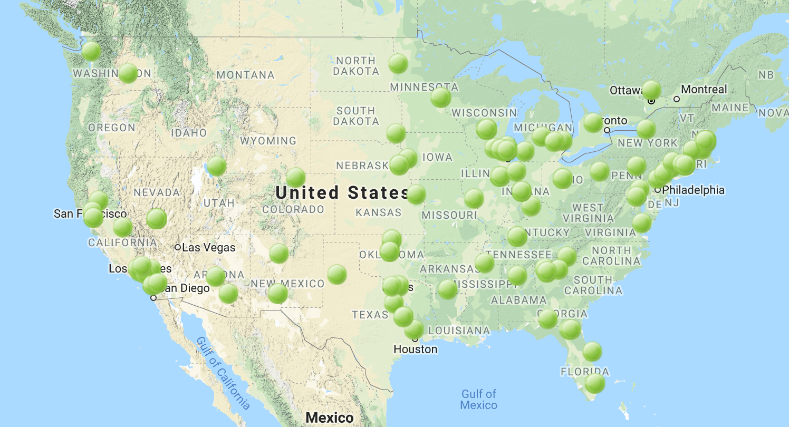



Software Across the OSG
OSG Connect

Slide 60
Module Commands
See what modules are available
Load a module
See loaded modules
[~]$ module avail
[~]$ module spider lammps
[~]$ module load lammps/20180822
[~]$ module list

Slide 61
Module Workflow
Find a module for your software.
Write a wrapper script that loads the module and runs your code.
Include requirements to ensure that your job has access to modules.
requirements = (HAS_MODULES =?= true) && (OSGVO_OS_STRING == “RHEL7”) && (OpSys == “LINUX”)

Slide 62
Module Workflow
Execute server
Submit server
wrapper script
load
+ run
load
+ run
+ requirements
software modules

