Slide 1
Handling Data on OSG
Wednesday, July 27
Mats Rynge
This work was supported by NSF grants MPS-1148698, OAC-1836650, and OAC-2030508

Slide 2

Like all things
I always think of HTC/OSG usage as a spectrum:
More Resources, More Planning
Laptop
Cluster
OSG

Slide 3
Planning?
Can’t control a cluster like your laptop, where you can install any software and place files (until they flat-out don’t fit)
OSG: heterogeneity, borrowed resources (including network and disk), lack of on-the-fly troubleshooting

Slide 4

Benefits!
On a cluster & OSG you can access 1000+ cores!
Automate job tasks (with HTCondor)!
Doesn’t burn up your laptop!

Slide 5
Handling Data on OSG
Overview / Things to Consider
HTCondor File Transfer
Web Proxy
Stash
Shared File Systems

Slide 6
What is big large data?
In reality, “big data” is relative
  What is ‘big’ for you? Why?

Slide 7
What is big large data?
In reality, “big data” is relative
  What is ‘big’ for you? Why?
Volume, velocity, variety!
  think: a million 1-KB files, versus one 1-TB file

Slide 8
Determining In-Job Needs
“Input” includes any files needed for the job to run
  executable
  transfer_input_files
  data and software
“Output” includes any files produced for the job that need to come back
  output, error

Slide 9
Data Management Tips
Determine your per-job needs
  minimize per-job data needs
Determine your batch needs
Leverage HTCondor and OSG data handling features!

Slide 10
First! Try to minimize your data
split large input for better throughput
eliminate unnecessary data
file compression and consolidation
  job input: prior to job submission
  job output: prior to end of job
  moving data between your laptop and the submit server

Slide 11
‘Large’ data: The collaborator analogy
What method would you use to send data to a collaborator?
amount | method of delivery
words | email body
tiny – 100MB | email attachment (managed transfer)
100MB – GBs | download from Google Drive, Drop/Box, other web-accessible repository
TBs | ship an external drive (local copy needed)
Never underestimate the bandwidth of a station wagon
full of tapes hurtling down the highway.
Andrew S. Tanenbaum (1981) – Professor Emeritus, Vrije Universiteit Amsterdam

Slide 12
Transfers
More Data
HTCondor
File Transfer
HTTP
Proxies
Stash
Local
Storage

Slide 13
Large input in HTC and OSG
exec server
file size | method of delivery
words | within executable or arguments?
tiny – 100MB per file | HTCondor file transfer (up to 500MB total per job)
100MB – 1GB, shared | download from web server (local caching)
1GB – 10GB, unique or shared | Stash (regional replication)
10 GB – TBs | shared file system (local copy, local execute servers)

Slide 14
Handling Data on OSG
Overview / Things to Consider
HTCondor File Transfer
Web Proxy
Stash
Shared File Systems and Other Options

Slide 15
Review: HTCondor Data Handling
submit server
HTCondor
exec server
submit file
executable
dir/ input
output
(exec dir)/
executable
input
output

Slide 16
Network bottleneck: the submit server
exec server
exec server
exec server
submit server
HTCondor
exec server
submit file
executable
dir/ input
output
(exec dir)/
executable
input
output

Slide 17
Network bottleneck: the submit server
Input transfers for many jobs will coincide
exec server
exec server
exec server
submit server
HTCondor
exec server
submit file
executable
dir/ input
output
(exec dir)/
executable
input
output

Slide 18
Network bottleneck: the submit server
Input transfers for many jobs will coincide
exec server
exec server
exec server
submit server
HTCondor
exec server
submit file
executable
dir/ input
output
(exec dir)/
executable
input
output
Output transfers are staggered

Slide 19
Hardware transfer limits
<100MB/file, 1GB total
exec server
exec server
exec server
submit server
HTCondor
exec server
<1GB/file and total
submit file
executable
dir/ input
output
(exec dir)/
executable
input
output

Slide 20
Handling Data on OSG
Overview / Things to Consider
HTCondor File Transfer
Web Proxy
Stash
Shared File Systems and Other Options

Slide 21
Large input in HTC and OSG
exec server
file size | method of delivery
words | within executable or arguments?
tiny – 100MB per file | HTCondor file transfer (up to 1GB total per-job)
100MB – 1GB, shared | download from web server (local caching)
1GB – 20GB, unique or shared | Stash (regional replication)
10 GB - TBs | shared file system (local copy, local execute servers)

Slide 22
Using a Web Proxy
Place the file onto a local, proxy-configured web server
Have HTCondor download via HTTP address
proxy web server
submit server
exec server

Slide 23
Using a Web Proxy
Place the file onto a proxy-configured web server
Have HTCondor download via HTTP address
proxy web server
file
submit server
exec server

Slide 24
Using a Web Proxy
Place the file onto a proxy-configured web server
Have HTCondor download via HTTP address
proxy web server
proxy web cache
file
submit server
exec server

Slide 25
Using a Web Proxy
Place the file onto a proxy-configured web server
Have HTCondor download via HTTP address
proxy web server
proxy web cache
file
HTCondor
submit server
exec server

Slide 26
Using a Web Proxy
Place the file onto a proxy-configured web server
Have HTCondor download via HTTP address
proxy web server
proxy web cache
file
file
HTCondor
submit server
exec server

Slide 27
Using a Web Proxy
Place the file onto a proxy-configured web server
Have HTCondor download via HTTP address
proxy web server
proxy web cache
file
file
HTCondor
submit server
exec server
exec server
exec server

Slide 28
Downloading HTTP Files
HTCondor submit file:
transfer_input_files=http://host.univ.edu/path/to/shared.tar.gz
Virtually any host or existing web server but ensure multiple downloads are permissible.

Slide 29
Web Proxy Considerations
Memory limited, max file size: 1 GB
Local caching at OSG sites
  good for shared input files
  perfect for software and common input
  renaming changed files recommended
Files are downloadable by ANYONE who has the specific HTTP address
  Will work on 100% of OSG sites, though not all sites will have a local cache

Slide 30
In the OSG (Ex. 2.1)
place files in /public/username/
address: http://stash.osgconnect.net/public/user/shared.tar.gz
Stash server
proxy web cache
file
file
HTCondor
any HTC submit
exec server
exec server
exec server

Slide 31
Handling Data on OSG
Overview / Things to Consider
HTCondor File Transfer
Web Proxy
Stash
Shared File Systems

Slide 32
Large input in HTC and OSG
exec server
file size | method of delivery
words | within executable or arguments?
tiny – 100MB per file | HTCondor file transfer (up to 1GB total per-job)
100MB – 1GB, shared | download from web server (local caching)
1GB – 20GB, unique or shared | Stash (regional replication)
10 GB - TBs | shared file system (local copy, local execute servers)

Slide 33
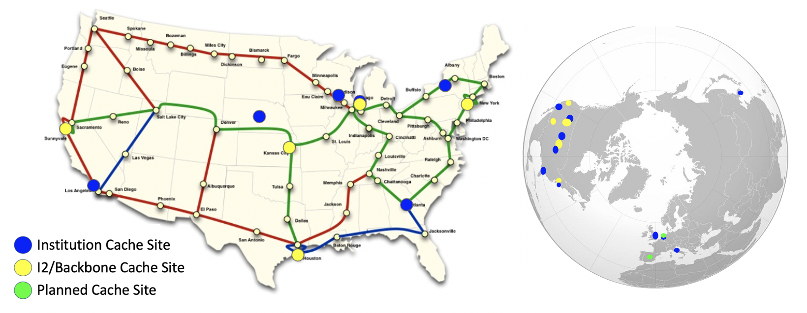
Using Stash for Input
regionally-cached repository managed by OSG Connect

Slide 34
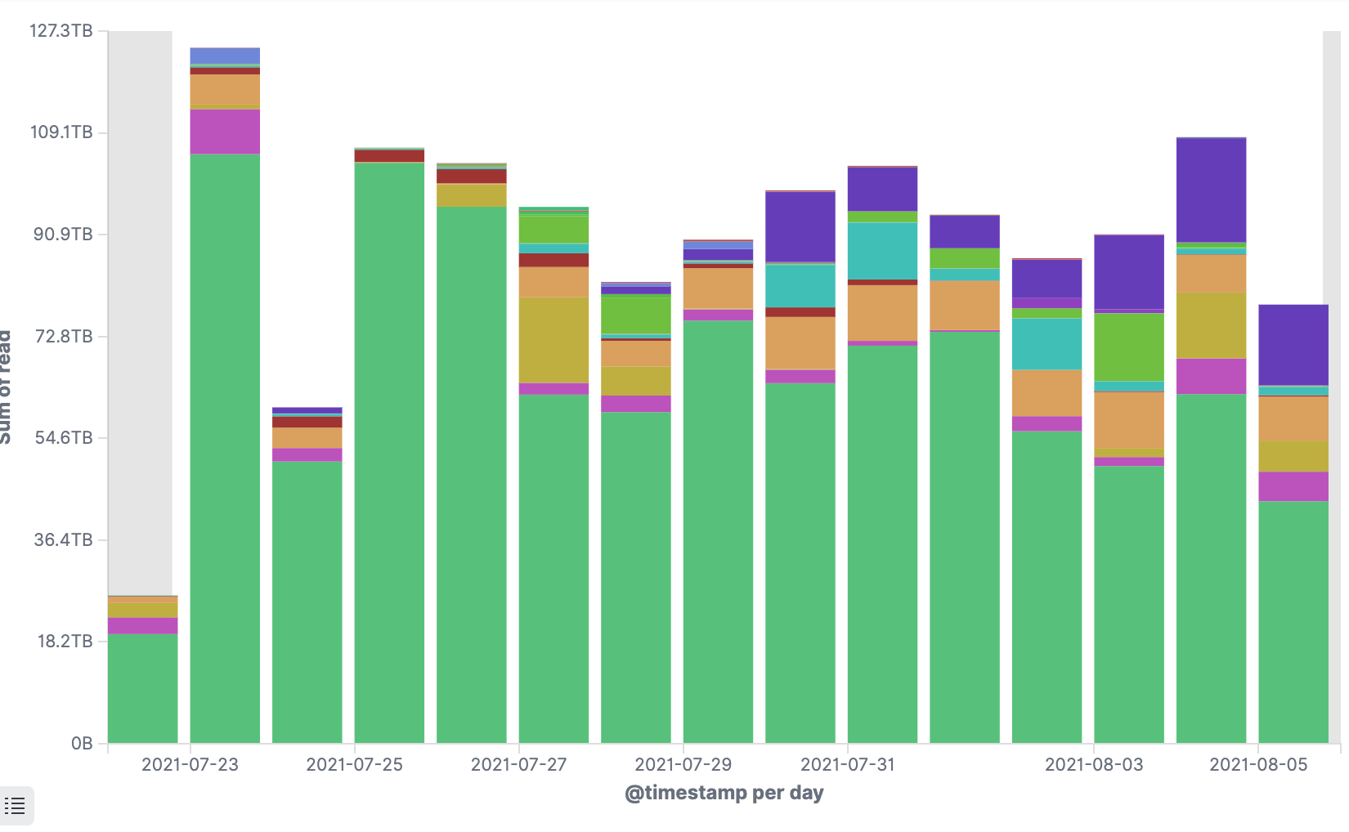
Stash Usage on OSG
Lots of experiments use Stash
Uboone: Neutrino
OSGConnect Users
Minerva:
Neutrino Experiment

Slide 35
Stash Considerations
Available at ~90% of OSG sites
Regional caches on very fast networks
  Recommended max file size: 20 GB
  shared OR unique data
Can copy multiple files totaling >10GB
Just like HTTP proxy, change name when update files

Slide 36
Placing Files in Stash
Place files in /public/username/ on osgconnect.net
login04.osgconnect.net
“Stash” origin
regional cache
local server
file
/public/username/
any OSG submit
exec server
exec server
exec server

Slide 37
Obtaining Files in Stash
Use HTCondor transfer for other files
login04.osgconnect.net
“Stash” origin
regional cache
local server
file
file
/public/username/
HTCondor
any OSG submit
exec server
exec server
exec server

Slide 38
Obtaining Files in Stash
Download using stashcp command (available as an OASIS software module)
login04.osgconnect.net
“Stash” origin
regional cache
local server
file
file
stashcp
/public/username/
HTCondor
any OSG submit
exec server
exec server
exec server

Slide 39
In the Submit File
transfer_input_files=stash:///osgconnect/public/USERNAME/…

Slide 40
What’s Different for Output?
always unique (right?), so caching won’t help
files not associated with your local username
  security barriers outside of local context
security issues with world-writability
  (versus okay world-readability for input)

Slide 41
Output for HTC and OSG
exec server
amount | method of delivery
words | within executable or arguments?
tiny – 1GB, total | HTCondor file transfer
1GB - 20GB, unique or shared | Stash
20GB+, total | shared file system (local copy, local execute servers)

Slide 42
Output for HTC and OSG
exec server
amount | method of delivery
words | within executable or arguments?
tiny – 1GB, total | HTCondor file transfer
1GB – 20GB, unique or shared | Stash
20GB+, total | shared file system (local copy, local execute servers)

Slide 43
Writing to stash
transfer_output_remaps = "Output.txt = stash:///osgconnect/public/<username>/Output.txt"

Slide 44
Other Considerations
Only use these options if you MUST!!
  Each comes with limitations on site accessibility and/or job performance, and extra data management concerns
file size | method of delivery
words | within executable or arguments?
tiny – 10MB per file | HTCondor file transfer (up to 1GB total per-job)
10MB – 1GB, shared | download from web server (local caching)
1GB - 10GB, unique or shared | Stash (regional replication)
10 GB - TBs | shared file system (local copy, local execute servers)

Slide 45
Other Considerations
Only use these options if you MUST!!
  Each comes with limitations on site accessibility and/or job performance, and extra data management concerns
file size | method of delivery
words | within executable or arguments?
tiny – 10MB per file | HTCondor file transfer (up to 1GB total per-job)
10MB – 1GB, shared | download from web server (local caching)
1GB - 10GB, unique or shared | Stash (regional replication)
10 GB - TBs | shared file system (local copy, local execute servers)

Slide 46
Cleaning Up Old Data
For Stash AND web proxies:
make sure to delete data when you no longer need it in the origin!!!
Stash and VO-managed web proxy servers do NOT have unlimited space!
  Some may regularly clean old data for you. Check with local support.

Slide 47
Handling Data on OSG
Overview / Things to Consider
HTCondor File Transfer
Web Proxy
Stash
Shared File Systems

Slide 48
(Local) Shared Filesystems
data stored on file servers, but network-mounted to local submit and execute servers
Available on some submit servers
  CHTC ✓ Yes
  OSG Connect ✗ No
More details at the end of this presentation…

Slide 49
Filesystem Quotas
System | Location | Quota | Transfer Mechanism
CHTC | /home | 20 GB | HTCondor file transfer
 | /staging | 20 GB 20 files total | Accessed directly from within job
OSG Connect | /home | 50 GB | HTCondor file transfer
 | /public | 500 GB | Web Proxy, stashcp
Tips:
Choose data location and transfer carefully based on the size and type of the data
Remove unnecessary files
Configure workflow to discard unneeded intermediate files
To request increases contact:
CHTC: chtc@cs.wisc.edu
OSG Connect: support@osgconnect.net

Slide 50
Quick Reference
Option | Input or Output? | File size limits | Placing files | In-job file movement | Accessibility?
HTCondor file transfer | Both | 100 MB/file (in), 1 GB/file (out); 1 GB/tot (either) | via HTCondor submit node | via HTCondor submit file | anywhere HTCondor jobs can run
Web proxy | Shared input only | 1 GB/file | Service specific - OSGConnect in /public/user/ | HTTP download | anywhere, by anyone
Stash | Both | 20 GB/file | via OSG Connect submit server | via stashcp command (and module) | OSG-wide (most sites), by anyone
Shared filesystem | Input, likely output | TBs (may vary) | via mount location (may vary) | use directly, or copy into/out of execute dir | local cluster, only by YOU (usually)

Slide 51
Required Exercises
1.1 Understanding a job’s data needs
1.2 Using data compression with HTCondor file transfer
1.3 Splitting input (prep for large run in 2.1)
2.1 Using a web proxy for shared input
  place the blast database on the web proxy
2.2 Stash for shared input
  place the blast database in Stash
2.3 Stash for unique input
  convert movie files

Slide 52
Bonus Exercises
3.1 Shared Filesystem for Large Input
3.2 Shared Filesystem for Large Output

Slide 53
Acknowledgments
This work was supported by NSF grants OAC-1836650, and OAC-2030508

Slide 54
Additional Slides
Shared Filesystem Details

Slide 55
(Local) Shared Filesystems
data stored on file servers, but network-mounted to local submit and execute servers
use local user accounts for file permissions
  Jobs run as YOU!
  readable (input) and writable (output, most of the time)
MOST perform better with fewer large files (versus many small files of typical HTC)

Slide 56
Shared FS Technologies
via network mount
  NFS
  AFS
  Lustre
  /staging (may use NFS mount)
  Isilon (may use NSF mount)
distributed file systems (data on many exec servers)
  HDFS (Hadoop)
  CEPH

Slide 57
Shared FS Configurations
Submit directories WITHIN the shared filesystem
  most campus clusters
  limits HTC capabilities!!
Shared filesystem separate from local submission directories
  supplement local HTC systems
  treated more as a repository for VERY large data (>GBs)
Read-only (input-only) shared filesystem
  Treated as a repository for VERY large input, only

Slide 58
Submit dir within shared FS
exec server
exec server
exec server
submit server
exec server
HTCondor
Shared FS
(submit dir)/
file.sub
input, software
log, error, output
Notes:
Don’t use HTCondor. Use the shared filesystem

Slide 59
Submit dir within shared FS
exec server
exec server
exec server
submit server
exec server
HTCondor
# file.sub:
should_transfer_files = NO
transfer_input_files =
Shared FS
(submit dir)/
file.sub
input, software
log, error, output

Slide 60
Separate shared FS
exec server
exec server
exec server
submit server
exec server
HTCondor
submit file
executable
dir/ input
output
(exec dir)/
executable
input
output
Separate FS

Slide 61
Separate shared FS - Input
exec server
exec server
exec server
submit server
exec server
HTCondor
(exec dir)/
1.Place compressed input into FS
Separate FS
/path/to/lgfile
lgfile

Slide 62
Separate shared FS - Input
exec server
exec server
exec server
submit server
exec server
HTCondor
(exec dir)/
lgfile
2. Executable copies and decompressesthe file
Separate FS
/path/to/lgfile
lgfile

Slide 63
Separate shared FS - Input
exec server
exec server
exec server
submit server
exec server
HTCondor
(exec dir)/
3. Executable must remove the file in the exec dir after use
Separate FS
/path/to/lgfile
lgfile

Slide 64
Separate shared FS - Output
exec server
exec server
exec server
submit server
exec server
HTCondor
(exec dir)/
lgfile
1.Executable creates and compresses the output file
Separate FS

Slide 65
Separate shared FS - Output
exec server
exec server
exec server
submit server
exec server
HTCondor
(exec dir)/
lgfile
2. Executable copies the file
Separate FS
/path/to/lgfile
lgfile

Slide 66
Separate shared FS - Output
exec server
exec server
exec server
submit server
exec server
HTCondor
(exec dir)/
3. Executable removes the file in the exec dir
Separate FS
/path/to/lgfile
lgfile

Slide 67
At UW-Madison (Ex. 3.1-3.2)
exec server
learn.chtc.wisc.edu
exec server
exec server
submit server
exec server
HTCondor
(exec dir)/
Separate FS
/mnt/gluster/user/lgfile
lgfile

