Slide 1
Software Portability for HTC
Christina Koch
Slides adapted from Andrew Owen, Rachel Lombardi
OSG User School 2026

Slide 2
Goals for this session
Describe what it means to make software “portable.”
Describe what software (and data) is used by your research work
Use a Docker or apptainer container in a job
Build a conda, python, or R based container with packages

Slide 3
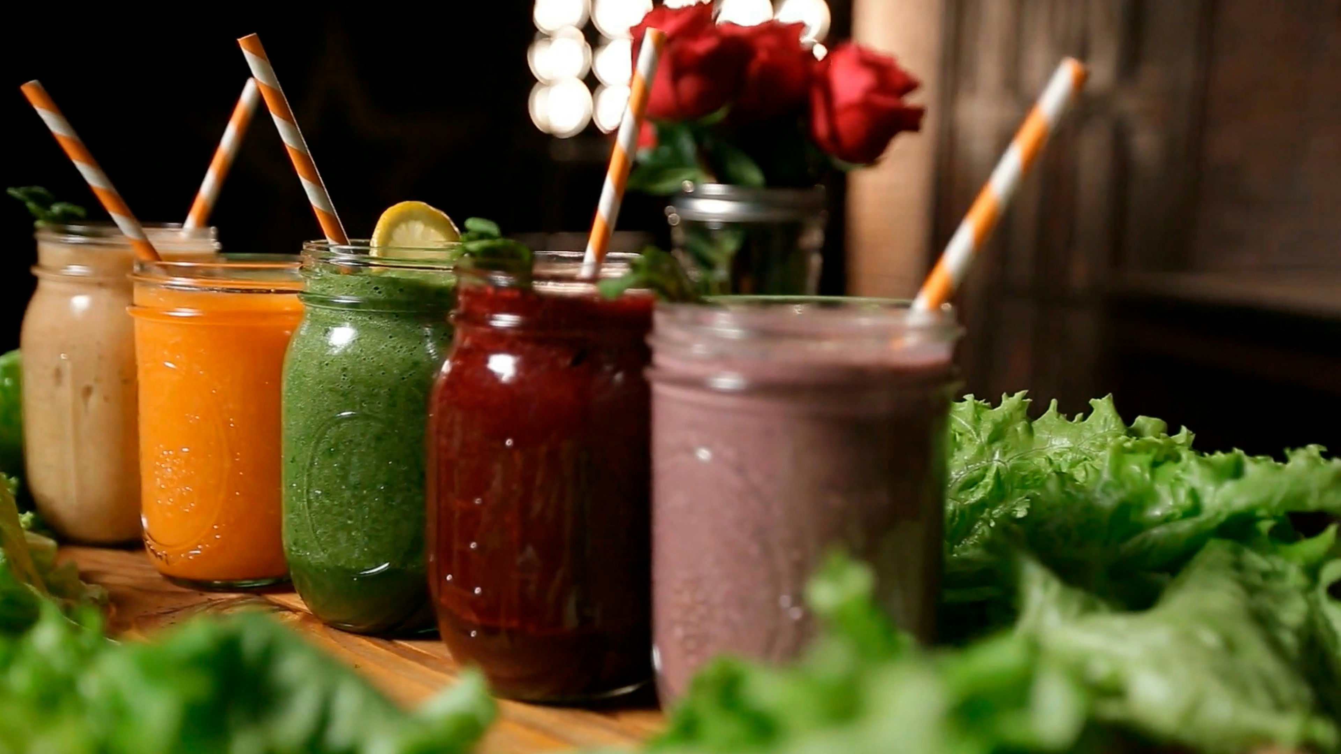
Imagine that we asked you to make a smoothie…

Slide 4
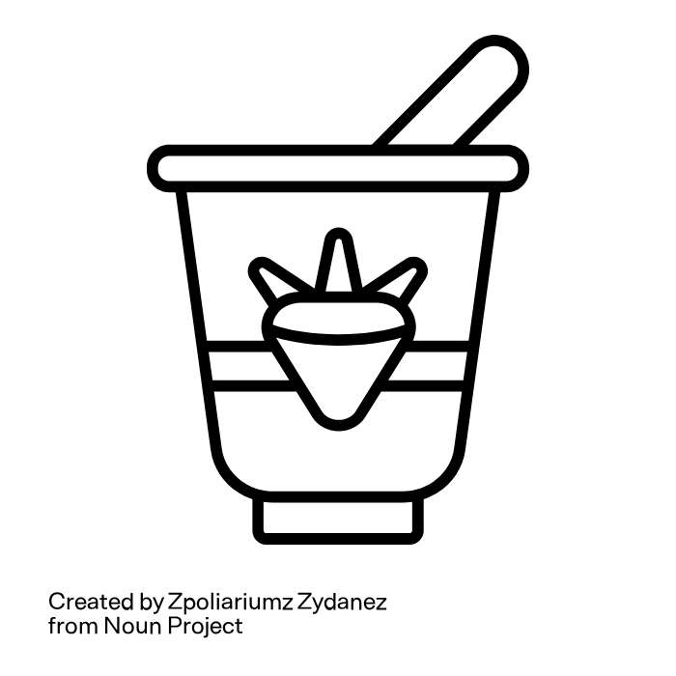
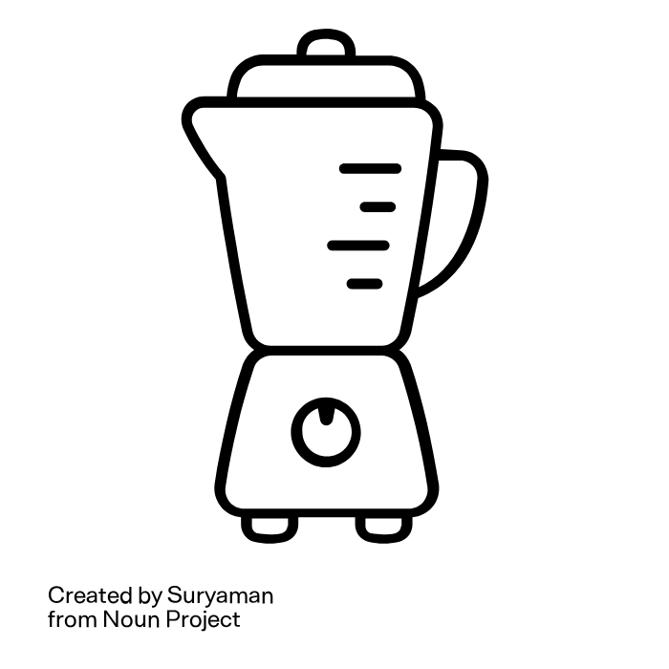
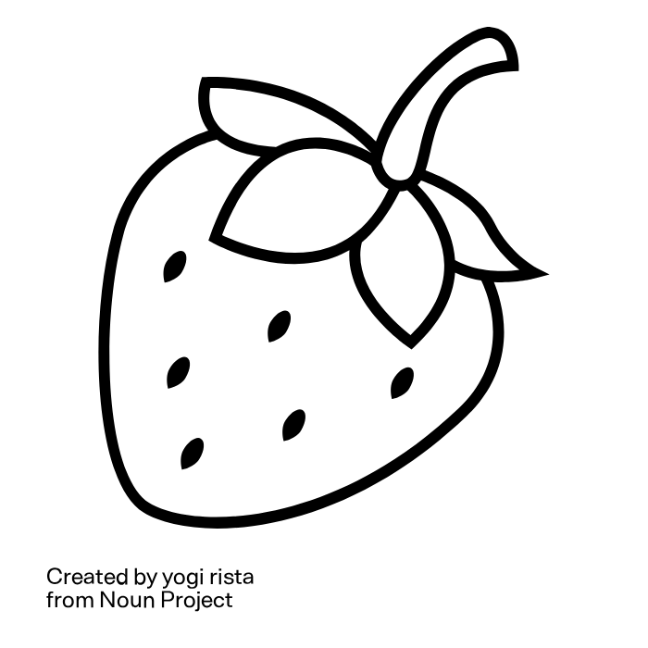
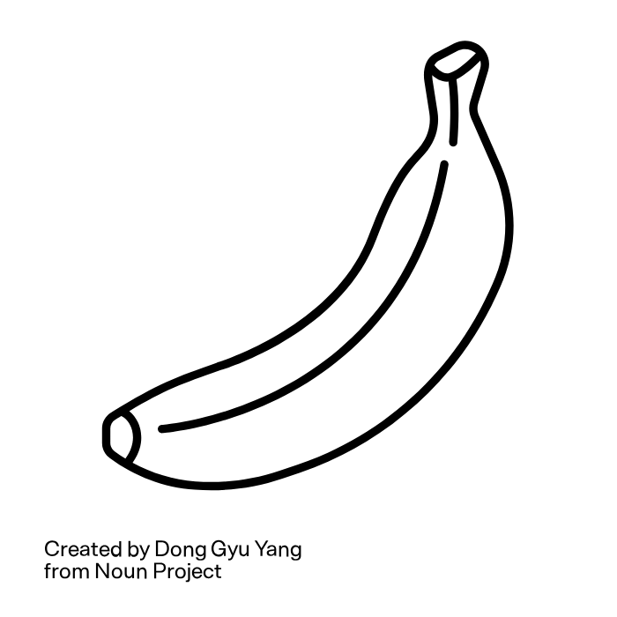
A computing smoothie
You need ingredients (fruit, yogurt, etc.) and equipment (a blender).
In computing for research, we need ingredients (data/scripts) and equipment (software) to generate results.
Data, scripts
Software

Slide 5
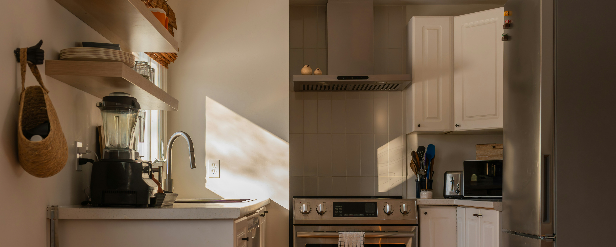
Software requirements
Specifically you need a kitchen that (a) has a blender (b) that you can find.
Just like you need your software files in a known location.
Notes:
Photo by Franco Debartolo on Unsplash

Slide 6
Working on your computer
Is like making food in your own kitchen
You know what is there.
  All the software you need is already installed.
You have the right versions.
You know where everything is (mostly).
You have full control.
  You can add new programs when and where you want.

Slide 7
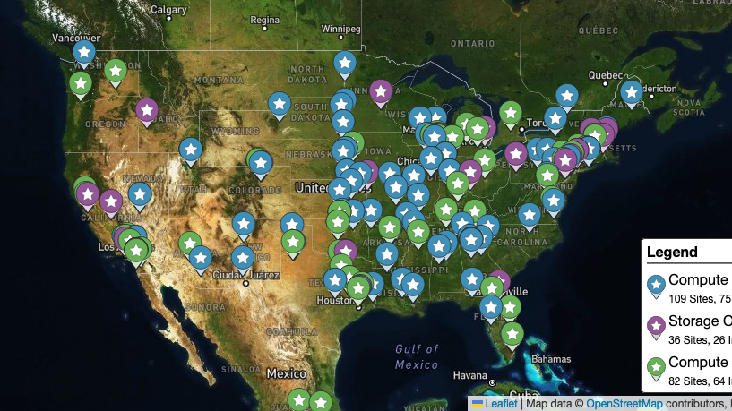
OSPool: Other People’s Computers

Slide 8
Working on someone else’s computer
Like trying to cook in someone else’s kitchen.
What’s already there?
  Is R installed? Or Python? What about the packages you need?
If the software you need is installed, do you know where it is or how to access it?
Is it the right version?
Are you allowed to change whatever you want?

Slide 9
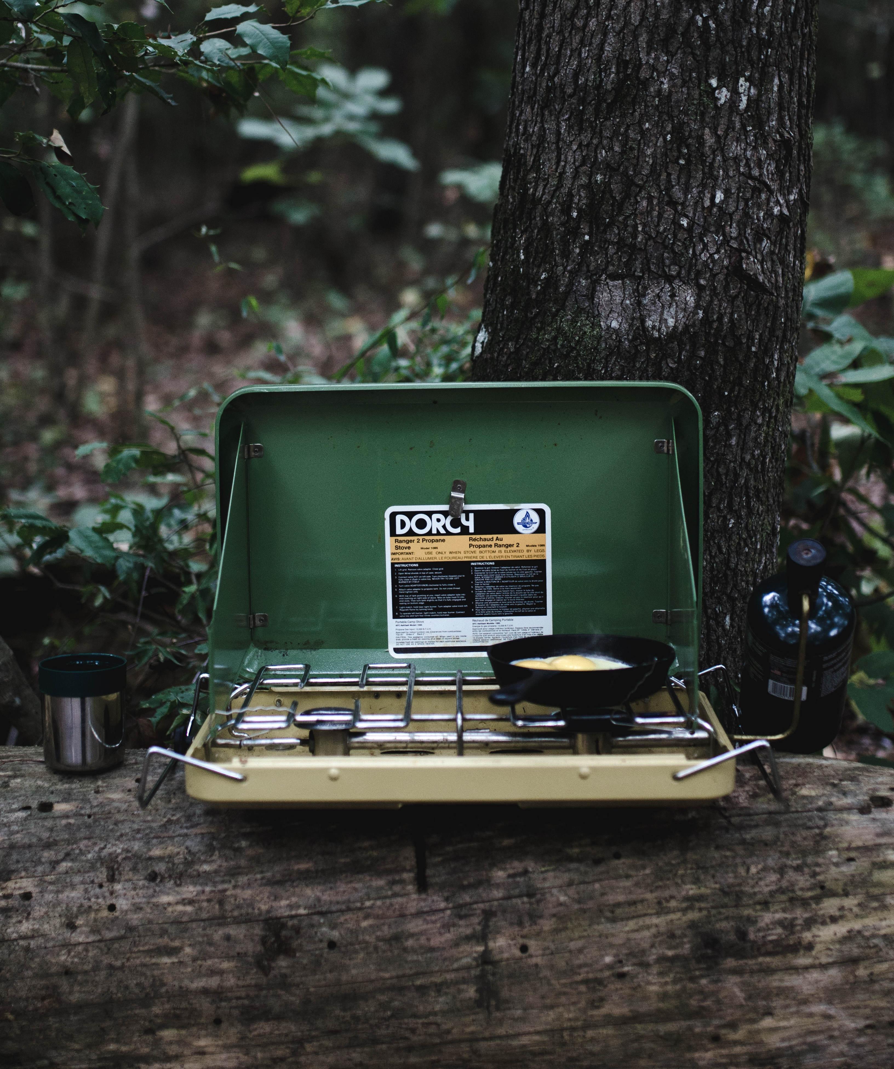
Software portability
Imagine going camping or backpacking – what do you need to do to cook anywhere?
Similarly: what would it take to drop into any computer and be able to run your software there?
This is what it means to make software portable.
Photo by andrew welch on Unsplash

Slide 10
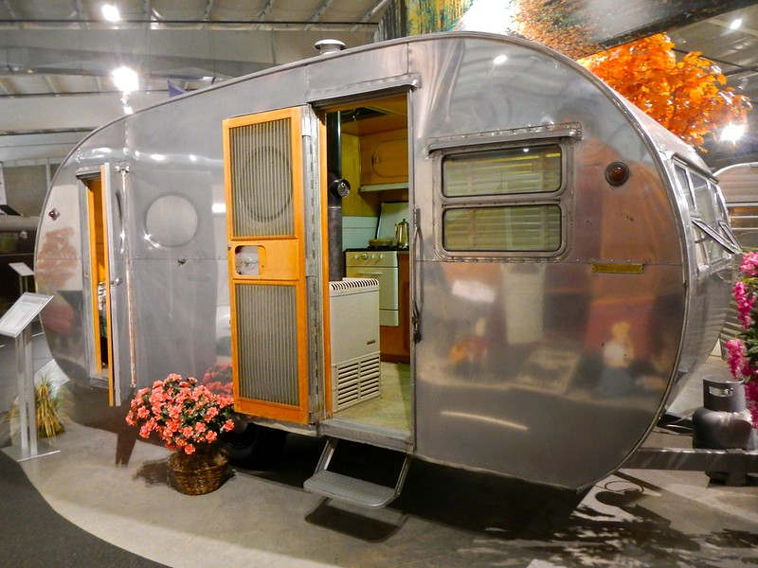
Enter containers
Using a container is like bringing along a whole kitchen, with all the specific equipment we need.
Photo by PunkToad on Flickr, CC-BY

Slide 11
Why use containers?
Containers provide
portability
  have ALL your files
  in the right places
user control – install software like on your computer
ease of use – add one line to your submit file

Slide 12
Using containers in jobs
For today:
container_image = cowsay.sif
...usual submit options...
That's it!

Slide 13
Using containers in jobs
Well… all other times:
container_image = osdf:///ospool/ap40/username/cowsay.sif
...usual submit options...
More on OSDF tomorrow!

Slide 14

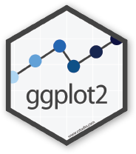



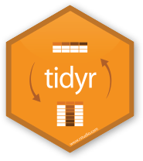
Containers
Containers are a tool for capturing an entire “environment” (software, libraries, operating system) into an “image” that can be run and used as the environment for a job
run
Credit: polaroid photos by Nick Bluth from the Noun Project
R-tidy.sif
run

Slide 15
Words for containers
container = the actively running ~thing~ that can run commands
container image = is the set of files that can be used to create the container
"Launching" or "running" a container is the process of using the "container image" to create the running "container"
"Building" is the process of creating the "container image" (and often uses a pre-existing container image as the basis for the new one)

Slide 16


Technology for containers
https://apptainer.org/
For beginners and those who only want to run the container on the OSPool
https://www.docker.com/
For advanced users and those who want to deploy containers to many places

Slide 17
Technology for containers
https://apptainer.org/
Open source software
Does not require root to install
Beginner friendly syntax
Fewer features
No distribution system
Harder to run on your laptop
https://www.docker.com/
Modern app interface (Docker Desktop), can be run on your laptop
Widely used distribution system (DockerHub, analogous to GitHub)
Non-intuitive syntax
Requires root to install
Commercial software

Slide 18
Demo
Notes:
pelican object get osdf:///osg-public/school/2026/ubuntu24.04.sif ./
python3 –version
apptainer shell ubuntu24.04.sif
python3 --version

Slide 19


Getting started with containers
Find an existing container
Build your own container

Slide 20
Find existing containers
Review your software’s web page / documentation
Go to common container repositories and search for tools. Opt for containers that are:
  Regularly updated
  Owned by official community organizations
(See Exercise 2.2)

Slide 21
Effort estimates for building containers
How hard was it to install this software initially?
(How hard would it be to install on a different computer?)
Building a container should be about the same amount of challenge/effort, not a lot more.

Slide 22
How it works
Create a definition file | Build a container image | Test the container image | Deploy in jobs!
Bootstrap: docker From: python:3.13 %post python3 -m pip install cowsay |  |  | container_image = cowsay.sif
apptainer shell
cowsay.sif
cowsay –t “hello”

Slide 23
Apptainer definition file
Create a definition file
Create a file container.def with the following contents:
Bootstrap: docker
From: python:3.13
%post
python3 -m pip install cowsay
Tells Apptainer to use the DockerHub "python" container with the tag* of "3.13"
The following commands should be used to modify the container
Install the "cowsay" Python package
*In the case of the "python" container, the "tag" equals the version of python inside.

Slide 24
Choosing a base container
Create a definition file
Search for your software + "container".
Most big-name softwares have official containers online
Once identified, find the container "address", usually represented in the form of a docker pull command:
docker pull user/repository:tag
Do not use the latest tag - choose an explicit one

Slide 25
Installation commands in %post
Create a definition file
Level 1
  Use common packages like those from PyPi or CRAN; build environments with conda. → Exercise 2.3
Level 2
  Use the Linux built in package manager (apt for Debian/Ubuntu, yum or dnf for Red Hat family). → Exercise 2.4
Level 3
  Run a series of installation commands that downloads or clones files, unzips files, runs an installation script or compiles code. Set environment variables as needed. → Exercise 2.5

Slide 26
Brief side quest
Create a definition file
Side quest
A software program is a FILE.
Linux expects software files to be in certain default PLACES.
Level 1 + 2 installation
  The package manager downloads the correct files and puts them in the right place.
Level 3 installation
  YOU have to make sure the files are downloaded, compatible with your version of Linux/your hardware, and you have to know where they are.

Slide 27
Demo
Notes:
To see your PATH: echo $PATH
To add a directory: export PATH=/dir/you/want/to/add:$PATH

Slide 28
Installation commands in %post
Create a definition file
Level 1
  Use common packages like those from PyPi or CRAN; build environments with conda. → Exercise 2.3
Level 2
  Use the Linux built in package manager (apt for Debian/Ubuntu, yum or dnf for Red Hat family). → Exercise 2.4
Level 3
  Run a series of installation commands that downloads or clones files, unzips files, runs an installation script or compiles code. Set environment variables as needed. → Exercise 2.5
90% of software installs

Slide 29
What to install and where
Create a definition file
"Common" tools/libraries/packages are rarely included in "official" containers; be sure to add what you need/want
Dynamic items (scripts, input data) should not be included in the container
Recommend that user software is installed in the /opt folder
🧰
❌
🗂️

Slide 30
Build the container image
Build a container image
Build the container image file using the provided definition file
apptainer build container.sif container.def
desired filename
definition file

Slide 31
Apptainer build output
Build a container image
Output details what Apptainer is doing:
Download the base container image
Launch the base container image
Execute the commands from the %post section
Create the new container image file
When finished, should see a message like
INFO: Build complete: container.sif

Slide 32
Test the Apptainer image
Test container image
Test the container.sif container by launching it with
apptainer shell -e container.sif
If you can get the "help" or "version" text for your desired program, should be good to go.

Slide 33
Test the Apptainer image
Test container image
Apptainer> cowsay "hello"
_____
| Hello |
=====
\
\
^__^
(oo)\_______
(__)\ )\/\
||----w |
|| ||
cowsay.sif
$ apptainer shell cowsay.sif

Slide 34
Differences between local & cluster use
Test container image
With HTCondor,
containers are always run as the user and never as root
But…
official containers often assume you are running as root!
When testing a container, test as the user.

Slide 35
Use the Apptainer image
Use container image
container_image = cowsay.sif
...usual submit options...
cowsay.sif

Slide 36
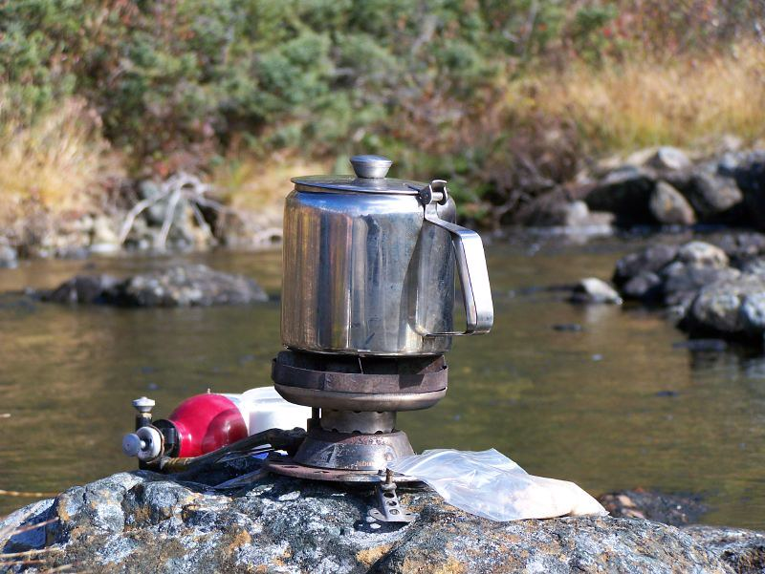
Back to our cooking analogy…
It is possible to use a backpacking approach (bring along files) instead of a portable kitchen (container).
Photo by Derrick Mercer on Flickr, CC-BY-SA

Slide 37
Bring along software files
We always need a “compiled” file that is compatible with the version of Linux used by the execution point. Some options:
Download pre-compiled software files
Compile software yourself
  Generate a single binary file
  Create an installation with multiple binary files contained in a single folder
If you think your use case may benefit from this approach (instead of a container) – talk to School staff.

Slide 38
Software installation pep talk 🎉
Software installation can be hard…and you can do it!
Make sure to read the instructions for installing your software, especially the requirements
The last error message you see may not be the same as the first error message that caused it..
Test, test, test!

Slide 39
Work Time
Go through the introductory exercises
Then, choose an approach for *your* software and try to find or make a portable version for OSPool jobs.
Ask for help!
Additional guides are at portal.osg-htc.org/documentation

Slide 40
Acknowledgements
This work is supported by NSF under Cooperative Agreement OAC-2030508 as part of the PATh Project. Any opinions, findings, and conclusions or recommendations expressed in this material are those of the author(s) and do not necessarily reflect the views of the NSF.

Slide 41
Appendix: Container and Compiling Tips

Slide 42
Best Practices in Using Containers on OSG
Don’t use the latest tag in images
Use version number/specific names in the images
Test images with apptainer shell
Unique image name eliminates the risk of running a job using previous versions due to stashing.

Slide 43
Where to install software?
Do not use $HOME, /root or /srv
  Container will run as some user we do not know yet, so $HOME is not known and will be mounted over
  /root is not available to unprivileged users
  /srv is used a job cwd in many cases
/opt or /usr/local are good choices

Slide 44
Common issues
Building Docker on a Mac (with ARM)
→ Make sure to include option --platform linux/amd64
Custom command not found
→ Manually add install location to your PATH at start of execution
Cannot create directory at /.cache
→ Manually set HOME or other environment variables at start of execution
Cannot write file at /app/data, etc.
→ Change program to use relative path for execution, not absolute

Slide 45
Finding files in the command line
Put the software location in the PATH variable
Give a relative/absolute path to the software location
The PATH variable is a list of folders on your computer.
When you type a command in the terminal, behind the scenes it checks each folder in the path for those files.
You can add folders to the PATH
You can also type *exactly* where the software files or your scripts are.
  Relative: starts with ./ or ../
  Absolute: starts with /
Notes:
To see your PATH: echo $PATH
To add a directory: export PATH=/dir/you/want/to/add:$PATH

Slide 46
Learn how to build/use containers
OSG User Documentation:
https://portal.osg-htc.org/documentation/
Videos:
  https://portal.osg-htc.org/documentation/support_and_training/training/materials/
  https://www.youtube.com/watch?v=awSLTflAIJ8

