Slide 1
Throughput Machine Learning
Ian Ross
Data Engineer, Center for High Throughput Computing

Slide 2



Objectives
Provide a too-brief overview of artificial intelligence and machine learning (AI, ML)
Throughput Machine Learning
Planting some seeds
  Is my ML work “HTC-able”?
  If yes, how can I go about growing it?

Slide 3
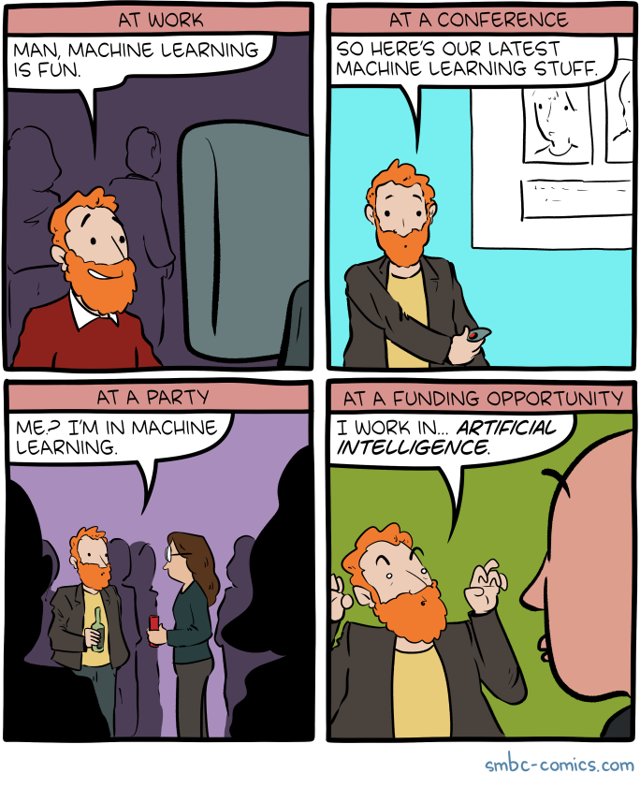
AI/ML – a too-brief overview
Artificial intelligence – Methods and software to enable machines to observe, identify, and react to stimuli to achieve a defined goal
Machine learning – Algorithms and practices to enable machines to recognize patterns in data and generalize to new data to achieve tasks with or without supervision
  Subset of AI

Slide 4
Artificial Intelligence
Machine Learning
Deep learning
Using artificial neural networks to capture
connections and strengths (weights)
between inputs and outputs
Generative AI
Models trained to generate data
similar to that used to train
Large language models

Slide 5
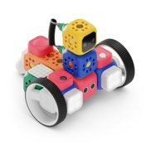




Artificial Intelligence
Evolutionary
algorithms
Machine Learning
Bayesian
networks
Random forests
Symbolic AI
Deep learning
Using artificial neural networks to capture
connections and strengths (weights)
between inputs and outputs
Decision trees
Linear
regression
K-means
clustering
Generative AI
Models trained to generate data
similar to that used to train
Large language models
Principal
component
analysis
Toy robot photo by Robo Wunderkind on Unsplash

Slide 6
Artificial Intelligence
Evolutionary
algorithms
Machine Learning
Bayesian
networks
Random forests
Symbolic AI
Deep learning
Using artificial neural networks to capture
connections and strengths (weights)
between inputs and outputs
Decision trees
Linear
regression
K-means
clustering
Generative AI
Models trained to generate data
similar to that used to train
Large language models
Principal
component
analysis
Toy robot photo by Robo Wunderkind on Unsplash

Slide 7
Data science
Artificial Intelligence
Data engineering
Machine Learning
Deep learning
Using artificial neural networks to capture
connections and strengths (weights)
between inputs and outputs
Generative AI
Models trained to generate data
similar to that used to train
Large language models

Slide 8
Data science
Statistics
Artificial Intelligence
Data engineering
Machine Learning
Bioinformatics
Deep learning
Using artificial neural networks to capture
connections and strengths (weights)
between inputs and outputs
Generative AI
Models trained to generate data
similar to that used to train
Large language models

Slide 9
Differences matter, but in an HTC setting, I mostly care about these disciplines primarily as tools and techniques that enable
new SCIENCE and less about distinctions between them
…but there are foundations to understand
(and complications to tackle!) to use them in the OSPool
Data science
Statistics
Artificial Intelligence
Data engineering
Machine Learning
Bioinformatics
Deep learning
Using artificial neural networks to capture
connections and strengths (weights)
between inputs and outputs
Generative AI
Models trained to generate data
similar to that used to train
Large language models

Slide 10
Neural networks, simplified
Historically analogous to neurons in a brain, where electrical signals spark pathways to carry signals
Artificial neurons are arranged into layers, (input, output, or hidden)
The activation (value) of a neuron depends on the values of the previous layer and predefined weights
Input
Output
Hidden layer

Slide 11
Neural networks, simplified
These weights are tuned during training, in order to maximize success for the defined task
These architectures can get very complicated, and this is where a lot of innovation is happening
  Attention mechanisms (transformers), RNN, (R)-CNNs, LSTM, …
Input
Output
Hidden layer

Slide 12
Dog/cat classifier “example”
Imagine we had thousands of labeled pictures of our pets (and our friends’ pets and our friends’ friends’ pets and…)
We might initialize a set of weights and then start the training process…

Slide 13
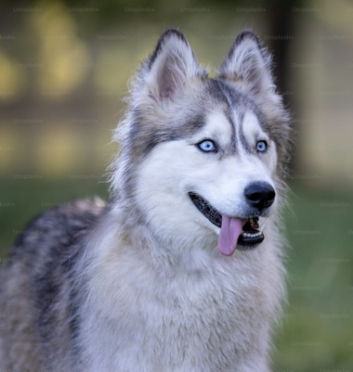
Training, oversimplified
Push training data into the model, compare the outputs to the truth, calculate how the predictions change as we shift the weight parameters slightly, move the parameters in a promising direction, and repeat. And repeat. And repeat…
This is computationally expensive, especially as models get larger and more complex (e.g. 30.85 million GPU hours for Llama3.1 405B)
P(😾) = 0.61
Dog photo by Matt Bango on Unsplash

Slide 14
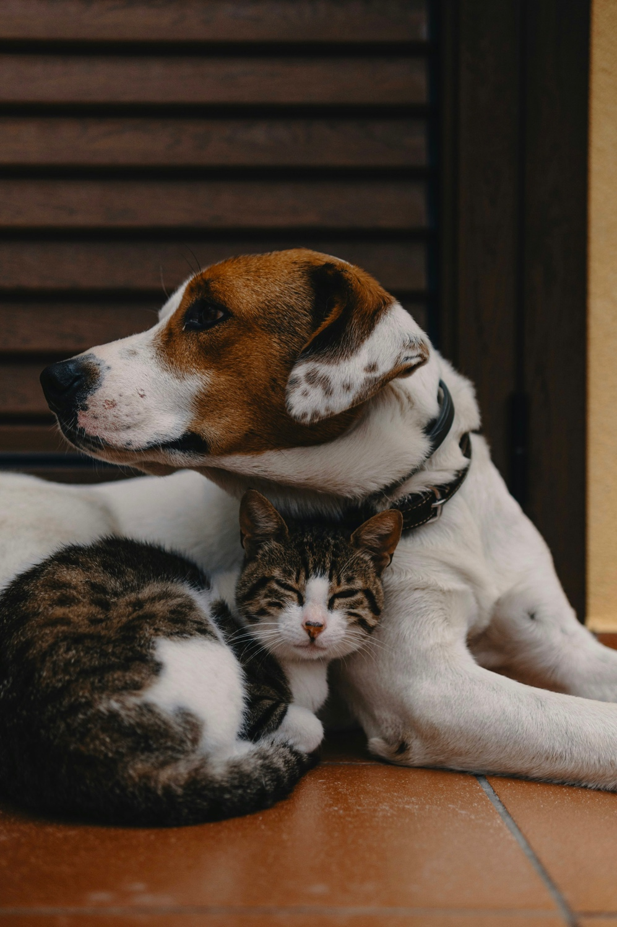
Now we have a model!
Let’s deploy it and identify some pets!
We’ll pass in some photos from CHTC’s #social channel (not from the training set) and see what our model infers from these pictures
Best friends photo by Alec Favale on Unsplash

Slide 15
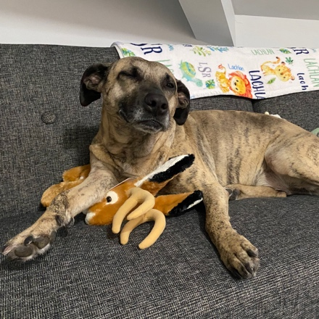


Inference tests
👍
P(🐶) = 0.99
Input data (in training too!) needs to be
preprocessed (e.g. tokenized)

Slide 16



Inference tests
👍
P(🐱) = 0.99

Slide 17
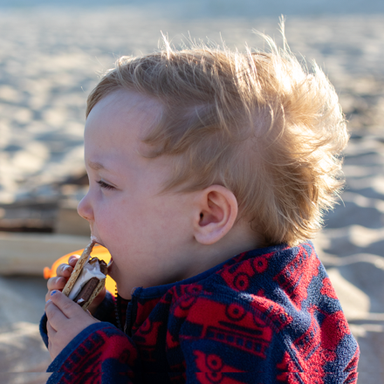


Inference tests
🤔
P(🐱) = 0.71

Slide 18
Limits of our model
These weights were trained on our pets dataset. Weights (and therefore the hidden layer) of this model captured 💫✨pet essence✨💫.
Our model does not know how to identify anything else. A picture of my son is outside of the training distribution and we should not expect it to perform in this case.
Know your data and know your objective!
Let’s take a closer look at what this inference requires computationally..

Slide 19
A bit of math…
a₁
Nodes are a linear combination of weighted nodes from the previous layer:
a₂
a₃
a₄
x₁
a₅
y₁
a₁ = W₁₁ * x₁ + W₂₁*x₂
y₂
x₂
a₆
Input
a₇
Output
a₈
a₉
a₁₀
Hidden layer

Slide 20
a₁
a₁ = W₁₁ * x₁ + W₂₁*x₂
a₂
a₃
a₂ = W₁₂ * x₁ + W₂₂*x₂
a₄
x₁
a₅
y₁
…
y₂
x₂
a₆
Input
a₇
Output
a_{n} = W_{1n} * x_{n} + W_{2n}*x_{n}
a₈
a₉
…and similar for the y_{n}
a₁₀
Hidden layer

Slide 21
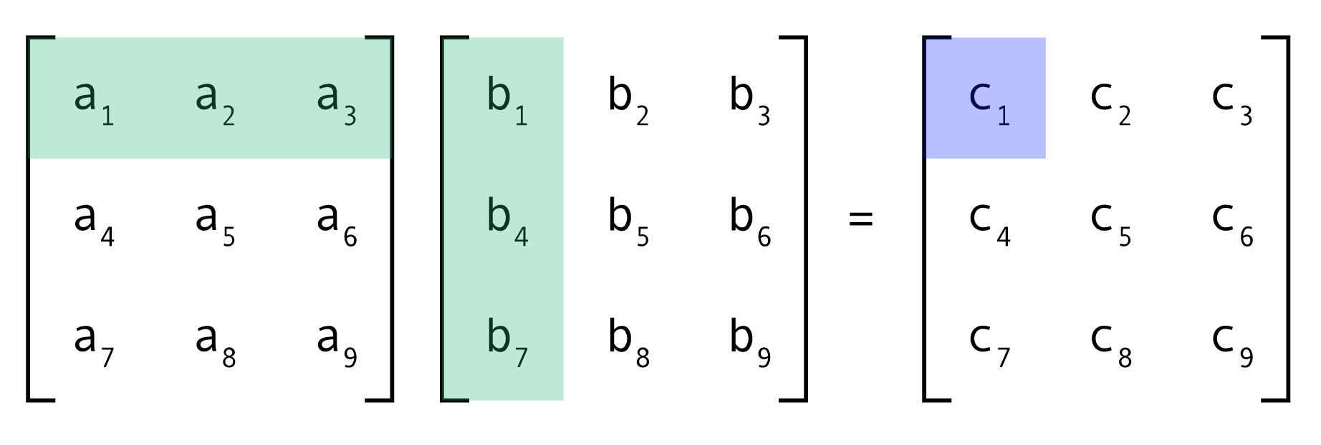
So… why GPUs?
GPUs are successful because they do one thing really well:
Inference and training often boil down to parallelized matrix multiplication, which GPUs excel at.

Slide 22
Challenges in ML/AI throughput computing
These are not new challenges! Defining resource needs, scheduling, data movement, workflow orchestration, learning new technologies… Sound familiar? So let’s talk through examples to understand whether an ML task is a good candidate for HTC…
GPUs bring their own layer of complexity
  Dropouts, user education, administration, cost, availability
Data and computing needs
  Size and scale aren’t unique to ML, but ML work tends to be on the heavy side
Training can be a long process
  Checkpointing required, especially in the OSPool

Slide 23
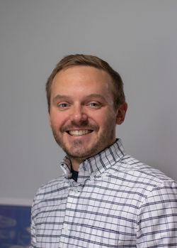
Throughput machine learning – Use case 1
I have 18 million scientific articles, and I want to search for, extract, and synthesize visual artifacts across them!

Slide 24
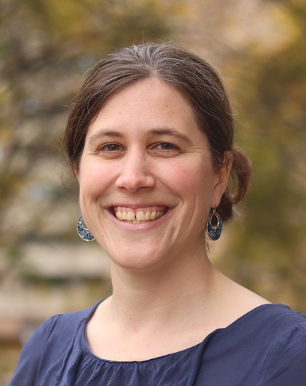
Is this a throughput workflow?
What is the smallest, self-contained computational task that is part of your work? How big is the list of these tasks? What is needed to run one task?

Slide 25
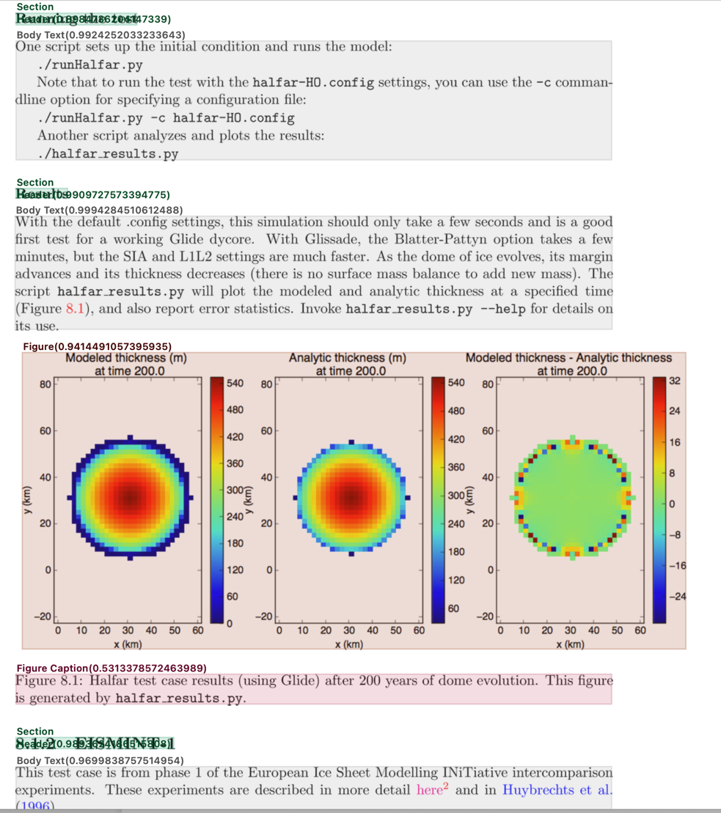
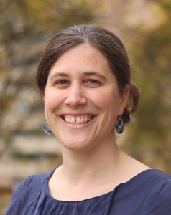
Scaling out with HTC
The atomic task is running our COSMOS visual pipeline on an individual PDF. Each PDF is on the order of 1 MB, produces 4 MB of output, and takes 5 seconds on a GPU or 5 minutes on a CPU. The model is ~8GB, and I have a docker container ready to go. However, these PDFs are bound by publisher agreements and can’t leave UW campus.
Great! This sounds ideal for CHTC, with standard input file transfer mechanisms. Have fun!

Slide 26
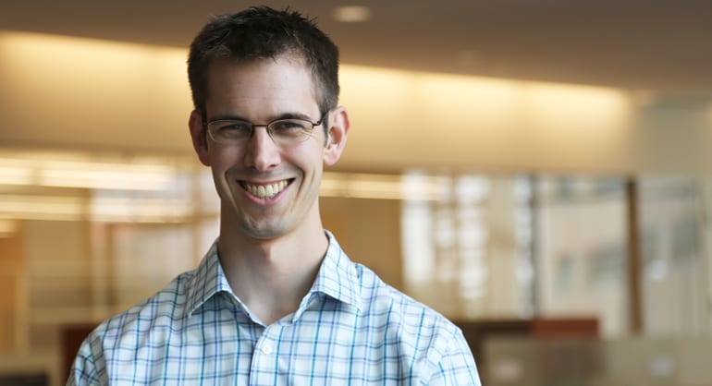
Throughput machine learning – Use case 2
I want to train many models, empirically measure their predictive power, and use those models to drive scientific exploration.

Slide 27
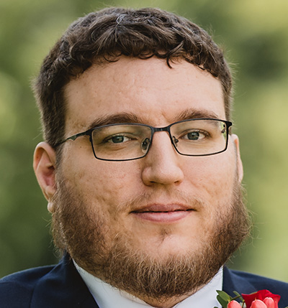
Is this a throughput workflow?
What is the smallest, self-contained computational task that is part of your work? How big is the list of these tasks? What is needed to run one task?

Slide 28
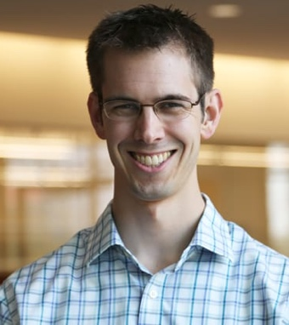
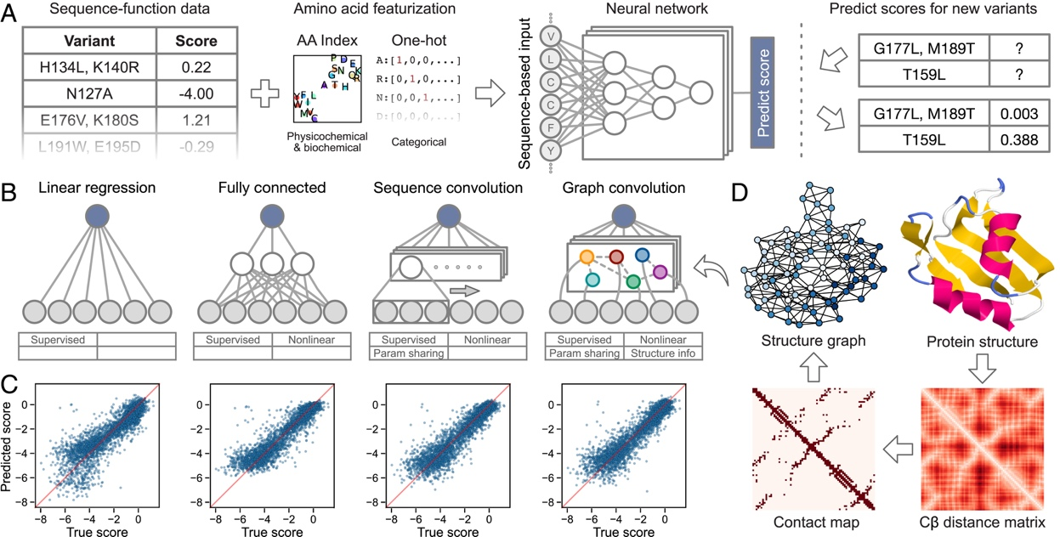

Scaling out with HTC
The atomic task is training a single model from our dataset, which is 10GB. We want to test many different architectures, but anticipate GPU runtimes on the order of days for each model. We want to test as many model architectures as possible. CPU, memory, and disk requirements are minimal.
Welcome to the OSPool! Let’s learn about OSDF and job checkpointing!
https://www.pnas.org/doi/full/10.1073/pnas.2104878118

Slide 29
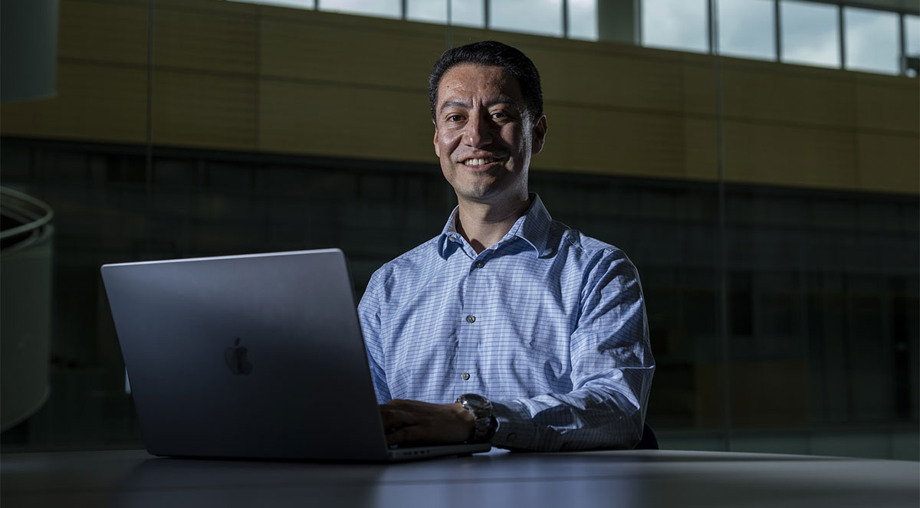
Throughput machine learning – Use case 3
I want to create a foundation model for bioimaging and want to scale training across multiple nodes!

Slide 30
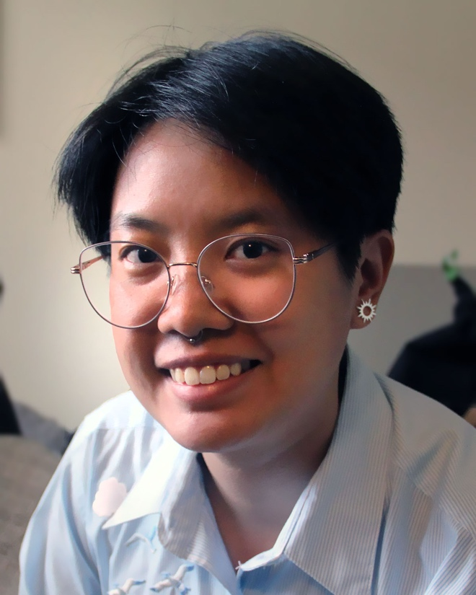
Is this a throughput workflow?
What is the smallest, self-contained computational task that is part of your work? How big is the list of these tasks? What is needed to run one task?

Slide 31
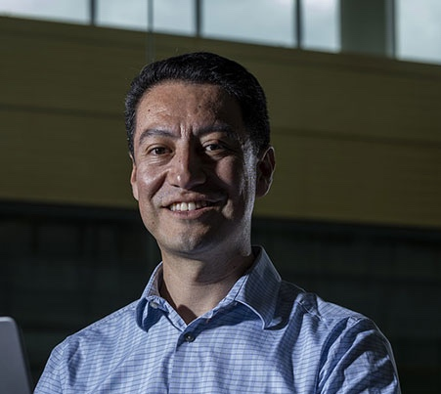

Scaling out with HTC?
Our dataset is 20TB. The model architecture we want to use is too big to fit on one GPU, and the memory needs are on the order of 128GB, and an epoch of training takes days
This isn’t a great fit for our usual computing philosophy, but let’s talk more and work together to see what we can do!

Slide 32
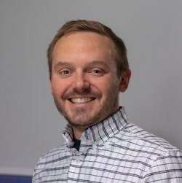
Throughput machine learning – use case 4
I want to actually create our theoretical cat-dog classifier example! I’ve talked to my RCF friends and determined it’s a good fit for the OSPool! Let’s go!
As I roll up my sleeves and get to work, what do I need to consider…
…as I start to do development?
…as I think about distribute jobs in the OSPool?
…as I think about improving my workflow in the OSPool?
This tutorial is available at https://github.com/osg-htc/tutorial-pytorch-catdog

Slide 33
Researcher-to-AI-workflow-proficiency pipeline!
Develop and test
Distribute work on HTC system
Improve workflow
✦
✦
✦
✦
✦
✦
Notes:
We want to take our researchers from the development and testing phase (on a single workstation) having the capability to distribute their work on systems, and even beyond that, improving their workflow to take advantage of the extra tools on our HTC systems that can speed up his workflow overall.

Slide 34
What should you consider during development?
Develop and test
Objective
Get a minimally viable workflow running on a local machine, while laying a foundation for distributed work that will accomplish your science.
Notes:
We want to take our researchers from the development and testing phase (on a single workstation) having the capability to distribute their work on systems, and even beyond that, improving their workflow to take advantage of the extra tools on our HTC systems that can speed up his workflow overall.

Slide 35

What should you consider during development?
Test with a subset of data.
Consider time, space, memory, and GPU needs.
Reduce computational project to a minimally viable workflow.
Know your software and create the software environment.
Notes:
First, our researcher wants to know what to consider as he’s developing his model. Here’s what I’d tell him:
During development the goal is to get a minimally viable workflow running on a local machine, while laying the foundation for distributed work that will accomplish your science.
A lot of researchers come to us with a limited background in distributed computing systems, so they’re not always thinking expansively – they’re thinking about having one machine manage everything. Here, we tell our researchers to shift their thinking a bit: Break down their task into the smallest chunk and let HTCondor handle managing the chunks.
Some key points here for researchers:
Develop and test your workflow with a subset of your data, not your full workflow
Ensure the data transfer “pipes” work – because our HTC systems don’t have a shared file system, we educate them on file transfer methods like using Pelican and the OSDF.
Know your software and containerize it – this ensures that their model will work on all machines.
Think about time, space, memory, and GPU needs

Slide 36
The training script
Add command line arguments to
handle input/output directories
Define the model architecture
def main(
data_dir: Path = typer.Option("./data", "--data-dir", "-d", \
help="Directory containing the training data"),
checkpoint_dir: Path = typer.Option("./checkpoints", "--checkpoint-dir", "-c", \
help="Directory to save model checkpoints"),
epochs: int = typer.Option(10, "--epochs", "-e", \
help="Number of training epochs"),
):
…
device = torch.device("cuda" if torch.cuda.is_available() else "mps" if torch.backends.mps.is_available() else "cpu")
…
# create train dataset
train_ds = CatDogDataset(train, transform)
train_dl = DataLoader(train_ds, batch_size=500)
# Create instance of the model and move to device
model = CatAndDogConvNet().to(device)
losses = []
accuracies = []
start = time.time()
loss_fn = nn.CrossEntropyLoss()
optimizer = torch.optim.Adam(model.parameters(), lr = 0.001)
..
if not os.path.exists(model_path):
# Model Training...
start = time.time() # start timer for training loop
for epoch in range(epochs):
epoch_loss = 0
epoch_accuracy = 0
for X, y in train_dl:
# Move data to device
X, y = X.to(device), y.to(device)
preds = model(X)
loss = loss_fn(preds, y)
optimizer.zero_grad()
loss.backward()
optimizer.step()
accuracy = ((preds.argmax(dim=1) == y).float().mean())
epoch_accuracy += accuracy
epoch_loss += loss
print('.', end='', flush=True)
# save model
torch.save(model.state_dict(), model_path)
class CatAndDogConvNet(nn.Module):
def __init__(self):
super().__init__()
# convolutional layers (3,16,32)
self.conv1 = nn.Conv2d(in_channels = 3, out_channels = 16, kernel_size=(5, 5), stride=2, padding=1)
self.conv2 = nn.Conv2d(in_channels = 16, out_channels = 32, kernel_size=(5, 5), stride=2, padding=1)
self.conv3 = nn.Conv2d(in_channels = 32, out_channels = 64, kernel_size=(3, 3), padding=1)
# connected layers
self.fc1 = nn.Linear(in_features= 64 * 6 * 6, out_features=500)
self.fc2 = nn.Linear(in_features=500, out_features=50)
self.fc3 = nn.Linear(in_features=50, out_features=2)
def forward(self, X):
…
class CatDogDataset(Dataset):
def __init__(self, image_paths, transform):
super().__init__()
self.paths = image_paths
self.len = len(self.paths)
self.transform = transform
…
def __getitem__(self, index):
path = self.paths[index]
image = Image.open(path).convert('RGB')
image = self.transform(image)
label = 0 if 'cat' in path else 1
return (image, label)
Use cuda as the backend device, if possible.
(⭐ bonus: use MPS if running on his Macbook! ⭐)
Train the model and save it after all epochs!
Define dataset, loader, initialize model, and move to
the specified device
Define dataset handler

Slide 37
Defining the environment and container image
# Start from a standard CUDA image
FROM nvidia/cuda:12.4.1-runtime-ubuntu22.04
# Update software repositories and install dependencies
RUN apt-get update
RUN apt-get install software-properties-common -y
RUN add-apt-repository ppa:deadsnakes/ppa -y
ARG DEBIAN_FRONTEND="noninteractive"
ENV TZ=America/Chicago
RUN apt-get update
# Install python and pip
RUN apt-get install -y \
python3.12 python3.12-dev python3.12-venv zip \
&& update-alternatives --install /usr/bin/python python /usr/bin/python3.12 1 \
&& python -m ensurepip --upgrade \
&& rm -rf /var/lib/apt/lists/*
# Set working directory
WORKDIR /app
# Copy only the requirements file first and install dependencies
COPY requirements.txt .
RUN pip3.12 install -r requirements.txt
We want to use GPUs and this is a generally compatible CUDA image to start from
  Other options: Starting from a pytorch image with the right cuda version or a conda image with a pytorch-gpu installation
We want to install python3.12 and make sure that pip is available
Install our python dependencies
Dockerfile
pandas
typer
torch
matplotlib
torchvision
requirements.txt

Slide 38
Some development time passes…
My code and my environment are ready!
I’ve gotten deeper understanding into
  My data
    I’ve split it into training and validation sets, defined preprocessing, and staged it appropriately
  My resource needs
    Or I’ve run enough tests for a useful estimate
And I’ve done some reps training locally
  At least enough to know that the code works

Slide 39
Researcher-to-AI-workflow-proficiency pipeline!
Develop and test
Distribute work on HTC system
Improve workflow
✦
✦
✦
✦
✦
✦
Notes:
We want to take our researchers from the development and testing phase (on a single workstation) having the capability to distribute their work on systems, and even beyond that, improving their workflow to take advantage of the extra tools on our HTC systems that can speed up his workflow overall.

Slide 40
What should you consider during deployment?
Distribute work on HTC system
Objective
Effectively utilize the available resources to train the model (or many variants of the model).
Notes:
We want to take our researchers from the development and testing phase (on a single workstation) having the capability to distribute their work on systems, and even beyond that, improving their workflow to take advantage of the extra tools on our HTC systems that can speed up his workflow overall.

Slide 41
GPUs in the OSPool
The OSPool makes a variety of GPUs available to you (just don't ask how many!)
Some GPUs you might land on:
GeForce GTX 1080 Ti (Capability: 6.1)
V100 (Capability: 7.0)
GeForce GTX 2080 Ti (Capability: 7.5)
Quadro RTX 6000 (Capability: 7.5)
A100 (Capability: 8.0)
A40 (Capability: 8.6)
GeForce RTX 3090 (Capability: 8.6)
H100 (Capability: 9.0)
H200 (Capability: 9.0)
GPUs in the GeForce series are "gaming" GPUs, but don't mistake this to mean they're incapable!
Compute Capability defines specific hardware features on the GPU.
It doesn't tell you about available memory.

Slide 42
Submit file options
Request GPUs with “request_gpus” and require minimum memory and CUDA capability:
request_cpus = 1
request_memory = 4 GB
request_disk = 8 GB
request_gpus = 1
gpus_minimum_capability = 8.0 #or gpus_maximum_capability
gpus_minimum_memory = 32000
https://portal.osg-htc.org/documentation/htc_workloads/specific_resource/gpu-jobs/

Slide 43
The submit file
train.sub
train.sh
container_image = osdf:///ospool/ap40/data/iaross/catdog.sif
# see our guide on converting docker images to apptainer
request_disk = 500MB
request_memory = 6GB
request_cpus = 1
# See guide
request_gpus = 1
gpus_minimum_capability = 7.5
gpus_minimum_memory = 4096
executable = train.sh
transfer_input_files = train.py,
osdf:///ospool/ap40/data/iaross/cat_dog/train.zip
transfer_output_files = output
output = $(CLUSTERID).out
error = $(CLUSTERID).err
log = catdog_training.log
queue
#!/bin/bash
wd=$(pwd)
mkdir data
mkdir $wd/output
unzip train.zip -d data/
rm train.zip
cd /app/
python train.py \
--data-dir $wd/data/ \
--checkpoint-dir $wd/output/
--epochs 20

Slide 44
Researcher-to-AI-workflow-proficiency pipeline!
Develop and test
Distribute work on HTC system
Improve workflow
✦
✦
✦
✦
✦
✦
Notes:
We want to take our researchers from the development and testing phase (on a single workstation) having the capability to distribute their work on systems, and even beyond that, improving their workflow to take advantage of the extra tools on our HTC systems that can speed up his workflow overall.

Slide 45
How can you improve your workflow?
Improve workflow
Objective
Get even more out of the available resources (“do more with less”), monitor and organize runs, and/or create ensembles of models.
✦
✦
✦
✦
✦
✦
Notes:
We want to take our researchers from the development and testing phase (on a single workstation) having the capability to distribute their work on systems, and even beyond that, improving their workflow to take advantage of the extra tools on our HTC systems that can speed up his workflow overall.

Slide 46
How can you improve your workflow?
Pre-processing
Automated workflows (e.g. using DAGMan)
Hyperparameter and ensembles – Don’t think of training one model, think of training many and finding (or combining) the best
Weights and Biases (or similar tools) to monitor training runs
  Site dependent but in my experience, works as expected
    …but be aware of API key leakage
Training
Training
Training
Post-processing

Slide 47
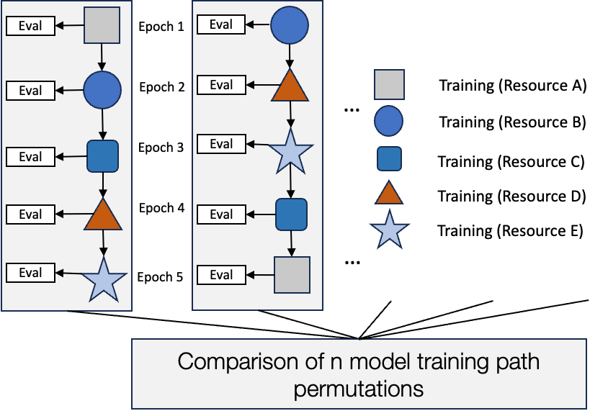
Real-life example
Run a suite of training tasks in the OSPool (supplementing with NAIRR allocations) to:
🔬 Characterize the impact of training models across heterogeneous resources
♻︎ (Translational Computer Science) Test and advance PATh Access Point capabilities to reduce the barrier of entry and support ML workloads in distributed and heterogeneous environments
Total epochs | 1,261
Total GPU hours | 19,695
Total data moved via OSDF | ~43.4 TB
Unique GPU types | 9
Unique sites | 6 (OSPool, Expanse, Delta, Bridges2, Anvil, AWS)
Unique sites, with OSPool sites breakout | 13

Slide 48

Checkpointing
Update the logic of the training script to enable loading+resuming from a checkpoint.
The job doesn’t need to run to full completion within one job lifetime. This means:
  You can run long training processes in the OSPool, a bit at a time
  Resilience against job eviction and machine issues

Slide 49
Checkpointing, required changes
train.py – add logic for loading and resuming
def main(
data_dir: Path = typer.Option("./data", "--data-dir", "-d", help="Directory containing the training data"),
checkpoint_dir: Path = typer.Option("./checkpoints", "--checkpoint-dir", "-c", help="Directory to save model checkpoints"),
epochs: int = typer.Option(10, "--epochs", "-e", help="Number of training epochs"),
checkpoint_every: int = typer.Option(5, "--checkpoint-every", "-c", help="Number of epochs between checkpoints"),
):
…
if os.path.exists(model_path):
print(f"Loading checkpoint from {model_path}")
checkpoint = torch.load(model_path)
model.load_state_dict(checkpoint['model_state_dict'])
optimizer.load_state_dict(checkpoint['optimizer_state_dict'])
start_epoch = checkpoint['epoch'] + 1
losses = checkpoint['losses']
accuracies = checkpoint['accuracies']
print(f"Resuming training from epoch {start_epoch}")
for epoch in range(start_epoch, epochs):
… # same internals as the baseline example
if (epoch+1) % checkpoint_every == 0 or (epoch+1) == epochs:
# Save checkpoint after each epoch
checkpoint = {
"epoch": epoch,
"model_state_dict": model.state_dict(),
"optimizer_state_dict": optimizer.state_dict(),
"losses": losses
}
torch.save(checkpoint, model_path)
print(f"Saving checkpoint to {model_path}. Epochs trained xx`: {epoch + 1} of {epochs}")
if epoch+1 == epochs:
sys.exit(0)
else:
sys.exit(85)
Add a command line option defining how often to save (nice addition)
Store some additional required information for resuming from a checkpoint
When to save checkpoints
The HTCondor bits:
  With submit file changes, HTCondor will detect this exit code and handle checkpoint files gracefully
See our documentation at https://portal.osg-htc.org/documentation/htc_workloads/submitting_workloads/checkpointing-on-OSPool/

Slide 50
Checkpointing, submit file changes
train.sub
train.sh
container_image = osdf:///ospool/ap40/data/iaross/catdog.sif
# see our guide on converting docker images to apptainer
checkpoint_exit_code = 85
transfer_checkpoint_files = output/model.pth
request_disk = 500MB
request_memory = 6GB
request_cpus = 1
# See guide
request_gpus = 1
gpus_minimum_capability = 7.5
gpus_minimum_memory = 4096
executable = train.sh
transfer_input_files = train.py,
osdf:///ospool/ap40/data/iaross/cat_dog/train.zip
transfer_output_files = output
output = $(CLUSTERID).out
error = $(CLUSTERID).err
log = catdog_training.log
queue
#!/bin/bash
wd=$(pwd)
mkdir data
mkdir $wd/output
unzip train.zip -d data/
rm train.zip
cd /app/
python train.py \
--data-dir $wd/data/ \
--checkpoint-dir $wd/output/ \
--epochs 20 \
--checkpoint-every 5
exit $?

Slide 51
Where to go from here?
Think about your workflow!
A world of education opportunities
  Pytorch, HuggingFace, <your software of choice> documentation
  YouTube for explanations and theory
  Blogs for examples and inspiration
  arXiv for preprints
Explore available pre-made images: Docker Hub, NGC catalog
OSPool documentation

Slide 52
Questions?
Talk to us! Don’t let computing be a barrier to your research!

