Slide 1
Backpacking with Code: Software Portability for HTC
Andrew Owen
Slides adapted from Christina Koch, Rachel Lombardi
OSG User School 2025

Slide 2
Goals For This Session
Describe what it means to make software “portable.”
Compare and contrast software portability techniques.
Choose the best portability technique for your software.
Build a portable software environment.
Follow steps to build a container
Compile code on a Linux computer

Slide 3
Introduction

Slide 4
Imagine that we asked you to go home and bake a cake...

Slide 5
An Analogy
Running software on your own computer is like cooking in your own kitchen.
Photo by jschantz on flickr, CC-BY

Slide 6
On Your Computer
You know what is there.
All the software you need is already installed.
You know where everything is (mostly).
You have full control.
You can add new programs when and where you want.

Slide 7
OSPool: Other People’s Computers

Slide 8
The Challenge
Running code on someone else’s computer is like cooking in someone else’s kitchen.
Photo by F Deventhal on Wikimedia, CC-BY

Slide 9
On Someone Else’s Computer
What’s already there?
Is R installed? Or Python? What about the packages you need?
If the software you need is installed, do you know where it is or how to access it?
Are you allowed to change whatever you want?

Slide 10
The Solution
Imagine going camping or backpacking – what do you need to do to cook anywhere?
Similarly: take your software with you to any computer.
This is what it means to make software portable.
Photo by andrew welch on Unsplash

Slide 11
Option 1: Containers

Slide 12
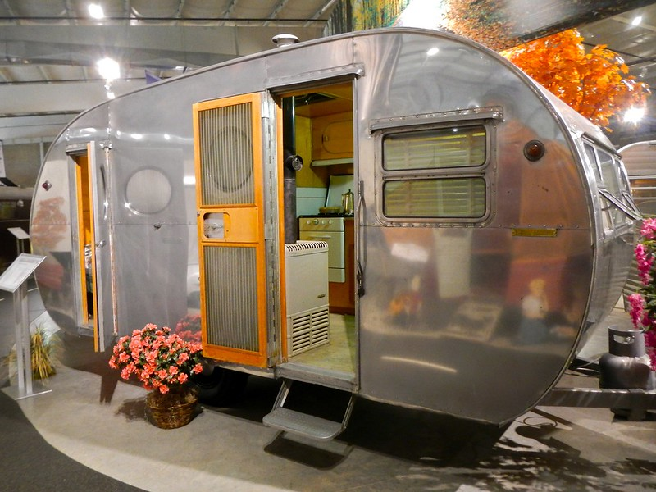
Returning to Our Analogy…
Using a container is like bringing along a whole kitchen.
Photo by PunkToad on Flickr, CC-BY

Slide 13
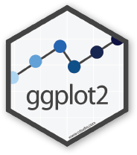
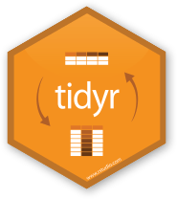
Containers
Containers are a tool for capturing an entire “environment” (software, libraries, operating system) into an “image” that can be run and used as the environment for a job
run
Credit: polaroid photos by Nick Bluth from the Noun Project
R-tidy.sif
run

Slide 14
Why Use a Container?
Containers provide
portability
user control
ease of use
and require no more technical skill than other methods of installing software!

Slide 15
Words for Containers
container = the actively running ~thing~ that can run commands
container image = is the set of files that can be used to create the container
"Launching" or "running" a container is the process of using the "container image" to create the running "container"
"Building" is the process of creating the "container image" (and often uses a pre-existing container image as the basis for the new one)

Slide 16
Technology for Containers
https://apptainer.org/
Open source software
Does not require root to install
Beginner friendly syntax
Fewer features
No distribution system
https://www.docker.com/
Modern app interface (Docker Desktop)
Widely used distribution system (DockerHub, analogous to GitHub)
Non-intuitive syntax
Requires root to install
Commercial software

Slide 17
Technology for Containers
https://apptainer.org/
For beginners and those who only want to run the container on the OSPool
https://www.docker.com/
For advanced users and those who want to deploy container to many places

Slide 18
Use Existing Containers
OSG provided: https://portal.osg-htc.org/documentation/htc_workloads/using_software/available-containers-list/
OSG user provided (just a list, no descriptions): https://github.com/opensciencegrid/cvmfs-singularity-sync/blob/master/docker_images.txt
Docker Hub: https://hub.docker.com/

Slide 19
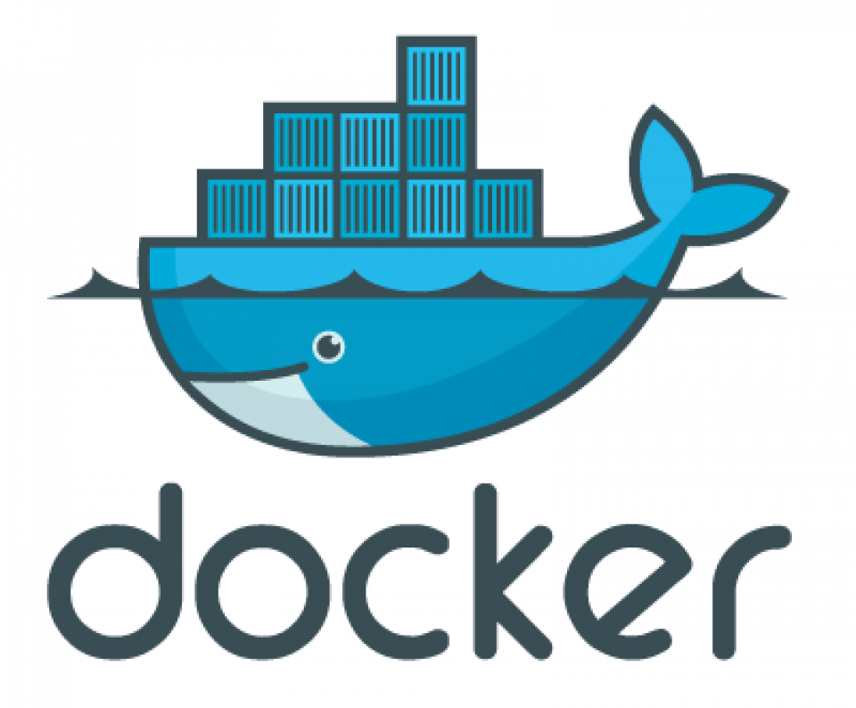
Explore Containers
Apptainer> python3 --version
Python 3.10.14
python:3.10
$ apptainer shell docker://python:3.10

Slide 20
Demo
Print Python version on Access Point
ap40$ python3 --version
Python 3.9.19
Build and run an apptainer container running Python 3.10
$ apptainer shell docker://python:3.10
Print Python version inside Apptainer container
Apptainer> python3 --version
Python 3.10.14

Slide 21
Create Apptainer Definition File
Create a file container.def with the following contents:
Bootstrap: docker From: python:3.13 %post python3 -m pip install cowsay

Slide 22
Create Apptainer Definition File
Create a file container.def with the following contents:
Bootstrap: docker From: python:3.13 %post python3 -m pip install cowsay
Tells Apptainer to use the DockerHub "python" container with the tag* of "3.13"
The following commands should be used to modify the container
Install the "cowsay" Python package
*In the case of the "python" container, the "tag" equals the version of python inside.

Slide 23
Choosing a base container
Search for your software + "container".
Most big-name softwares have official containers online
Once identified, find the container "address", usually represented in the form of a docker pull command:
docker pull user/repository:tag
Do not use the latest tag - choose an explicit one

Slide 24
What to install and where
"Common" tools/libraries/packages are rarely included in "official" containers; be sure to add what you need/want
Dynamic items (scripts, input data) should not be included in the container
Recommend that user software is installed in the /opt folder

Slide 25
Build the Container Image
Build the container image file using the provided definition file
apptainer build container.sif container.def
desired filename
definition file

Slide 26
Apptainer Build Output
Output details what Apptainer is doing:
Download the base container image
Launch the base container image
Execute the commands from the %post section
Create the new container image file
When finished, should see a message like
INFO: Build complete: container.sif

Slide 27
Test the Apptainer Image
Test the container.sif container by launching it with
apptainer shell -e container.sif
If you can get the "help" or "version" text for your desired program, should be good to go.

Slide 28
Test the Apptainer Image
Apptainer> cowsay "hello"
_____
| Hello |
=====
\
\
^__^
(oo)\_______
(__)\ )\/\
||----w |
|| ||
cowsay.sif
$ apptainer shell cowsay.sif

Slide 29
Using Containers in Jobs
For today:
container_image = cowsay.sif
...usual submit options...
That's it!

Slide 30
Using Containers in Jobs
Well… all other times:
container_image = osdf:///ospool/ap40/username/cowsay.sif
...usual submit options...
More on OSDF tomorrow!

Slide 31
Differences between local & cluster use
With HTCondor,
containers are always run as the user and never as root
But…
official containers often assume you are running as root!
When testing a container, test as the user.

Slide 32
Common issues
Building Docker on a Mac (with ARM) → Make sure to include option --platform linux/amd64
Custom command not found → Manually add install location to your PATH at start of execution
Cannot create directory at /.cache → Manually set HOME or other environment variables at start of execution
Cannot write file at /app/data, etc. → Change program to use relative path for execution, not absolute

Slide 33
Learn How to Build/ Use Containers
OSG User Documentation: https://portal.osg-htc.org/documentation/
Videos:
https://portal.osg-htc.org/documentation/support_and_training/training/materials/
https://www.youtube.com/watch?v=awSLTflAIJ8

Slide 34
Option 2: Bring Along Software Files

Slide 35
Back to the Kitchen Analogy…
A backpacking approach instead of a portable kitchen
–
Only bring the absolute minimum!
Photo by Derrick Mercer on Flickr, CC-BY-SA

Slide 36
Ways to Prepare Software Files
Download pre-compiled software files
Compile software yourself
Generate a single binary file
Create an installation with multiple binary files contained in a single folder
We always need a “compiled” file that is compatible with the version of Linux used by the execution point

Slide 37
Using Pre-Compiled Code
Some software providers have already done the hard work for you!
You just need to
Find the right file
Download and extract the file

Slide 38
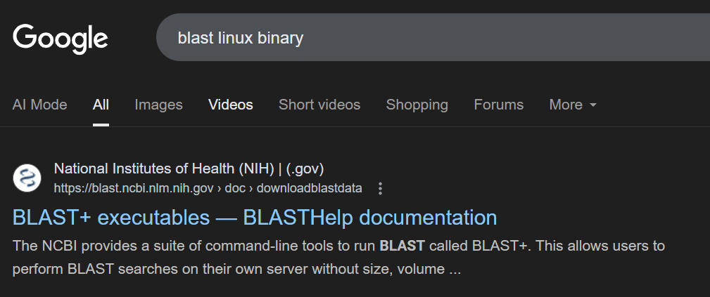
Find Pre-Compiled Code
Search for your software and "Linux binary"
Look for a .tar.gz file with keyword Linux and x86_64

Slide 39
Find Pre-Compiled Code
The exact process is different for each software!

Slide 40
Compiling from Source Code
Finding source code can be similar process
Once downloaded, usually need to extract the code
May need to clone a git repository

Slide 41
Compiling from Source Code
Source Code
Binary
compiled + dynamically linked into
compiler
and OS
libraries
uses
run on
binary code by Kiran Shastry from the Noun Project
Source Code by Mohamed Mbarki from the Noun Project
Computer by rahmat from the Noun Project
books by Viral faisalovers from the Noun Project

Slide 42
Static Linking
Source Code
Static Binary
compiled + static linked into
compiler
and OS
libraries
run anywhere
Book by Aleksandr Vector from the Noun Project

Slide 43
Compiling from Source Code
Most common: a three-step build process
./configure # or cmake # configures the build process
make # does the compilation and linking
make install # moves compiled files to specific location(s)
Installation options (like where to install) are usually set at the configure/cmake step

Slide 44
Compiling from Source Code
Advanced: Use a compiler (like gcc) directly
Can use options to control compilation process
We assume you know what you are doing!

Slide 45
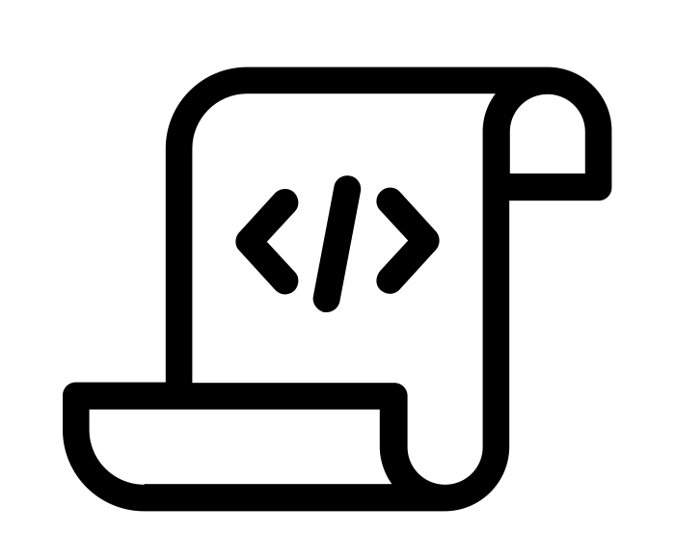
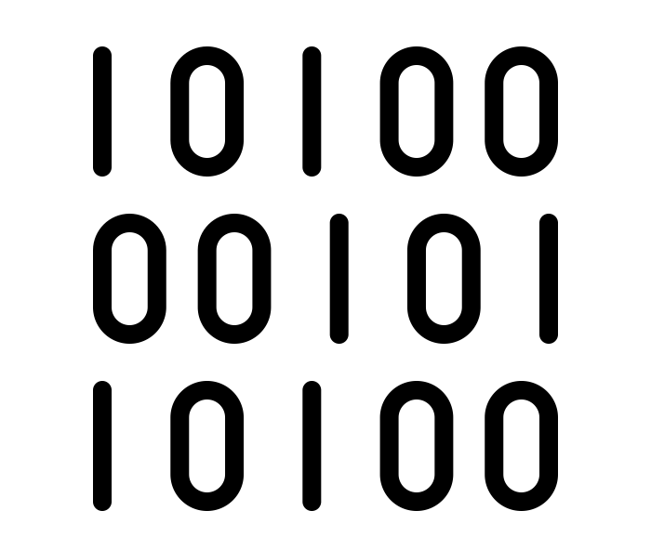
What Kind of Code?
Programs written in C, C++ and Fortran are typically compiled.
For interpreted (scripting) languages like perl, Python, R, or Julia:
Don’t compile the scripts, but *do* use a compiled copy of the underlying language interpreter.
Script
Interpreter
Binary
(binary file)

Slide 46
Using Software Files in Jobs
Executable
Wrapper Script
Software must be a single compiled binary file or single script.
Software can be in any compiled format.
executable = run_program.sh
transfer_input_files =
program.tar.gz
executable = program.exe
queue 1
#!/bin/bash
# run_program.sh
tar –xzf program.tar.gz
program/bin/run in.dat
program.exe
Notes:
do something with colors or arrows

Slide 47
Why Bring Along Software Files
No Installation Required (sometimes)
Software releases that are pre-compiled for Linux don’t need any compiling or installation!
No Docker/Apptainer Required
Not all computers in the OSPool support containers
Lightweight
Rely on the execution point's operating system for most things

Slide 48
Next Steps

Slide 49
Using Software in a HTC System
Create or find software files:
Put them in a container (or find a container that has them already)
Download them in a tar.gz or .zip file
Make a tar.gz file with code you have built
Declare necessary files, requirements in your submit file
If needed, write a wrapper script to set up the environment when the job runs.

Slide 50
Choosing a Software Method
Containers
Easy to deploy
Consistent environment
Best for complex programs
Building image can be difficult
Image file can be large
Bring-along-files
Standalone binaries Just Work™
Lightweight
Execution points have inconsistent environments
Not suitable for programs with lots of dependencies

Slide 51
Installing Software
Software installation can be hard.
Make sure to read the instructions for installing your software, especially the requirements
The last error message you see may not be the same as the first error message that caused it..
Test, test, test!

Slide 52
Work Time
Go through the introductory exercises
Then, choose an approach for *your* software and try to find or make a portable version for OSPool jobs.
Ask for help!
Additional guides are at portal.osg-htc.org/documentation

Slide 53
Acknowledgements
This work is supported by NSF under Cooperative Agreement OAC-2030508 as part of the PATh Project. Any opinions, findings, and conclusions or recommendations expressed in this material are those of the author(s) and do not necessarily reflect the views of the NSF.

Slide 54
Appendix: Container and Compiling Tips

Slide 55
Best Practices in Using Containers on OSG
Don’t use the latest tag in images
Use version number/specific names in the images
Test images with apptainer shell
Unique image name eliminates the risk of running a job using previous versions due to stashing.

Slide 56
Where to install software?
Do not use $HOME, /root or /srv
Container will run as some user we do not know yet, so $HOME is not known and will be mounted over
/root is not available to unprivileged users
/srv is used a job cwd in many cases
/opt or /usr/local are good choices

