Slide 1
Workflows with HTCondor’s DAGMan
OSG School 2024
Rachel Lombardi

Slide 2
Goals for this Session
Why create a workflow?
Describe workflows as directed acyclic graphs (DAGs)
Workflow execution via DAGMan (DAG Manager)
Stopping, resuming, troubleshooting
Node-level options in a DAG
Modular organization of DAG components

Slide 3
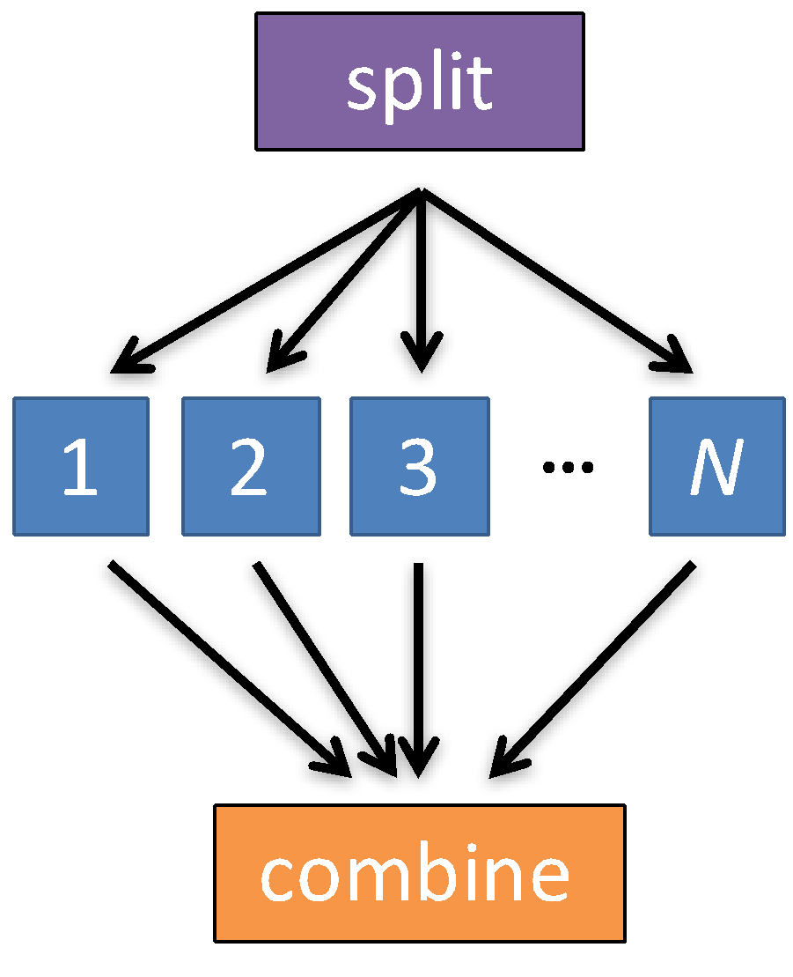
Automation!
Objective: Submit jobs in a particular order, automatically.
Especially if: Need to replicate the same workflow multiple times in the future.

Slide 4
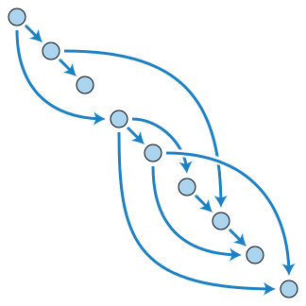
DAG = ”directed acyclic graph”
topological ordering of vertices (“nodes”) is established by directional connections (“edges”)
“acyclic” aspect requires a start and end, with no looped repetition
  can contain cyclic subcomponents, covered in later slides for DAG workflows
Wikimedia Commons
wikipedia.org/wiki/Directed_acyclic_graph

Slide 5
DESCRIBING WORKFLOWS WITH DAGMAN

Slide 6
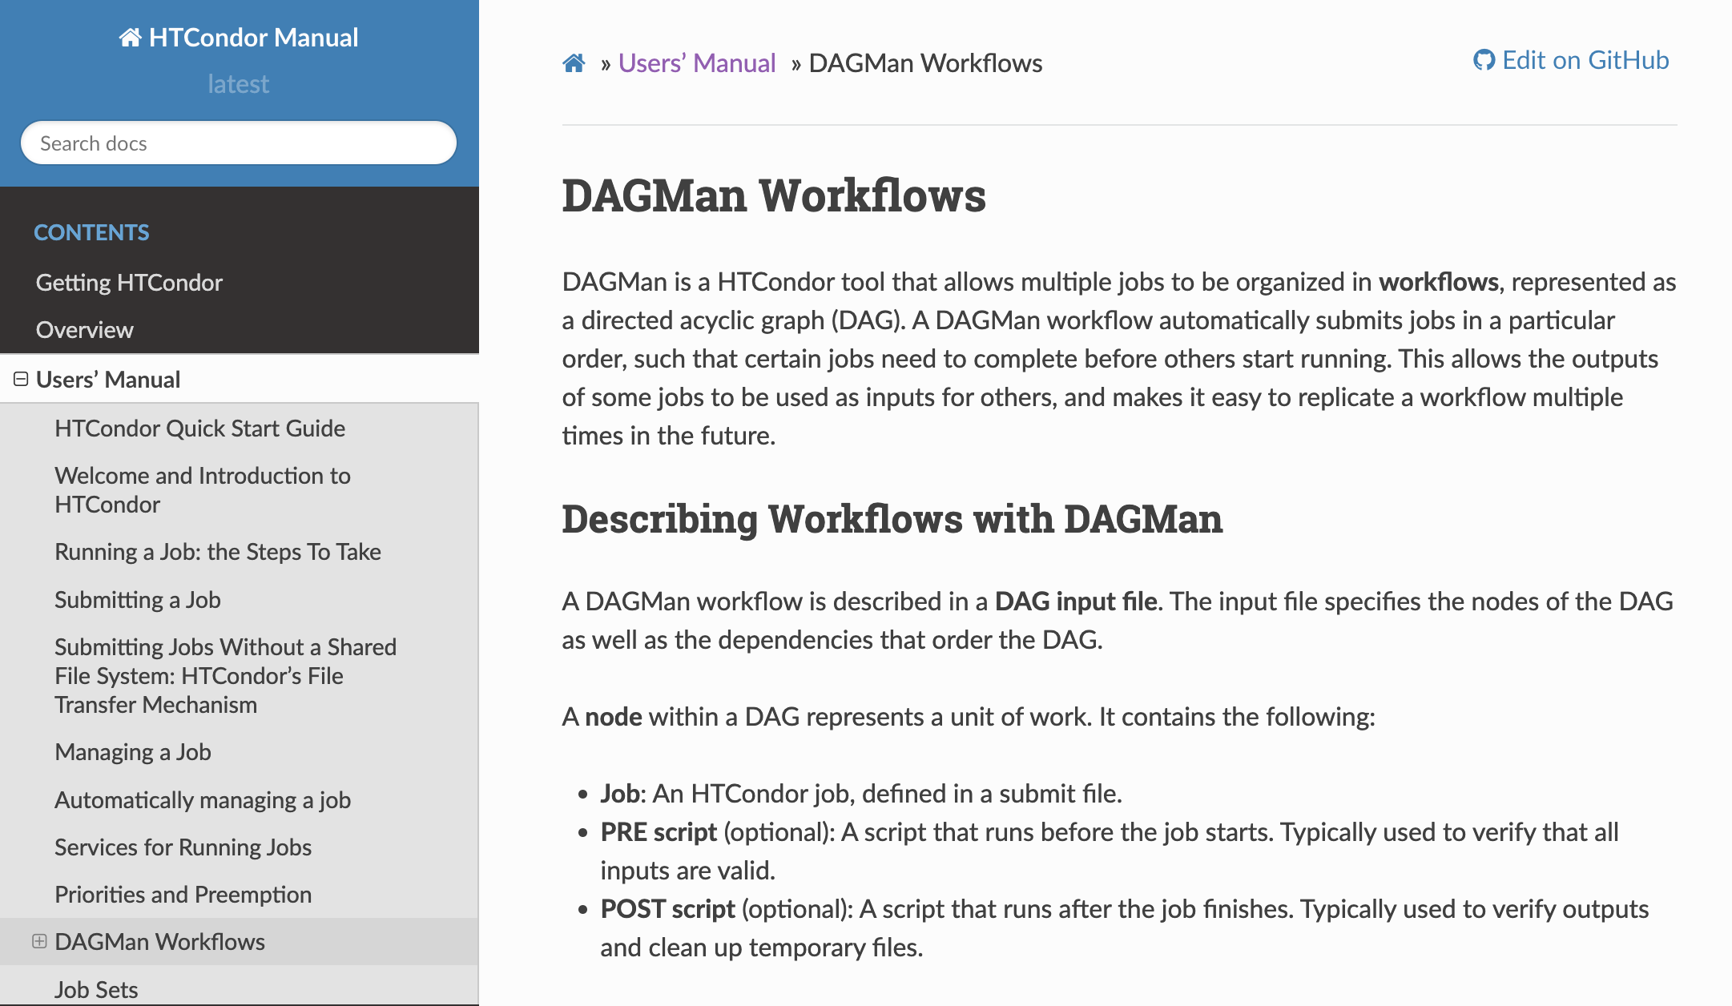
DAGMan in the HTCondor Manual
https://htcondor.readthedocs.io/en/latest/automated-workflows/index.html

Slide 7
An Example HTC Workflow
User must communicate the “nodes” and directional “edges” of the DAG

Slide 8
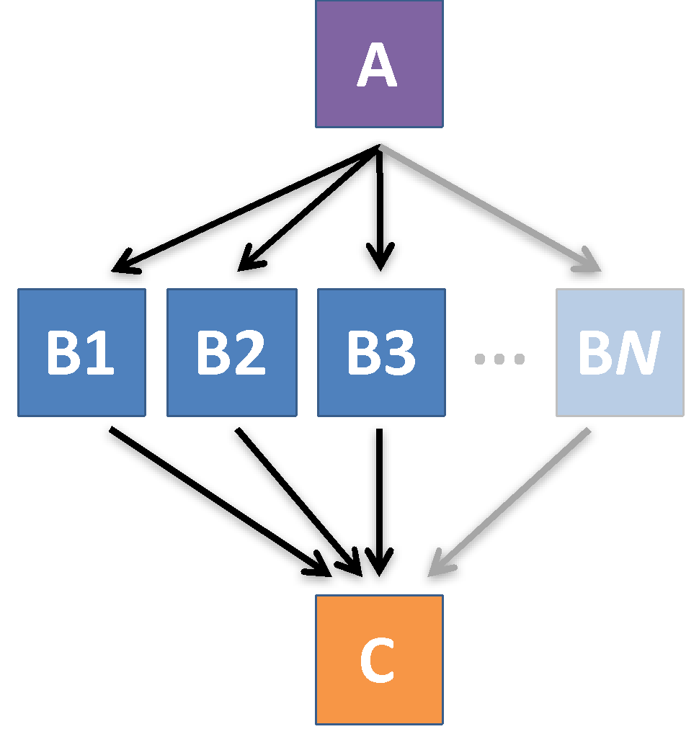
Simple Example for this Tutorial
The DAG input file will communicate the “nodes” and directional “edges” of the DAG

Slide 9
Basic DAG input file:
JOB nodes, PARENT-CHILD edges
my.dag
JOB A A.sub
JOB B1 B1.sub
JOB B2 B2.sub
JOB B3 B3.sub
JOB C C.sub
PARENT A CHILD B1 B2 B3
PARENT B1 B2 B3 CHILD C
Node names will be used by various DAG features to modify their execution by DAGMan.

Slide 10
Basic DAG input file:
JOB nodes, PARENT-CHILD edges
my.dag
(dag_dir)/
JOB A A.sub
JOB B1 B1.sub
JOB B2 B2.sub
JOB B3 B3.sub
JOB C C.sub
PARENT A CHILD B1 B2 B3
PARENT B1 B2 B3 CHILD C
A.sub B1.sub
B2.sub B3.sub
C.sub my.dag
(other job files)
Node names and filenames are your choice.
Node name and submit filename do not have to match.

Slide 11
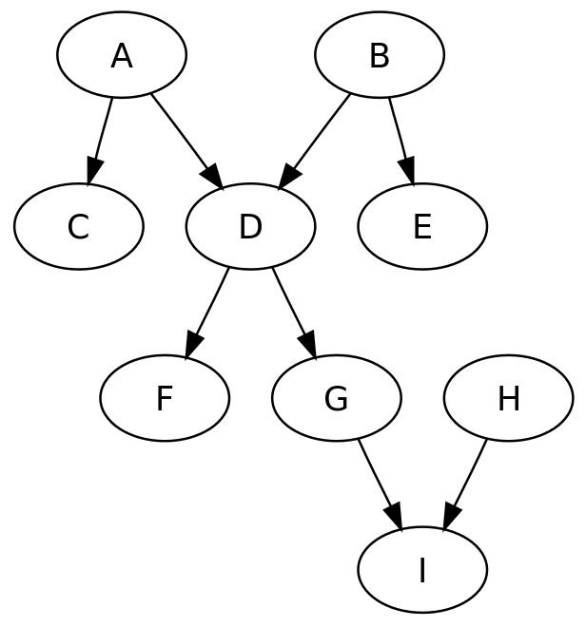
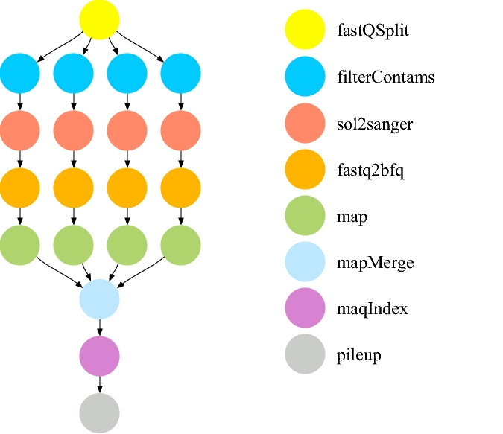
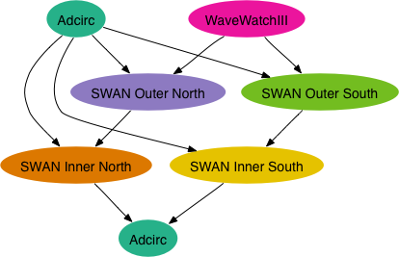
Endless Workflow Possibilities
Wikimedia Commons
https://confluence.pegasus.isi.edu/display/pegasus/WorkflowGenerator

Slide 12
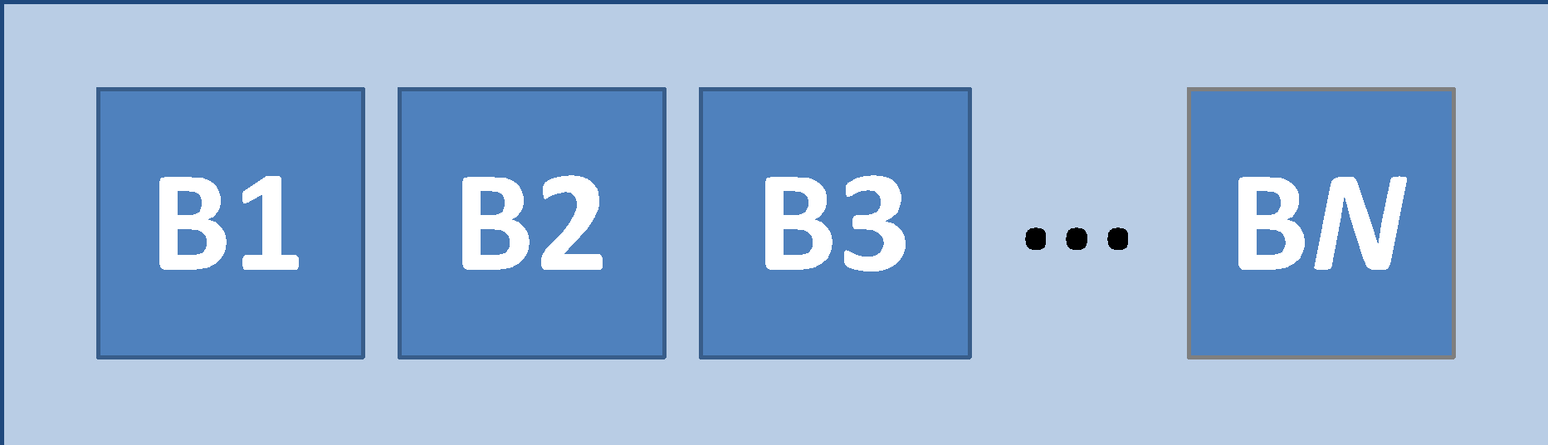
DAGs are also useful for non-sequential work
‘bag’ of HTC jobs
disjointed workflows

Slide 13
Basic DAG input file:
JOB nodes, PARENT-CHILD edges
my.dag
JOB A A.sub
JOB B1 B1.sub
JOB B2 B2.sub
JOB B3 B3.sub
JOB C C.sub
PARENT A CHILD B1 B2 B3
PARENT B1 B2 B3 CHILD C

Slide 14
SUBMITTING AND MONITORING A DAGMAN WORKFLOW

Slide 15
Submitting a DAG to the queue
Submission command:
  condor_submit_dag dag_file
$ condor_submit_dag my.dag
------------------------------------------------------------------
File for submitting this DAG to HTCondor : mydag.dag.condor.sub
Log of DAGMan debugging messages : mydag.dag.dagman.out
Log of HTCondor library output : mydag.dag.lib.out
Log of HTCondor library error messages : mydag.dag.lib.err
Log of the life of condor_dagman itself : mydag.dag.dagman.log
Submitting job(s).
1 job(s) submitted to cluster 128.
------------------------------------------------------------------

Slide 16
A submitted DAG creates a
DAGMan job in the queue
DAGMan runs on the access point, as a job in the queue
At first:
$ condor_q
-- Schedd: submit-3.chtc.wisc.edu : <128.104.100.44:9618?... OWNER BATCH_NAME SUBMITTED DONE RUN IDLE TOTAL JOB_IDS
alice my.dag+128 4/30 18:08 _ _ _ _ 0.0
1 jobs; 0 completed, 0 removed, 0 idle, 1 running, 0 held, 0 suspended
$ condor_q -nobatch
-- Schedd: submit-3.chtc.wisc.edu : <128.104.100.44:9618?...
ID OWNER SUBMITTED RUN_TIME ST PRI SIZE CMD
128.0 alice 4/30 18:08 0+00:00:06 R 0 0.3 condor_dagman
1 jobs; 0 completed, 0 removed, 0 idle, 1 running, 0 held, 0 suspended

Slide 17
Jobs are automatically submitted by the DAGMan job
Seconds later, node A is submitted:
$ condor_q
-- Schedd: submit-3.chtc.wisc.edu : <128.104.100.44:9618?... OWNER BATCH_NAME SUBMITTED DONE RUN IDLE TOTAL JOB_IDS
alice my.dag+128 4/30 18:08 _ _ 1 5 129.0
2 jobs; 0 completed, 0 removed, 1 idle, 1 running, 0 held, 0 suspended
$ condor_q -nobatch
-- Schedd: submit-3.chtc.wisc.edu : <128.104.100.44:9618?...
ID OWNER SUBMITTED RUN_TIME ST PRI SIZE CMD
128.0 alice 4/30 18:08 0+00:00:36 R 0 0.3 condor_dagman
129.0 alice 4/30 18:08 0+00:00:00 I 0 0.3 A_split.sh
2 jobs; 0 completed, 0 removed, 1 idle, 1 running, 0 held, 0 suspended

Slide 18
Jobs are automatically submitted by the DAGMan job
After A completes, B1-3 are submitted
$ condor_q
-- Schedd: submit-3.chtc.wisc.edu : <128.104.100.44:9618?... OWNER BATCH_NAME SUBMITTED DONE RUN IDLE TOTAL JOB_IDS
alice my.dag+128 4/30 18:08 1 _ 3 5 130.0...132.0
4 jobs; 0 completed, 0 removed, 3 idle, 1 running, 0 held, 0 suspended
$ condor_q -nobatch
-- Schedd: submit-3.chtc.wisc.edu : <128.104.100.44:9618?...
ID OWNER SUBMITTED RUN_TIME ST PRI SIZE CMD
128.0 alice 4/30 18:08 0+00:20:36 R 0 0.3 condor_dagman
130.0 alice 4/30 18:18 0+00:00:00 I 0 0.3 B_run.sh
131.0 alice 4/30 18:18 0+00:00:00 I 0 0.3 B_run.sh
132.0 alice 4/30 18:18 0+00:00:00 I 0 0.3 B_run.sh
4 jobs; 0 completed, 0 removed, 3 idle, 1 running, 0 held, 0 suspended

Slide 19
Jobs are automatically submitted by the DAGMan job
After B1-3 complete, node C is submitted
$ condor_q
-- Schedd: submit-3.chtc.wisc.edu : <128.104.100.44:9618?... OWNER BATCH_NAME SUBMITTED DONE RUN IDLE TOTAL JOB_IDS
alice my.dag+128 4/30 18:08 4 _ 1 5 133.0
2 jobs; 0 completed, 0 removed, 1 idle, 1 running, 0 held, 0 suspended
$ condor_q -nobatch
-- Schedd: submit-3.chtc.wisc.edu : <128.104.100.44:9618?...
ID OWNER SUBMITTED RUN_TIME ST PRI SIZE CMD
128.0 alice 4/30 18:08 0+00:46:36 R 0 0.3 condor_dagman
133.0 alice 4/30 18:54 0+00:00:00 I 0 0.3 C_combine.sh
2 jobs; 0 completed, 0 removed, 1 idle, 1 running, 0 held, 0 suspended

Slide 20
Status files are created at the time of DAG submission
(dag_dir)/
A.sub B1.sub B2.sub
B3.sub C.sub (other job files)
my.dag my.dag.condor.sub my.dag.dagman.log
my.dag.dagman.out my.dag.lib.err my.dag.lib.out
my.dag.nodes.log
*.condor.sub and *.dagman.log describe the queued DAGMan job process, as for any other jobs
*.dagman.out has DAGMan-specific logging (look to first for errors)
*.lib.err/out contain std err/out for the DAGMan job process
*.nodes.log is a combined log of all jobs within the DAG

Slide 21
DAG Completion
(dag_dir)/
A.sub B1.sub B2.sub
B3.sub C.sub (other job files)
my.dag my.dag.condor.sub my.dag.dagman.log
my.dag.dagman.out my.dag.lib.err my.dag.lib.out
my.dag.nodes.log my.dag.dagman.metrics
*.dagman.metrics is a summary of events and outcomes
*.dagman.log will note the completion of the DAGMan job
*.dagman.out has detailed logging (look to first for errors)

Slide 22
STOPPING, RESTARTING, AND TROUBLESHOOTING
,

Slide 23
Removing a DAG from the queue
Remove the DAGMan job in order to stop and remove the entire DAG:
  condor_rm dagman_jobID
Creates a rescue file so that only incomplete or unsuccessful NODES are repeated upon resubmission
$ condor_q
-- Schedd: submit-3.chtc.wisc.edu : <128.104.100.44:9618?... OWNER BATCH_NAME SUBMITTED DONE RUN IDLE TOTAL JOB_IDS
alice my.dag+128 4/30 8:08 4 _ 1 6 129.0...133.0
2 jobs; 0 completed, 0 removed, 1 idle, 1 running, 0 held, 0 suspended
$ condor_rm 128
All jobs in cluster 128 have been marked for removal

Slide 24
Removal of a DAG creates a rescue file
(dag_dir)/
A.sub B1.sub B2.sub B3.sub C.sub (other job files)
my.dag my.dag.condor.sub my.dag.dagman.log
my.dag.dagman.out my.dag.lib.err my.dag.lib.out
my.dag.metrics my.dag.nodes.log my.dag.rescue001
  Named dag_file.rescue001
    increments if more rescue DAG files are created
  Records which NODES have completed successfully
    does not contain the actual DAG structure

Slide 25
Rescue Files
For Resuming a Failed DAG
A rescue file is created when:
  a node fails, and after DAGMan advances through any other possible nodes
  the DAG is removed from the queue (or aborted, see manual)
  the DAG is halted and not unhalted (see manual)
Resubmission uses the rescue file (if it exists) when the original DAG file is resubmitted
  override: condor_submit_dag dag_file -f

Slide 26
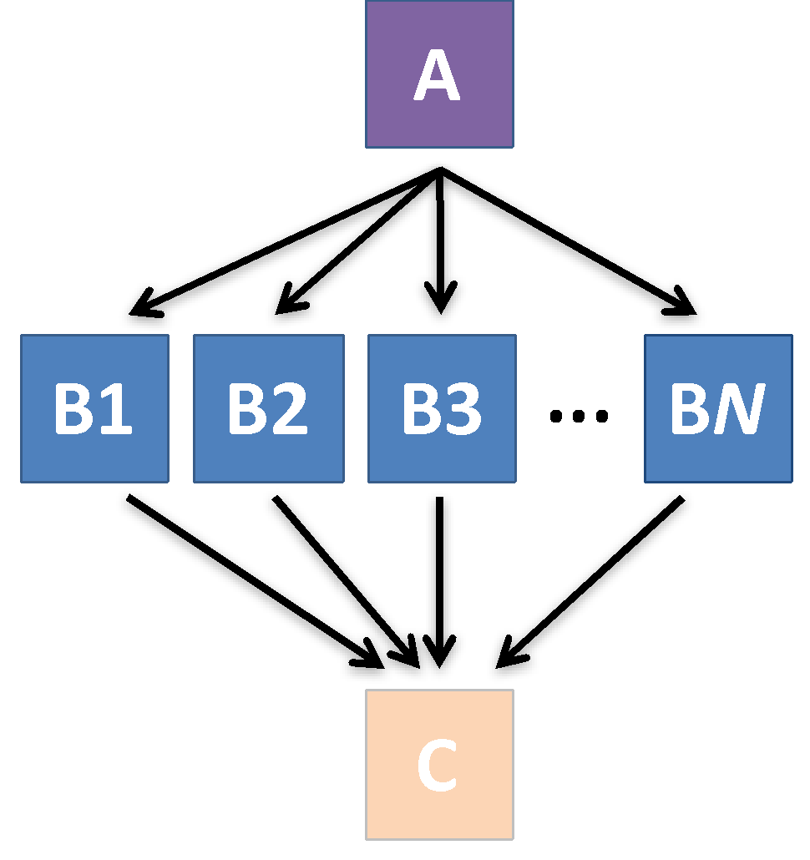
Node Failures
Result in DAG Failure
If a node JOB fails (non-zero exit code)
  DAGMan continues to run other JOB nodes until it can no longer make progress
Example at right:
  B2 fails
  Other B* jobs continue
  DAG fails and exits after B* and before node C

Slide 27
Best Workflow Control Achieved with One Process per JOB Node
While submit files can ‘queue’ many processes, a single job process per submit file is usually best for DAG JOBs
  Failure of any queued process in a JOB node results in failure of the entire node and immediate removal of all other processes in the node.
  RETRY of a JOB node retries the entire submit file.

Slide 28
Resolving held node jobs
$ condor_q -nobatch
-- Schedd: submit-3.chtc.wisc.edu : <128.104.100.44:9618?...
ID OWNER SUBMITTED RUN_TIME ST PRI SIZE CMD
128.0 alice 4/30 18:08 0+00:20:36 R 0 0.3 condor_dagman
130.0 alice 4/30 18:18 0+00:00:00 H 0 0.3 B_run.sh
131.0 alice 4/30 18:18 0+00:00:00 H 0 0.3 B_run.sh
132.0 alice 4/30 18:18 0+00:00:00 H 0 0.3 B_run.sh
4 jobs; 0 completed, 0 removed, 0 idle, 1 running, 3 held, 0 suspended
Look at the hold reason (in the job log, or with ‘condor_q -hold’)
Fix the issue and release the jobs (condor_release) -OR- remove the entire DAG, resolve, then resubmit the DAG (remember the automatic rescue DAG file!)

Slide 29
BEYOND THE BASIC DAG:
NODE-LEVEL MODIFIERS

Slide 30
Default File Organization
my.dag
(dag_dir)/
JOB A A.sub
JOB B1 B1.sub
JOB B2 B2.sub
JOB B3 B3.sub
JOB C C.sub
PARENT A CHILD B1 B2 B3
PARENT B1 B2 B3 CHILD C
A.sub B1.sub
B2.sub B3.sub
C.sub my.dag
(other job files)
What if you want to organize files into other directories?

Slide 31
Node-specific File Organization with DIR
DIR sets the submission directory of the node
my.dag
(dag_dir)/
JOB A A.sub DIR A
JOB B1 B1.sub DIR B
JOB B2 B2.sub DIR B
JOB B3 B3.sub DIR B
JOB C C.sub DIR C
PARENT A CHILD B1 B2 B3
PARENT B1 B2 B3 CHILD C
my.dag
A/ A.sub (A job files)
B/ B1.sub B2.sub
B3.sub (B job files)
C/ C.sub (C job files)

Slide 32
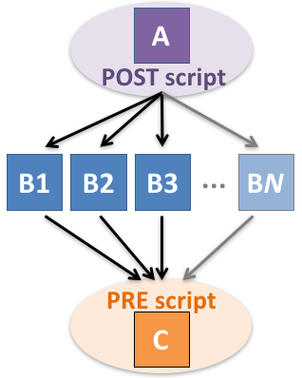
PRE and POST scripts run on the access point, as part of the node
my.dag
JOB A A.sub
SCRIPT POST A sort.sh
JOB B1 B1.sub
JOB B2 B2.sub
JOB B3 B3.sub
JOB C C.sub
SCRIPT PRE C tar_it.sh
PARENT A CHILD B1 B2 B3
PARENT B1 B2 B3 CHILD C
Use sparingly for lightweight work; otherwise include work in node jobs

Slide 33
RETRY failed nodes to overcome transient errors
Retry a node up to N times if the exit code is non-zero:
RETRY node_name N
Note: Unnecessary for nodes (jobs) that can use max_retries in the submit file
See also: retry except for a particular exit code (UNLESS-EXIT), or retry scripts (DEFER)
JOB A A.sub
RETRY A 5
JOB B B.sub
PARENT A CHILD B
Example:

Slide 34
RETRY applies to whole node, including PRE/POST scripts
PRE and POST scripts are included in retries
RETRY of a node with a POST script uses the exit code from the POST script (not from the job)
  POST script can do more to determine node success, perhaps by examining JOB output
Achieve repetitive iterations!
Example:
JOB A A.sub
SCRIPT POST A checkA.sh
RETRY A 5

Slide 35
MODULAR ORGANIZATION OF DAG COMPONENTS

Slide 36
Submit File Templates via VARS
VARS line defines node-specific values that are passed into submit file variables
VARS node_name var1=“value” [var2=“value”]
Allows a single submit file shared by all B jobs, rather than one submit file for each JOB.
my.dag
B.sub
JOB B1 B.sub
VARS B1 data=”B1” opt=“10”
JOB B2 B.sub
VARS B2 data=“B2” opt=“12”
JOB B3 B.sub
VARS B3 data=“B3” opt=“14”
…
InitialDir = $(data)
arguments = $(data).csv $(opt)
…
queue

Slide 37
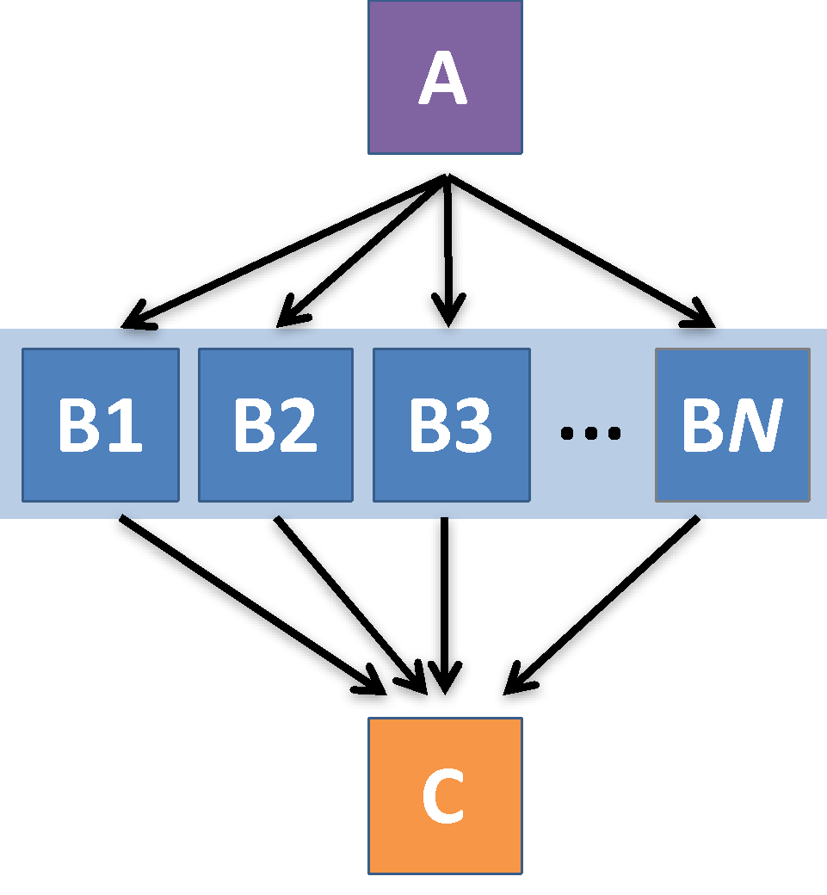
SPLICE subsets of a DAG to simplify lengthy DAG files
my.dag
JOB A A.sub
SPLICE B B.spl
JOB C C.sub
PARENT A CHILD B
PARENT B CHILD C
B.spl
JOB B1 B1.sub
JOB B2 B2.sub
…
JOB BN BN.sub

Slide 38
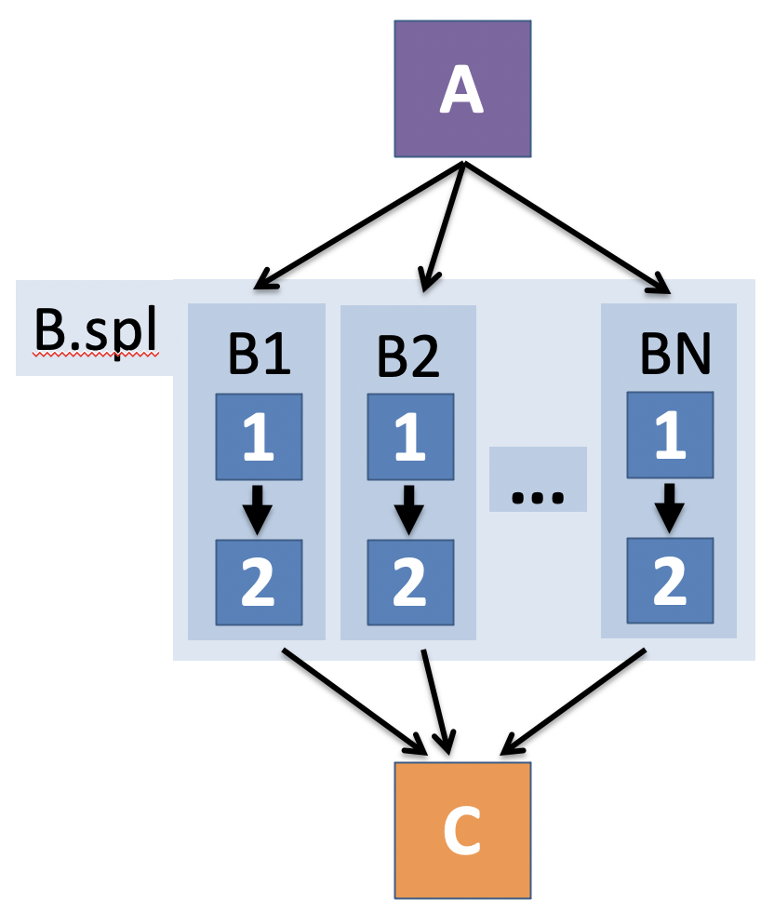
Use nested SPLICEs with DIR to achieve templating
my.dag
JOB A A.sub DIR A
SPLICE B B.spl DIR B
JOB C C.sub DIR C
PARENT A CHILD B
PARENT B CHILD C
B.spl
SPLICE B1 ../inner.spl DIR B1
SPLICE B2 ../inner.spl DIR B2
…
SPLICE BN ../inner.spl DIR BN
inner.spl
JOB 1 ../1.sub
JOB 2 ../2.sub
PARENT 1 CHILD 2

Slide 39
Use nested SPLICEs with DIR to achieve templating
my.dag
JOB A A.sub DIR A
SPLICE B B.spl DIR B
JOB C C.sub DIR C
PARENT A CHILD B
PARENT B CHILD C
(dag_dir)/
my.dag
A/ A.sub (A job files)
B/ B.spl inner.spl
1.sub 2.sub
B1/ (1-2 job files)
B2/ (1-2 job files)
…
BN/ (1-2 job files)
C/ C.sub (C job files)
B.spl
SPLICE B1 ../inner.spl DIR B1
SPLICE B2 ../inner.spl DIR B2
…
SPLICE BN ../inner.spl DIR BN
inner.spl
JOB 1 ../1.sub
JOB 2 ../2.sub
PARENT 1 CHILD 2

Slide 40
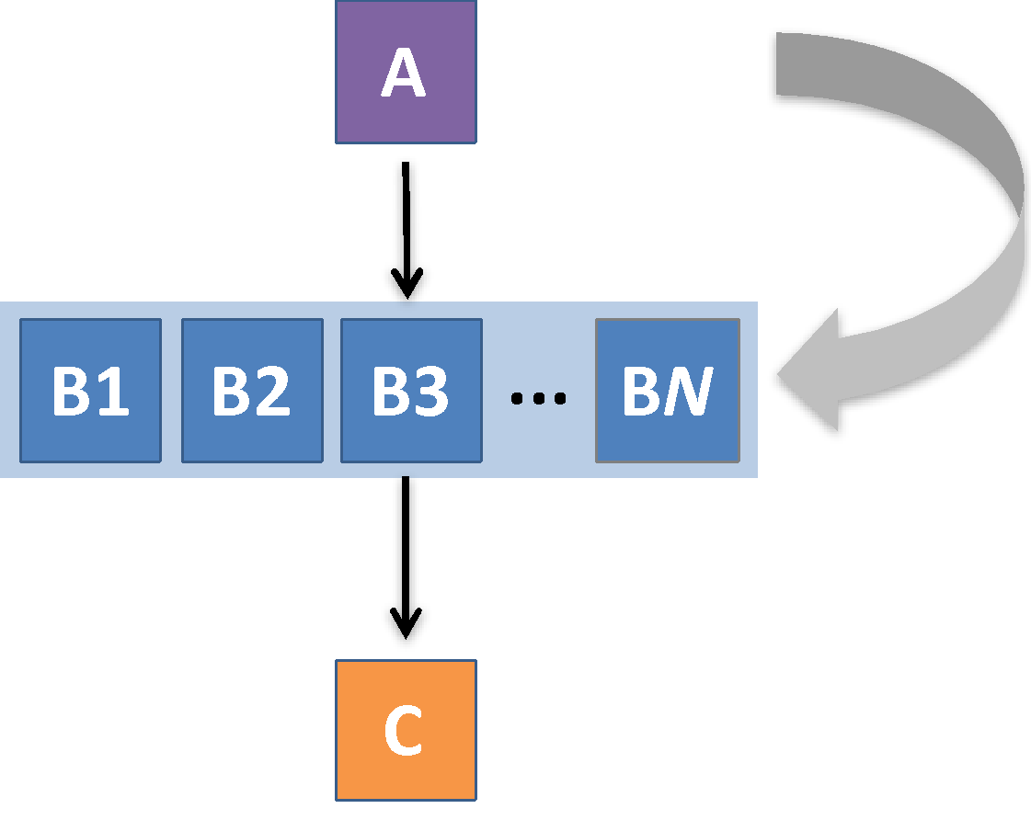
What if some DAG components can’t be known at submit time?
If N can only be determined as part of the work of A …

Slide 41
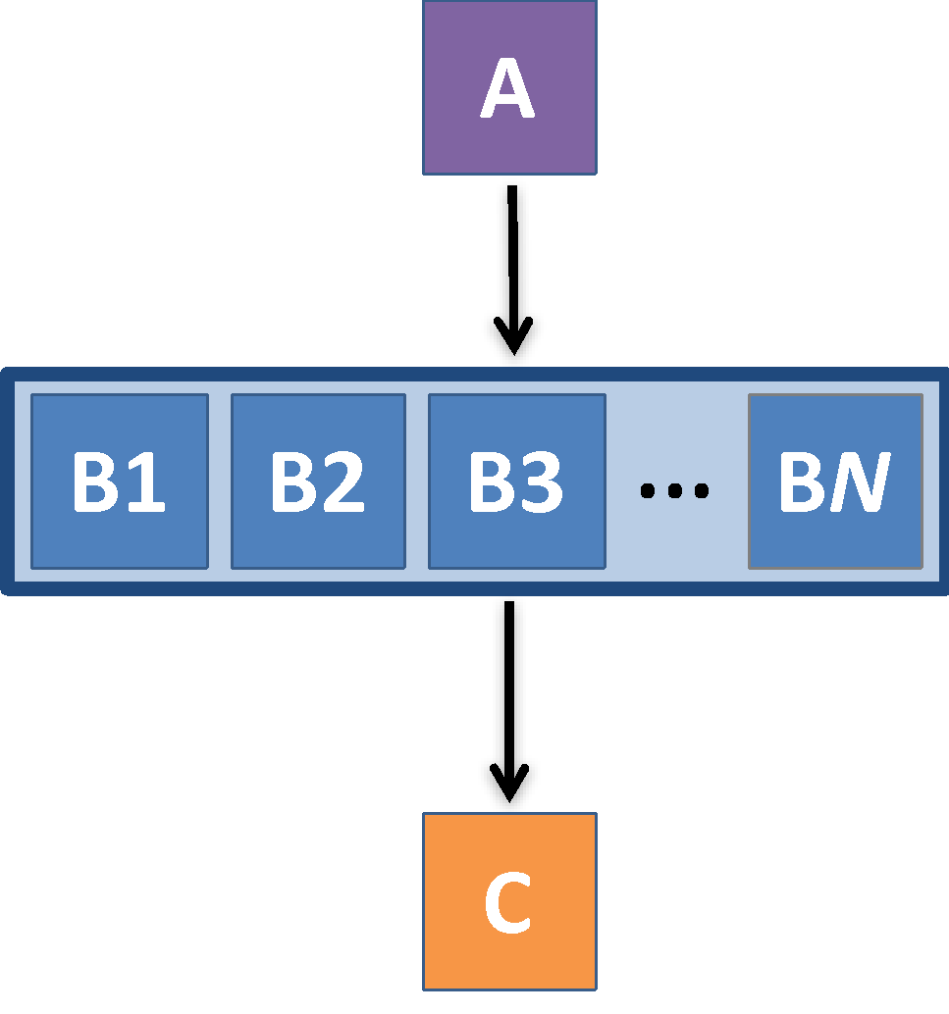
A SUBDAG within a DAG
my.dag
JOB A A.sub
SUBDAG EXTERNAL B B.dag
JOB C C.sub
PARENT A CHILD B
PARENT B CHILD C
B.dag (written by A)
JOB B1 B1.sub
JOB B2 B2.sub
…
JOB BN BN.sub

Slide 42
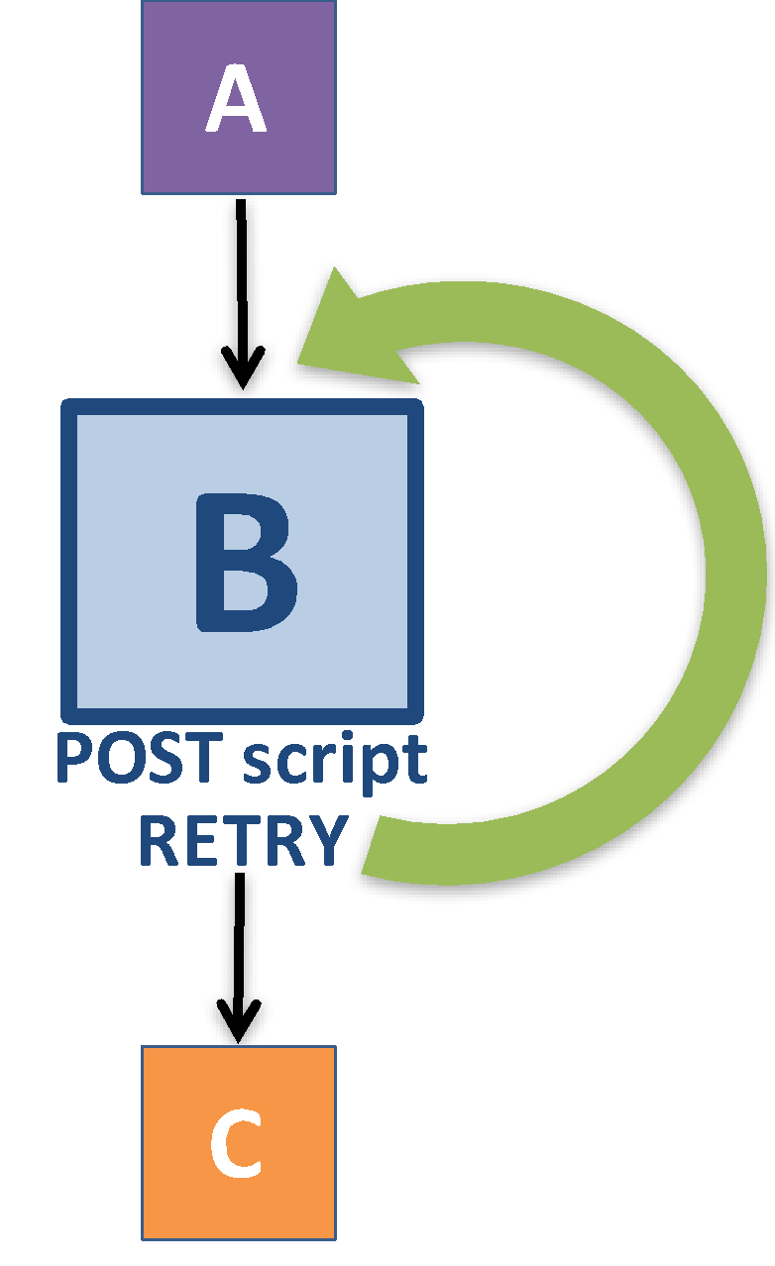
Use a SUBDAG to achieve a Cyclic Component within a DAG
POST script determines whether another iteration is necessary; if so, exits non-zero
RETRY applies to entire SUBDAG, which may include multiple, sequential nodes
my.dag
JOB A A.sub
SUBDAG EXTERNAL B B.dag
SCRIPT POST B iterateB.sh
RETRY B 1000
JOB C C.sub
PARENT A CHILD B
PARENT B CHILD C

Slide 43
More in the HTCondor Manual!!!

Slide 44
DAGMan Exercises!
Essential: Exercises 1-4
Ask questions! ‘See you in Slack!

