Slide 1
Backpacking with Code: Software Portability for DHTC
Rachel Lombardi
Slides adapted from Christina Koch
OSG User School 2024

Slide 2
Goals For This Session
Describe what it means to make software “portable.”
Compare and contrast software portability techniques.
Choose the best portability technique for your software.
Build a portable software environment.
Follow steps to build a container
Compile code on a Linux computer

Slide 3
Introduction

Slide 4
Imagine that we asked you to go home and bake a cake...

Slide 5
An Analogy
Running software on your own computer is like cooking in your own kitchen.
Photo by jschantz on flickr, CC-BY

Slide 6
On Your Computer
You know what is there.
All the software you need is already installed.
You know where everything is (mostly).
You have full control.
You can add new programs when and where you want.

Slide 7
OSPool: Other People’s Computers

Slide 8
The Challenge
Running code on someone else’s computer is like cooking in someone else’s kitchen.
Photo by F Deventhal on Wikimedia, CC-BY

Slide 9
On Someone Else’s Computer
What’s already there?
Is R installed? Or Python? What about the packages you need?
If the software you need is installed, do you know where it is or how to access it?
Are you allowed to change whatever you want?

Slide 10
The Solution
Imagine going camping or backpacking – what do you need to do to cook anywhere?
Similarly: take your software with you to any computer.
This is called making software portable.
Photo by andrew welch on Unsplash

Slide 11
Option 1: Containers

Slide 12
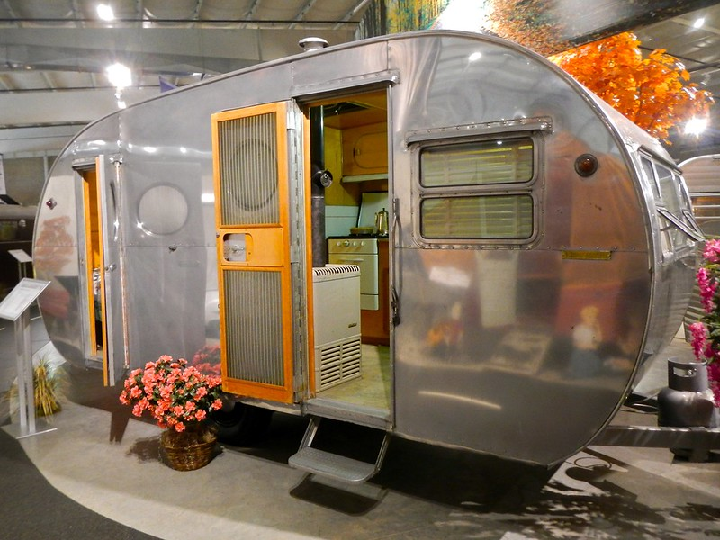
Returning to Our Analogy…
Using a container is like bringing along a whole kitchen.
Photo by PunkToad on Flickr, CC-BY

Slide 13
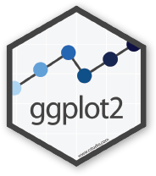
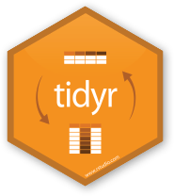
Containers
Containers are a tool for capturing an entire “environment” (software, libraries, operating system) into an “image” that can be run and used as the environment for a job
run
R-tidy.sif
run
Credit: polaroid photos by Nick Bluth from the Noun Project

Slide 14
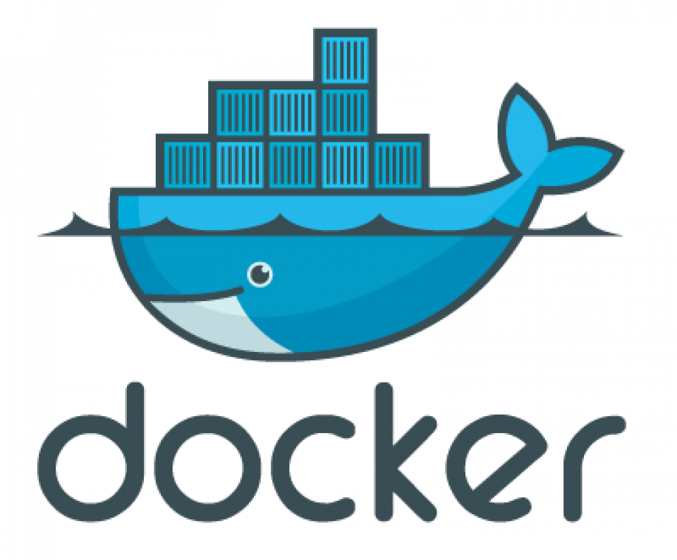
Container Technologies
Singularity/Apptainer containers are more commonly supported on research computing systems. Apptainer is a fork of Singularity - we use the two names/products interchangeably on OSG services.
Container system not used on most research computing systems, but has a huge catalog of existing containers.

Slide 15
Container Technologies
Container system =
Container image format
Container "engine" for running
Image Format
Always Linux-based
Docker images can be converted to Apptainer images
"Engine" capabilities
Apptainer "engine" can run both Docker + Apptainer images
Docker "engine" installs on Linux, Mac, Windows, meaning Docker containers can be run on any operating systems

Slide 16
Use Existing Containers
OSG provided: https://portal.osg-htc.org/documentation/htc_workloads/using_software/available-containers-list/
OSG user provided (just a list, no descriptions): https://github.com/opensciencegrid/cvmfs-singularity-sync/blob/master/docker_images.txt
Docker Hub: https://hub.docker.com/

Slide 17
Explore Containers
Apptainer> python3 --version
Python 3.10.14
python:3.10
$ apptainer shell docker://python:3.10

Slide 18
Demo
Print Python version on Access Point
ap40$ python3 --version
Python 3.9.19
Build and run an apptainer container running Python 3.10
$ apptainer shell docker://python:3.10
Print Python version inside Apptainer container
Apptainer> python3 --version
Python 3.10.14

Slide 19
Build Your Own Container
Definition File (cowsay.def)
Image File (cowsay.sif)
Bootstrap: docker
From: ubuntu:20.04
%post
pip install cowsay
cowsay.sif
$ apptainer build cowsay.sif cowsay.def

Slide 20
Explore Containers, Part 2
Singularity :~> cowsay “hello”
_____
| Hello |
=====
\
\
^__^
(oo)\_______
(__)\ )\/\
||----w |
|| ||
cowsay.sif
$ apptainer shell cowsay.sif

Slide 21
Definition File Details
Bootstrap: docker
From: ubuntu:20.04
%files
install.R
%post
apt install r-base
Rscript install.R
%environment
RHOME=/opt/R
What type of container to start with, and what is its name/where is it?
Copy in any files that are needed for installing software or running the container
Use installation tools or shell commands to install desired software or packages
Add environment variables to be used when the container is run.

Slide 22
Using Containers in Jobs
# For right now/testing
container_image = cowsay.sif
# Later this week
+SingularityImage = “osdf:///ospool/<apNN>/data/<USER>/my-container-v1.sif”

Slide 23
Why Use Containers
Consistent and complete
Always the same software environment, with everything included
Good for sharing software among groups!
Handles complexity, is customizable
As an “administrator” can control exactly what goes into the container and use built-in Linux installation tools
Cross-platform
Can run (Docker) containers on Linux, Windows, Mac
Easy to re-create (if you use Dockerfiles/definition files)

Slide 24
Learn How to Build/ Use Containers
OSG User Documentation: https://portal.osg-htc.org/documentation/
Videos:
https://www.youtube.com/watch?v=8fi7uSYlOdc
https://portal.osg-htc.org/documentation/support_and_training/training/osgusertraining/

Slide 25
Option 2: Bring Along Software Files

Slide 26
Back to the Kitchen Analogy…
A more flexible, but sometimes more challenging approach to software portability is to bring along a set of software files. This is more like taking a backpacking approach to a portable kitchen – just bringing the essentials in a bag.
Photo by Derrick Mercer on Flickr, CC-BY-SA

Slide 27
Ways to Prepare Software Files
Download pre-compiled software files
Compile software yourself
Generate a single binary file
Create an installation with multiple binary files contained in a single folder
We always need a “compiled” file of some kind, that is compatible with the version of Linux that is most common on the OSPool (Red Hat aka CentOS, Rocky, Alma)

Slide 28
What is Compilation?
Source Code
Binary
compiled + linked into
compiler
and OS
libraries
uses
run on
binary code by Kiran Shastry from the Noun Project
Source Code by Mohamed Mbarki from the Noun Project
Computer by rahmat from the Noun Project
books by Viral faisalovers from the Noun Project

Slide 29
What is Compilation?
Source Code
Binary
compiled + linked into
compiler
and OS
libraries
uses
run on
binary code by Kiran Shastry from the Noun Project
Source Code by Mohamed Mbarki from the Noun Project
Computer by rahmat from the Noun Project
books by Viral faisalovers from the Noun Project

Slide 30
Find Existing Software Files

Slide 31
Download Source and Compile

Slide 32
Compiling Code
Use a compiler (like gcc) directly
Can use options to control compilation process
More common – a three-step build process:
./configure # or cmake # configures the build process
make # does the compilation and linking
make install # moves compiled files to specific location(s)
Installation options (like where to install) are usually set at the configure/cmake step

Slide 33
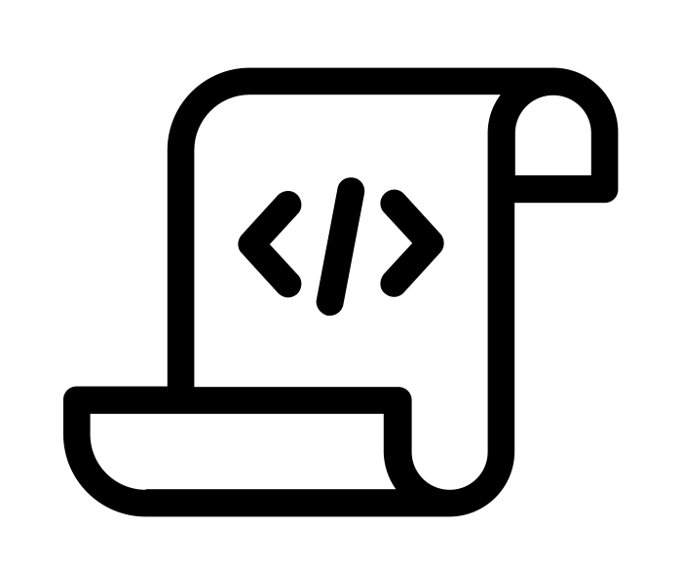
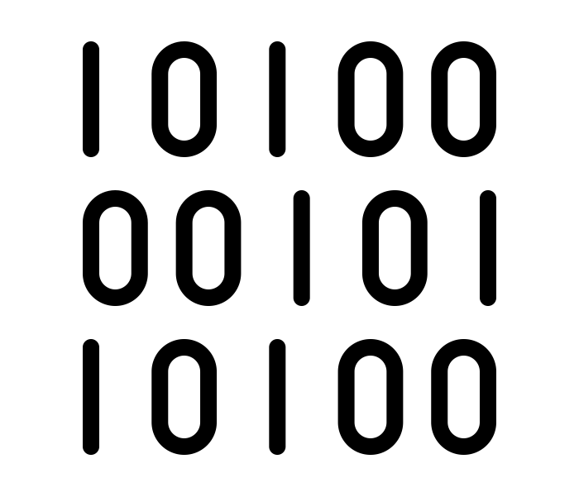
What Kind of Code?
Programs written in C, C++ and Fortran are typically compiled.
For interpreted (scripting) languages like perl, Python, R, or Julia:
Don’t compile the scripts, but *do* use a compiled copy of the underlying language interpreter.
Script
Interpreter
Binary
(binary file)

Slide 34
Using Software Files in Jobs
Executable
Wrapper Script
Software must be a single compiled binary file or single script.
Software can be in any compiled format.
executable = run_program.sh
transfer_input_files =
program.tar.gz
executable = program.exe
queue 1
#!/bin/bash
# run_program.sh
tar –xzf program.tar.gz
program/bin/run in.dat
program.exe
Notes:
do something with colors or arrows

Slide 35
Why Bring Along Software Files
No Installation Required (sometimes)
Software releases that are pre-compiled for Linux don’t need any compiling or installation!
No Docker/Apptainer Required
Not all computers in the OSPool support containers
Use Familiar Environments
This approach can work with conda environments

Slide 36
Next Steps

Slide 37
Using Software in a DHTC System
Create/find software files:
Put them in a container (or find a container that has them already)
Download them in a tar.gz or .zip file
Make a tar.gz file with code you have built
Account for all dependencies, files, and requirements in the submit file.
If needed, write a wrapper script to set up the environment when the job runs.

Slide 38
Two Approaches
Containers
Bring Along Files
Files
Choose a base Linux version
Use built-in installation tools
Compile software files
Findability
Files can be in default location
Can reference custom location or use the PATH variable
Files
Download a tar.gz file with Linux-compatible files
Compile software files on Linux system + zip them up
Findability
Reference custom location or use the PATH variable

Slide 39
Which Approach to Use?
Containers
Bring along files
Container already exists with software
Installation is complex, requires many dependencies
Special hardware (GPUs)
Want to share installation
Good general option
Software already exists as a tar.gz download
Software that produces a single binary file, with few dependencies
Easy to zip installation folder

Slide 40
Work Time
Go through the introductory exercises
Then, choose an approach for *your* software and try to find or make a portable version for OSPool jobs.

Slide 41
Acknowledgements
This work is supported by NSF under Cooperative Agreement OAC-2030508 as part of the PATh Project. Any opinions, findings, and conclusions or recommendations expressed in this material are those of the author(s) and do not necessarily reflect the views of the NSF.

Slide 42
Appendix: Container and Compiling Tips

Slide 43
Best Practices in Using Containers on OSG
Don’t use the latest tag in images
Use version number/specific names in the images
Test images with apptainer shell
Unique image name eliminates the risk of running a job using previous versions due to stashing.

Slide 44
Where to install software?
Do not use $HOME, /root or /srv
Container will run as some user we do not know yet, so $HOME is not known and will be mounted over
/root is not available to unprivileged users
/srv is used a job cwd in many cases
/opt or /usr/local are good choices

Slide 45
Static Linking
Source Code
Static Binary
compiled + static link into
compiler
and OS
libraries
run anywhere
Book by Aleksandr Vector from the Noun Project

